Slide 1
Moving Faith Formation Online
John Roberto
jroberto@lifelongfaith.com

Slide 2
John Roberto
jroberto@lifelongfaith.com
www.LifelongFaith.com
Go to Moving Online
Vibrant Faith Catalyst:
https://vibrant-faith-catalyst.mn.co

Slide 3
LifelongFaith.com www.lifelongfaith.com/moving-online.html

Slide 4
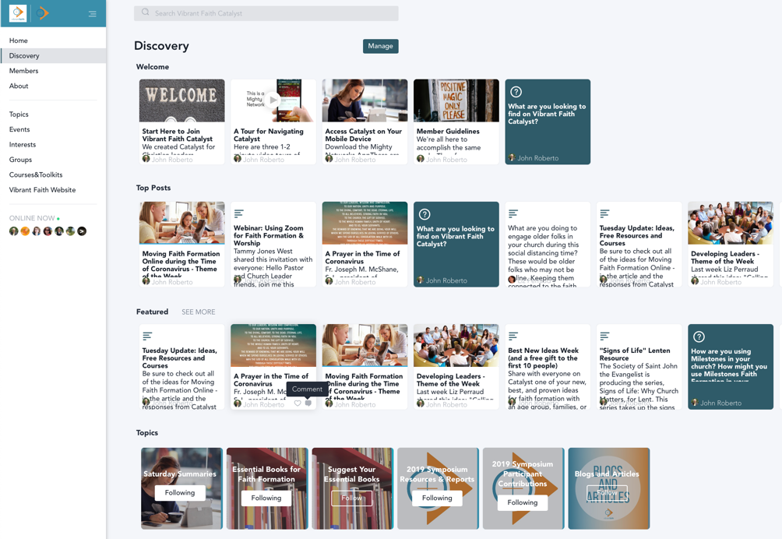
Vibrant Faith Catalyst https://vibrant-faith-catalyst.mn.co

Slide 5
Webinar Topics
Digital Tools You Need
Strategies for Online Programming
Abundance of Digital Resources

Slide 6
Three Types of Programming
Gathered Programming
(church, camp, mission trip, retreat center, community places)
Blended Program
Gathered & Online
Online Programming
(individual, families, small groups)

Slide 7
Part One Digital Tools
What Do You Need. . . .
A Digital Platform: Website
Communication Tools: Email, Texting
Social Media Tools: Facebook, Instagram
Video Conferencing & Streaming: Zoom, Facebook Live
Group Interaction: Facebook Groups
Online Learning Platforms

Slide 8
Digital Platform: Websites
Create special pages on your church’s website or create a special website for online faith formation.
Create webpages of content.

Slide 9
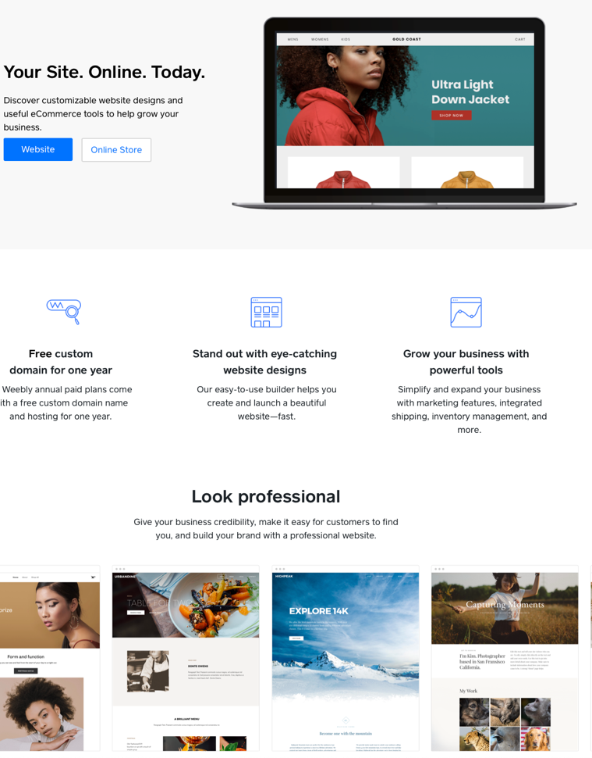
Website Builder: Weebly.com

Slide 10
Communication Tools: Email
Create a weekly e-newsletter with the learning activities for the week.
Use your church’s email
MailChimp (https://mailchimp.com)
ConstantContact (https://www.constantcontact.com)
MailChimp is free for up to 2000 names.
ConstantContact is $20 per month for up to 500 and $45 per month for 501-2500 (there is also a nonprofit discount).

Slide 11
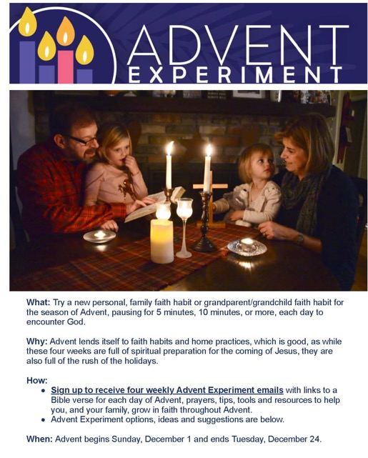
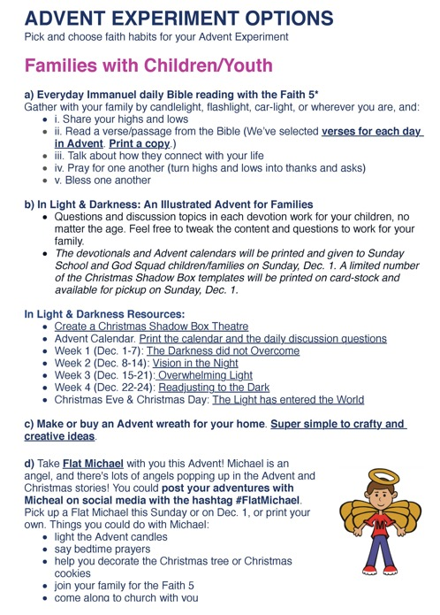
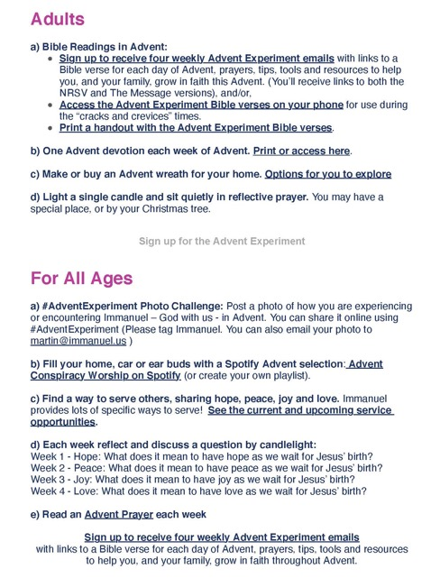
E-Newsletter

Slide 12
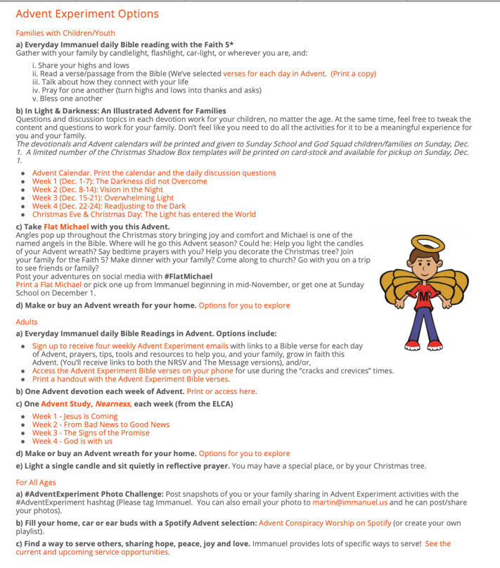
Webpage

Slide 13
Communication Tools: Texting
Use texting to send reminders and links to activities on the faith formation website.
GroupMe – app and web-based (https://groupme.com/en-US)
Telegram—app and web-based (https://telegram.org)
WhatsApp (https://www.whatsapp.com)
Viber (https://www.viber.com).

Slide 14
Group Texting
Prayer of the day
Scripture verse of the day
Link to online content
Link to the learning session for the day
Link to programming
Reminders

Slide 15
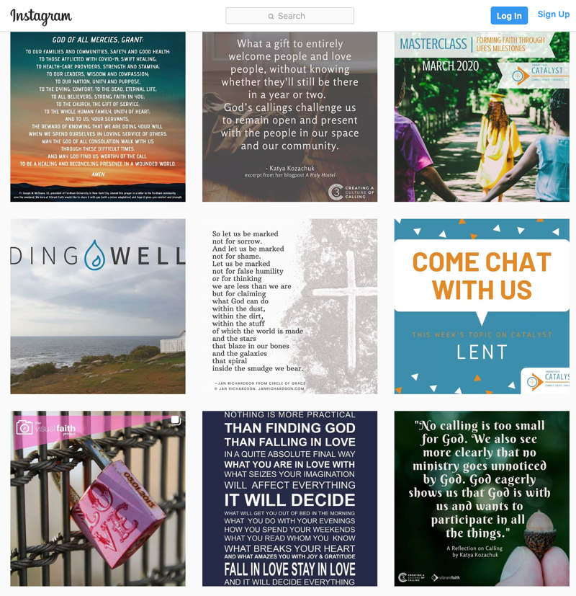
Social Media: Facebook & Instagram

Slide 16
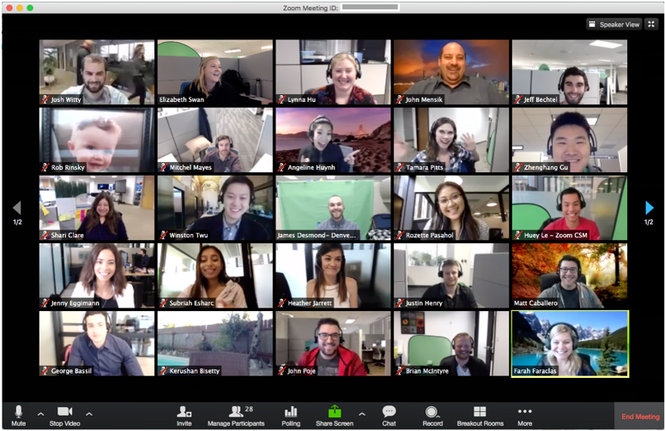
Video Conferencing & Streaming

Slide 18
Facebook Groups

Slide 19
Online Learning Platform
Edmodo
(https://new.edmodo.com)
An online learning platform provides a way to connect children and youth (and parents) with teachers/leaders and the content in a safe environment.
This can provide a long-term format for blending gathered and online learning.

Slide 20
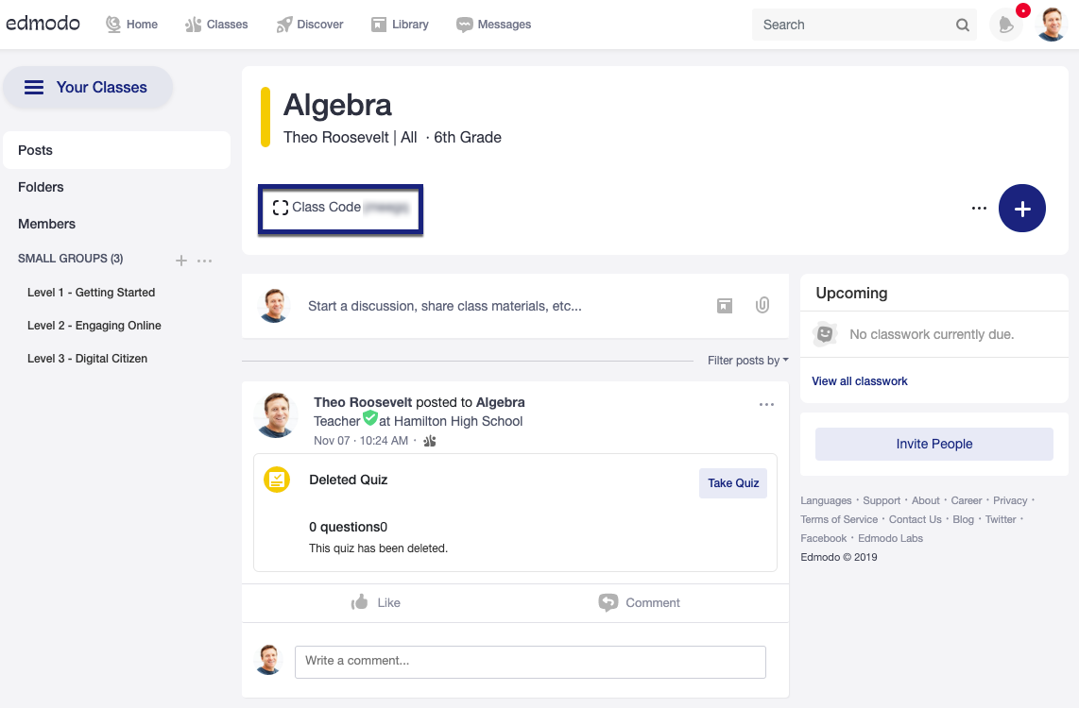
Example: Edmodo

Slide 21
Part Two Strategies
Redesign your gathered program into an online program.
Focus on the Sunday Scripture readings and/or the church year season.
Develop a weekly theme or focus for the online program.
Develop online mini-courses.
Use live streaming for presentations or a mini-course.
Provide a variety of resources for independent learning.

Slide 22
Redesign gathered programs into an online program
Use the lesson plans or program designs you already have and redesign them into self-directed online learning sessions for individual or family use.
You can publish these sessions on a website or use a learning platform like Edmodo.
You can also create a Facebook Group for interaction and discussion.

Slide 23
Sunday Worship and the Church Season Focus
There is an abundance of resources on the Sunday readings that would make it easy to develop a webpage for each Sunday with the readings, a video, a podcast, and activities for different age groups.

Slide 24
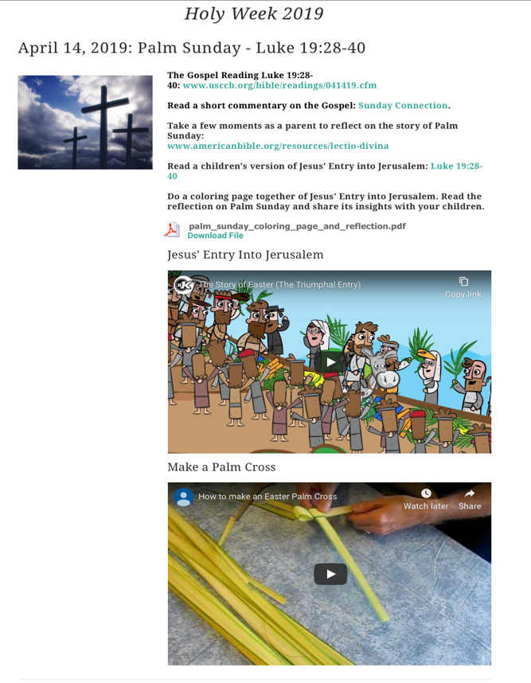
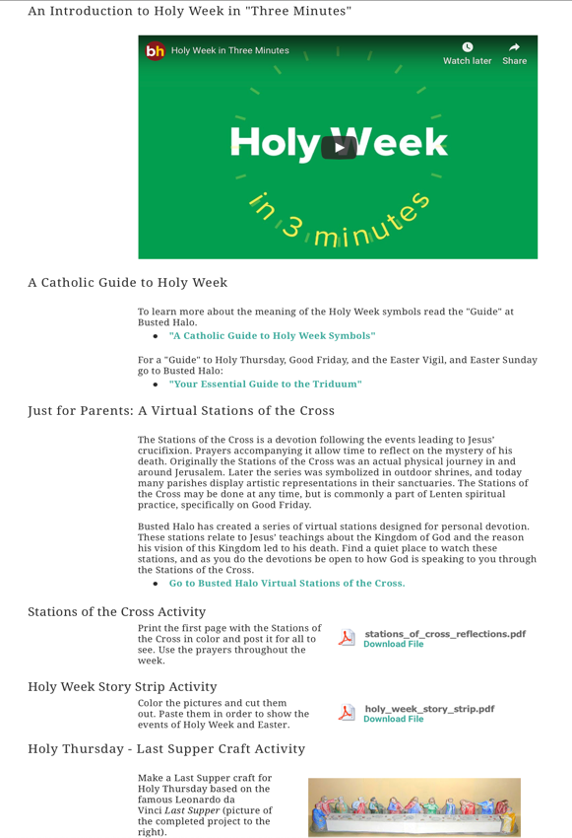

Slide 25
Faith Experiment Focus
7-Day or 30-Day Experiments
Add a faith practice(s) or a family life skill into a family’s daily routine.
Learn together with resources provided by the church (print, video, audio, etc.) .
What if there was a daily text, email, video?
Instagram #, Facebook Group, etc. to share experiences, post photos

Slide 26
The Family Faith Moments: 7-Day Start-Up Plan will help you:
add family faith moments into your daily routine
learn new spiritual practices alongside your kids; no previous religious experience necessary
teach your children to appreciate religious diversity with time-tested non-Christian and Christian spiritual practices
Get Ready: Create a Sacred Space
Imagination
Gratitude Cafe
Anxiety: Wash Away Worries
Bubble Prayers
Wind Prayers for the World
Daily Office: Morning & Evening Prayer

Slide 27
Bible Story Focus
Select a Bible story for all ages. Read the story, watch the video, discuss the story, do a creative activity, etc.
Provide developmentally-appropriate learning experiences online for children, teens, adults.
Provide resources for parent enrichment and to use Bible learning activities at home.

Slide 28
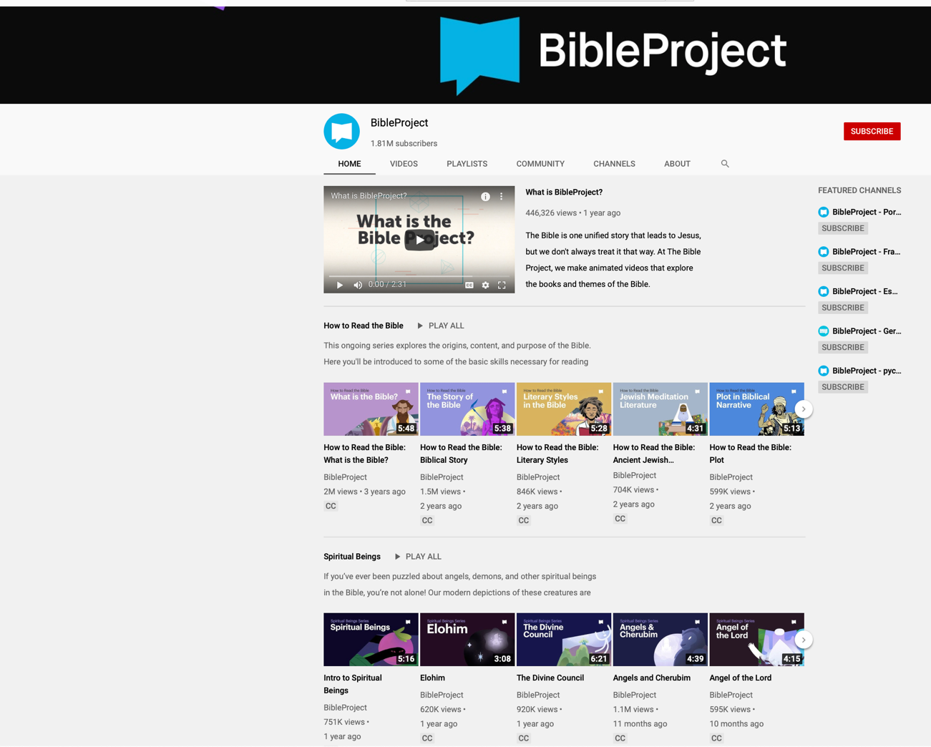

Slide 29
Prayer Practice Focus
Teach a different form of prayer, and/or experience a prayer practice: contemplative, Scriptural, intercessory, praise (adoration), thanksgiving, etc.
Provide activities and videos that teach the practice practice.
Provide support for parents to lead the prayer practices at home.

Slide 30
Christian Practice Focus
Provide online learning activities (print, activities, video, audio) for Christian practices:
Eating Well
Forgiving
Generosity
Hospitality
Keeping Sabbath
Praying
Reading the Bible
Stewardship / Care for Creation
Transforming the World
Support parents in reinforcing the practice through continued at-home experiences that you provide online for easy access.

Slide 31
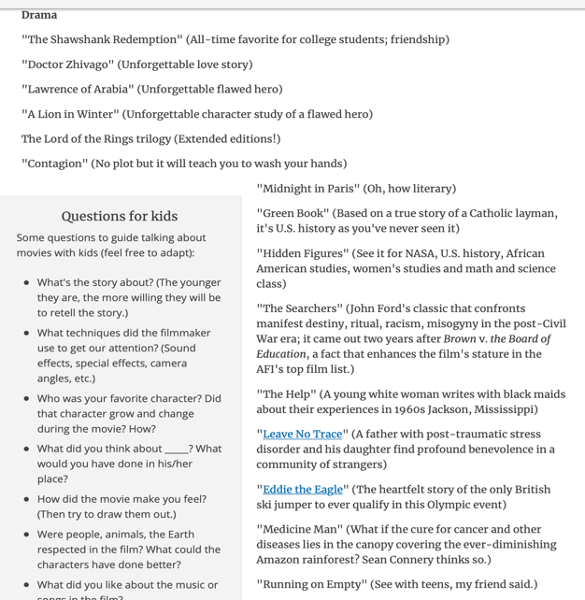
Film & Video Series
Curate a list of films/videos. Develop a webpage with the playlists.
Have a “film of the week” with a Facebook group for discussion.
https://www.ncronline.org/news/opinion/diy-edifying-film-festival-social-distanced-and-quarantined

Slide 32
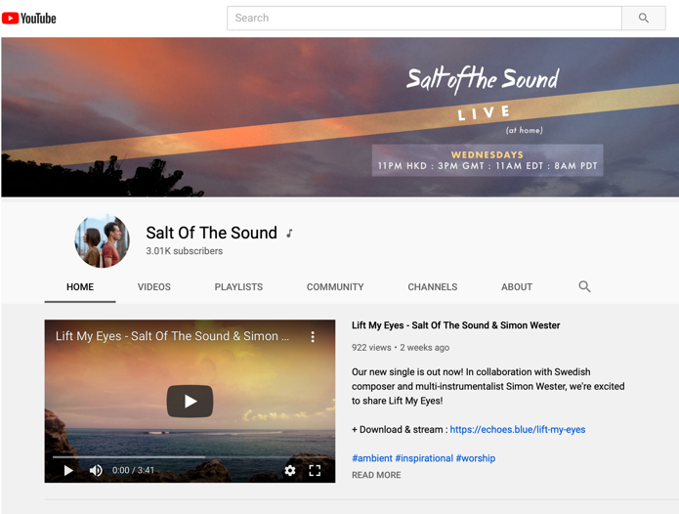
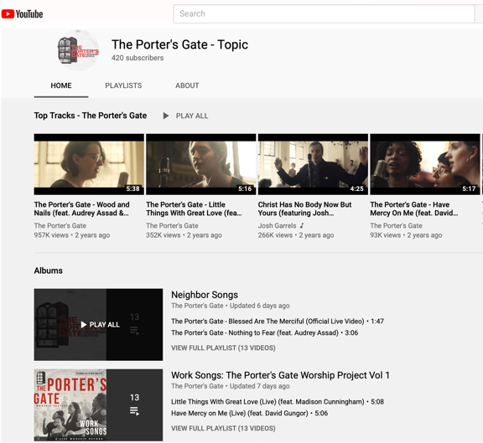
Song of the Day

Slide 33
Mini-Courses
Design or redesign programming into short form mini-courses on a variety of faith themes and practices. Produce a course on a webpage.
Prayer practices (varieties of ways to pray)
Study a book of the Bible (pick a Book with lots of online resources like the Gospels)
Explore social justice issues (lots of video and websites to explore different issues).

Slide 34
Independent Learning
Offer online programs, especially for youth, adults, and parents.
Develop a webpage for self-directed independent learning with courses from seminaries, universities, websites, etc.

Slide 35
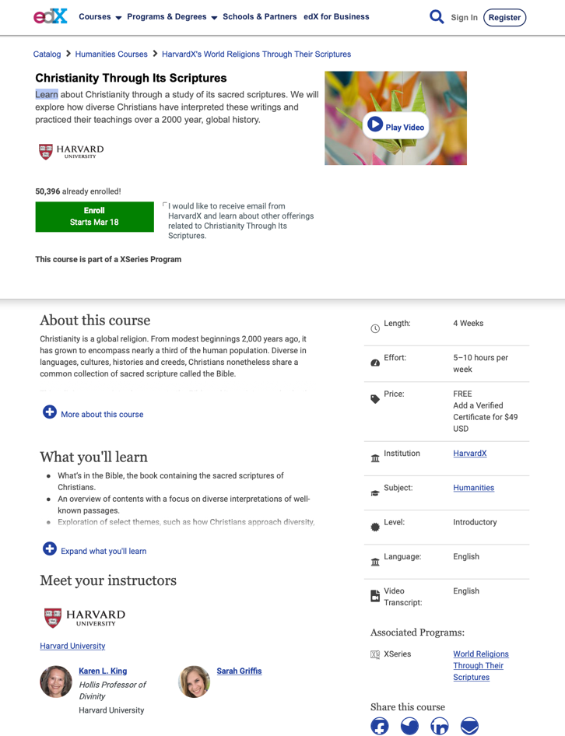
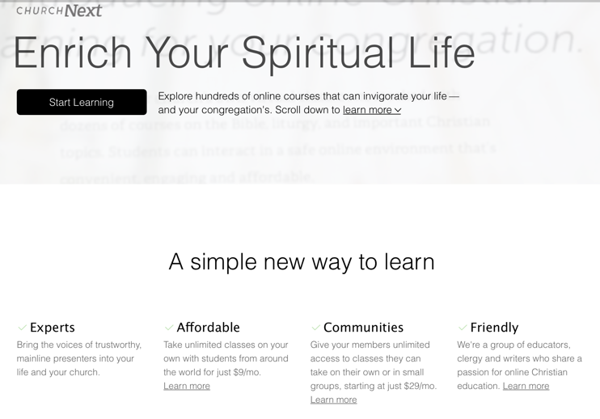
Online Courses

Slide 36
Live Streaming
Offer a presentation or course online via streaming that is delivered to people at home.
The guest presenter and the host are the only people online while everyone watches on their laptop, tablet, or television.
People can ask questions via a chat box.
Live streaming can be used for all age groups.

Slide 37
Abundant Digital Resources

