Slide 1


Shaping the Future of
Faith Formation
John Roberto
Executive Director, NCCL

Slide 2
Shaping the Future of Faith Formation
Download the Presentation & Articles from the Lifelong Faith Website:
Under Home Menu: NCEA 2023
Websites
www.LifelongFaith.com
www.NCCLCatholic.org
John Roberto
(jroberto@lifelongfaith.com)

Slide 3
Part One
Context for Faith Formation

Slide 4
Social-Culture Change – Big Picture
(Charles Taylor, Secular Age)
Age of Association
1800s-1960s
People voluntarily join membership organizations to find belonging and accomplish purposes in the world.
(older generations)
Age of Authenticity
1960s-Present
People look inward to discover and express their true identities apart from organizations.
(younger generations)
We are living in a transitional period

Slide 5
Changing Context for Faith Formation
A pluralistic and diverse society with competing value systems
Diversity in religious affiliation
Decline in church participation and faith practice
Decline in religious socialization and transmission at home and church
Lack of support systems/communities for sustaining and living a religious identity
Impact of the pandemic on every aspect of life

Slide 6
Changing Religious Practice
Not Spiritual, Not Religious
Unaffiliated
Moderate Faith Practice & Occasional Engagement
Occasionals
Vibrant Faith & Engagement at the Center of Life
Actives
Spiritual but Not Religious
Uninvolved

Slide 7
A Three-Decade View
Children
1st Decade
Adolescents 2nd Decade
Young Adults 3rd Decade

Slide 8
Adolescence: Faith Unbundled
The State of Religion and Young People 2021. Springtide Research Institute
Young people are not turning to religious leaders, communities, practices, or beliefs in times of uncertainty or difficulty, though the majority of young people nonetheless identify as religious or spiritual.
Young people who identify as “religious” don’t necessarily participate in religion in the traditional sense. The majority are not accepting the whole “bundle” of rituals, practices, and beliefs that religious institutions offer.
Faith, or “being religious,” among the youngest generations is more “unbundled and worth a close look, especially because our data show that young people who identify as “religious” also report that in almost every facet of their lives they are flourishing more than young people who identify as “not religious.”

Slide 9
Adolescence: Faith Unbundled
The State of Religion and Young People 2021. Springtide Research Institute
When we describe faith as unbundled, we mean that religious young people are not relying on a single religious tradition or organization to form and inform their beliefs and practices. Instead they mix together things from various traditions, religious and otherwise.
Faith Unbundled is a term that describes the way young people increasingly construct their faith by combining elements such as beliefs, identity, practices, and community from a variety of religious and non-religious sources, rather than receiving all these things from a single, intact system, or tradition.
Young people with unbundled faith will partake in religion, including practices, beliefs, and communities to the degree that suits them, with no formal or permanent commitment.

Slide 10
Adolescence: Faith Unbundled
The State of Religion and Young People 2021. Springtide Research Institute
Springtide sees the phenomena of Faith Unbundled expressed clearly in our data:
  young people who identify with a particular religion but adopt few of none of its practices
  young people who attend religious services regularly but consider themselves agnostic, atheist, or nothing in particular
  young people who are more than twice as likely to practice the arts as a “religious or spiritual practice” than attend weekly faith groups
Young people are turning to a wide range of traditions, practices, and belief when asking and answering important questions about their faith: What do I believe? Who am I?” What is my purpose in the world? What practices have value?

Slide 11
Adolescence: Faith Unbundling
The State of Religion and Young People 2021. Springtide Research Institute
What does it look like to unbundle belief from a single source or system?
  It looks like young people who turn to many or various sources when making meaning and discerning what to believe about right and wrong, purpose and calling, salvation and suffering, and more. It looks like curiosity.
What does it look like to unbundle identify from a single source of system?
  It looks like young people who are unwilling to shed parts of themselves to fit into a prescribed narrative about who and how to be in the world. It looks like a commitment to wholeness.
What does it look like to unbundle community from a single source or system?
  It looks like young people who show up where trusted personal relationships exist or new ones seem possible, young people who are willing to forgo participation in communities lacking these qualities, even if they have had long associations with these communities. It looks like connection.
What does it look like to unbundle practices from a single source or system?
  It looks like young people who blend and adapt various rituals and behaviors to suit and make sense of the current questions they’re facing. It looks like flexibility.

Slide 12
A Three-Decade View
Children
1st Decade
Adolescents 2nd Decade
Young Adults 3rd Decade
How we develop faith formation in the first decade of life that provides a foundation for the 2nd decade?
How do we address these changes?
How do we interpret the religious challenges of the 20s?
How do we interpret the religious changes in adolescence?
How do we prepare adolescents for the third decade of life?
How do we address these challenges?
How do we guide people in their 20s in developing an adult faith?

Slide 13
Part Two
Features of Faith Formation

Slide 14
Holistic Faith the Christian faith as a way of life
A way of the head
informing
A way of the heart
forming
A way of the hands
transforming

Slide 15
Holistic Formation
Leading to a Knowledge of Faith (Scripture & Tradition)
Initiating into the Celebration of Mystery (Liturgy)
Forming for Life in Christ
Teaching Prayer
Belonging to the Community
Five Tasks of Catechesis
Directory for Catechesis (2020)

Slide 16
Essential Environments
Intergenerational
Family
Peers or
Life Stage

Slide 17
Faith Maturing Goals
Goals for Maturing in Faith
Jesus
Discipleship
Bible
Beliefs & Teachings
Prayer & Spiritual Life
Moral Living
Service, Justice, Creation
Worship & Church Seasons
Community Life
Gifts & Talents

Slide 18
Maturing in Faith Goals
Jesus
Developing and sustaining a personal relationship and commitment to Jesus Christ
Discipleship
Living as a disciple of Jesus Christ and making the Christian faith a way of life
Bible
Reading and studying the Bible—its message, meaning, and application to life today
Teachings
Learning the Christian story and foundational teachings of the Catholic faith and integrating its meaning into one’s life
Praying
Praying—together and by ourselves—and seeking spiritual growth through spiritual disciplines

Slide 19
Maturing in Faith Goals
Morality
Serve, Justice
Worshipping God with the community at Sunday worship, ritual celebrations, and the seasons of the church year
Being actively engaged in the life, ministries, and activities of the faith community
Gifts
Living with moral integrity guided by Christian ethics and values
Living the Christian mission in the world—serving those in need, caring for God’s creation, and acting and advocating for justice and peace.
Worship
Engaged
Practicing faith in Jesus Christ by using one’s gifts and talents within the Christian community and in the world

Slide 20
Goal-Centered Faith Formation
Goal
Variety of Content & Programs
Variety of Resources & Formats
Variety of Times & Scheduling
@ Church
@ Home
Large Group, Small Group, Mentored
Online Only
Hybrid

Slide 21
Part Three
Suggestions for Practice

Slide 22
Continuous & Seamless
Young Children
Young Adolescents
Young Adults (20s)
Grade School Children
Older Adolescents
Shared goals for lifelong faith maturing
Integration of Intergenerational – Family – Life Stage faith forming
Variety of content, experiences, settings
In-person – Online – Hybrid faith forming
Personalized to the address faith growth and needs

Slide 23
Focus of Each Decade
Children
Adolescents
Interactive & immersive – practices of faith
Exploring & Discerning
Adult guides & mentors
Whole family programs & experiences
Identity &Belonging
Integrating beliefs and practices into an identity (religious or spiritual)
Young Adults (20s)
Engaging in justice & service
Immersion into faith practices
Religious socialization
Belonging
Experience & Affiliation
Intergenerational relationships & faith forming experiences
Family faith formation @ home
Parent education & formation
Belonging
Developing personal spiritual practices
Developing a way of life and faith practices
Finding a community to belong to
Becoming
Parent education & formation
Intergenerational relationships & faith forming experiences
Whole family experiences

Slide 24
Families at the Center
Focus on parents – the most significant influence on the religious and spiritual outcomes of young people – their faith and practice, the parent-child relationship, modeling and teaching, family conversations, family faith practices.
Focus on home life – the primary way by which a religious identity becomes rooted in children’s lives are the day-to-day religious practices of the family and the ways parents model their faith and share it.
Focus on faith practices – that make a significant difference in nurturing the faith of children and teens at home. Raising religious children should primarily be a practice-centered process, not a didactic teaching program.
Focus on parent’s relationship with child and parenting style – warmth and love, balancing religious firmness with flexibility and continuity with agency, talking about religious matters during the week, listening more and preaching less.

Slide 25
Family Practices
Reading the Bible as a family & encouraging child/teen to read the Bible
Praying together as a family & encouraging child/teen to pray
Serving people in need as a family & supporting service by young people
Participating regularly in Sunday worship as a family
Being involved in a faith community
Eating together as a family
Celebrating rituals and holidays at home
Having family conversations
Talking about faith, religious issues, and questions and doubts
Ritualizing important family moments and milestone experiences
Celebrating holidays and church year seasons at home
Providing moral instruction

Slide 26
Parents as Faith Formers
Encourage parents to grow in faith and become faith formers
Equip parents to incorporate faith practices into family life at home
Engage parents in education and formation, as well as the whole family in faith forming experiences and program
Young Children
Older Children
Young Adolescents
Encourage
Older Adolescents
Encourage
Encourage
Equip
Engage
Encourage
Equip
Engage
Equip
Engage
Equip
Engage

Slide 27
Family + Church + Catholic School
Young Children
Family @ Home + Church + School
Older Children
Family @ Home + Church + School
Young Adolescents
Family @ Home + Church + School
Older Adolescents
Family @ Home + Church + School
Intergenerational
Intergenerational
Intergenerational
Intergenerational
Age-specific
Age-specific
Age-specific
Age-specific
Family @ home and church experiences
Intergenerational faith forming experiences
Age-specific experiences
Variety of content, experiences, settings
In-person-online-hybrid
Faith Faith Formation
Faith practices
Milestones
Church year seasons
Parenting practices and skills
Parenting for faith growth
Family-centered gatherings and programs at church

Slide 28
Hybrid Process for Family Formation
Preparing
Experiencing
Living
How will you sustain/extend the event?
What types of experiences, programming, activities, and resources will you develop to prepare people for the event?
How will you facilitate or guide people’s experience of the event?
What types of experiences, programs, activities, and resources will you offer people?
Independent, small group, large group
Online playlists
Independent, small group, large group
Online playlists
Physical and online settings
Physical and online settings
How will you design the event or utilize an existing event?
Type of Experiences: sacraments, Sunday worship, Church year, family programs, parent programs, etc.

Slide 29
Example: Families with Children 0-5
Baptism preparation that engages the parents in their own faith growth and prepares them for nurturing faith in young children
Mentors from the church community (e.g., grandparents) to accompany parents on the journey from Baptism to start of school
Faith Practices - Bible stories, prayers, meal rituals, values
Seasons of the Year activities
Milestones - birthdays, baptism anniversaries, “first” milestones, entry to preschool and kindergarten
Parenting Practices - understanding young child development and practices for effective parenting of young children
Parenting for Faith Skills - reading a Bible story, praying with a young child, having faith conversations
Online Support Groups for parents of young children
Gatherings for parents and for families at church
At Church
At Home
Online
Hybrid

Slide 30
Part Four
Hybrid Faith Formation

Slide 31
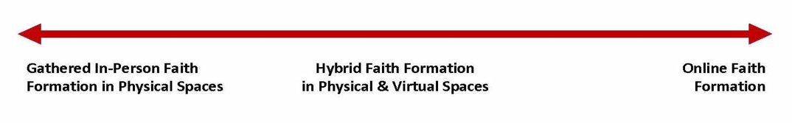
Hybrid Programming
Synchronous and Asynchronous
Gathered Programming
Hybrid Programming
Gathered & Online
Online Programming

Slide 32
Hybrid Process for Family Formation
Preparing
Experiencing
Living
How will you sustain/extend the event?
What types of experiences, programming, activities, and resources will you develop to prepare people for the event?
How will you facilitate or guide people’s experience of the event?
What types of experiences, programs, activities, and resources will you offer people?
Independent, small group, large group
Online playlists
Independent, small group, large group
Online playlists
Physical and online settings
Physical and online settings
How will you design the event or utilize an existing event?
Type of Experiences: sacraments, Sunday worship, Church year, family programs, parent programs, etc.

Slide 33
Hybrid: Connected Approach
#1. Experience of Program/Activity
(School or Parish)
#2. Family Activities
Playlists Online
- print, audio, video, activities
#3. Demonstrate & Reflect on Learning
- project, photo/video, Facebook group, etc.

Slide 34
Hybrid: Flipped Approach
Individual, Family, or Small Group Online
Playlists
Exploring the Content
- print, audio, video, activities
Gathered Program in Physical Space
Applying the Content:
Create – Practice - Perform - Participate
Facebook Group or other online meeting
space for sustained interaction and connection

Slide 35
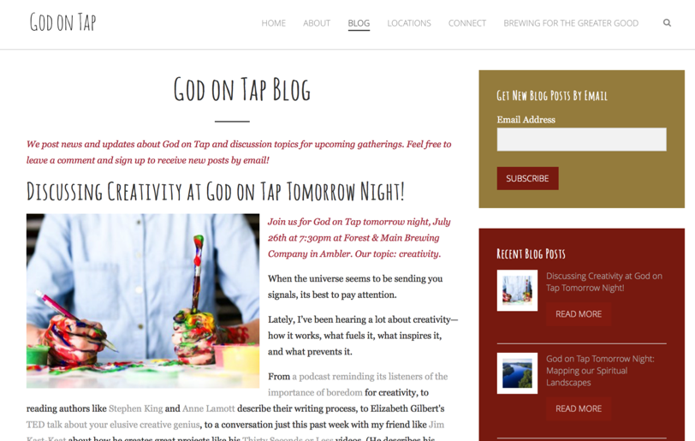
“Flipped” Outreach Initiative

Slide 36
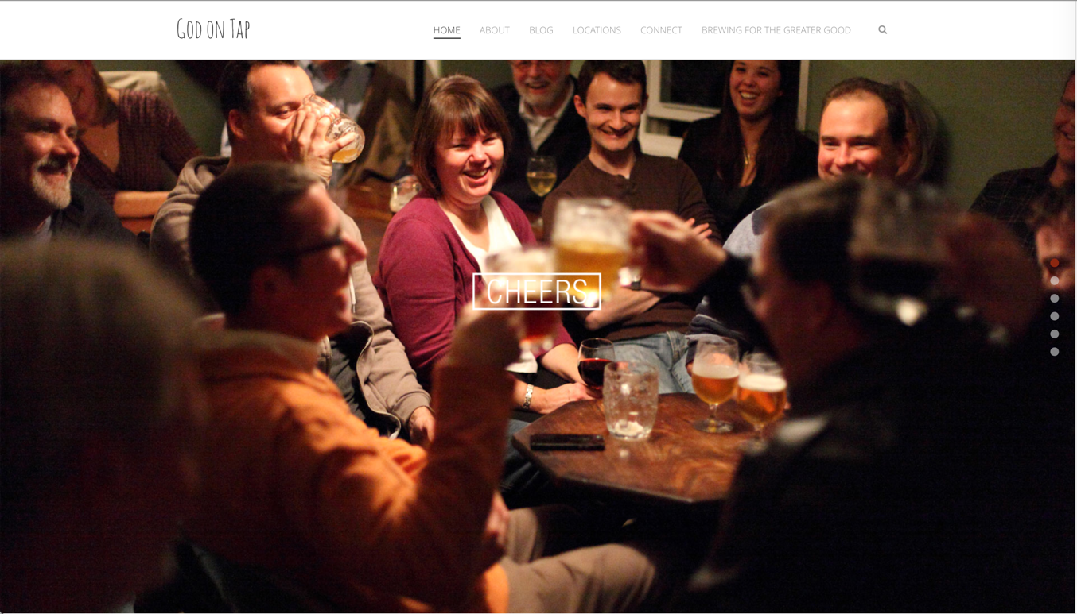
“Flipped” Outreach Initiative

Slide 37
“Flipped”
Confirmation Program
On Your Own: Engage young people with a monthly learning playlist—watching videos, reading short articles, praying, writing reflections in a journal—on the theme.
In a Small Group: Have young people participate in one online small group experience to discuss the content in the playlist and what they are learning.
In a Large Group: Involve young people in a monthly meeting with all groups for community sharing, interactive activities, short presentations, and ideas for living faith.

Slide 38

Our Confirmation preparation program has two components: Once a month in-person classes and an online study. The online study is a place for students to develop their faith weekly by completing multi-media lessons which include videos, reading, Saint reflections, multiple-choice questions and online small group discussions. Each small group has their own online space to discuss faith topics, ask questions, and pray for one another.
  Class Sessions - Once a month (7 in total/year)
  Online Sessions - 3 per month
  “Insight” Youth Group Meetings - Attend 3 per year
  Service Projects - 2 per year
  Retreat - Year 1 and 2

Slide 39
Hybrid: Family-Centered Approach
Week #1. Family Centered Gathering at Church (2-2 ½ hours)
Week #2. At Home Learning with Digital Playlist
Week #3. Age Groups Gathered Session at Church
Week #4. At Home Learning with Digital Playlist

Slide 40
Hybrid: Multi-Session Programming
Week 1
Presentation
Gathering with live stream
(video available)
Week 2
Online Learning Playlist
Week 3
Small Group Discussions
(in-person or online)
Week 4
Continued Learning (playlist)
Sharing Learning
Add a Facebook Group or other online meeting space for sustained interaction and connection

Slide 41
Hybrid Approaches
Involve more people with time- and schedule-friendly programming
Promote more engaged learners
Find multiple ways to use the programming we create.
Reach more people through different learning formats
Engage or re-engage those who participate occasionally or who have stopped participating in church life.

Slide 42
One Program, Multiple Formats
Large group physical gathering: People gather at church and a leader facilitates the program: live or video presentation, time to read and reflect, and small group discussion.
Small group physical gathering: People gather in small groups in homes or coffee shops or other conducive setting, watch the video, read and reflect on the content, and discuss the content.
Small group online setting: People gather online in a small group (Zoom or other video conferencing platform) to watch the video together, read and reflect on the content, and discuss the content.
Hybrid: People complete each session on their own, share reflections in a Facebook group (asynchronous), meet together to discuss the program (synchronous).
Online independent: People complete the learning program on their own.

Slide 43

Ideas for Hybrid Design
reinvent or create
Marriage preparation
Baptism preparation for new parents
Families with young children (0-5)
Children’s faith formation with an at-home component
First communion preparation for parents and whole family
Confirmation preparation
All adult faith formation
Outreach initiatives

Slide 44

Intergenerational Faith Formation

Slide 45
Intergenerational
At every stage of life people need to be connected to other generations and have intergenerational faith forming experiences
Design All-Ages Faith Formation around Intergenerational Church Life Events
Transform multigenerational into intergenerational
Transform age-specific into intergenerational
Design new intergenerational initiatives
Make intergenerational learning central to church life

Slide 46
Intergenerational
Formation around
Church Events
Sunday worship
Feasts and season of the church year
Rituals, milestones, and sacramental celebrations
Justice and service ministries
Congregational events
And more
1. Prepare for the event
2. Experience the event
3. Reflect on the event
4. Live the meaning of the event

Slide 47
Intergenerational
Multigenerational to Intergenerational
Every church has multigenerational environments in which at least two generations are participating in an event or activity—Sunday worship, church events, social gatherings, and more.
How can you transform multigenerational environments into experiences of intergenerational connection and community?
Identify ministries, programs, and activities that are already intergenerational (with generations building relationships, learning, praying, worshipping, serving, and/or leading together); and develop strategies for strengthening and expanding intergenerational ministries, programs, and activities.

Slide 48
Intergenerational
Transform Age-Specific into Intergenerational
How can you transform age-specific programs by adding intergenerational activities or by redesigning the program into an intergenerational experience?
Identify ministries, programs, and activities that are multigenerational (with all ages present without the intergenerational connection and experiences) that can be transformed into more intentionally intergenerational experiences

Slide 49
Intergenerational
Design New Intergenerational Initiatives
Create new programs, activities, or experiences that bring together all of the generations for learning, celebrating, praying, reading the Bible, serving and working for justice, worshipping, and more.
Where are the greatest needs and/or opportunities for creating new initiatives that will contribute toward building an intergenerational culture in your congregation?

Slide 50
Intergenerational
Design Intergenerational Learning
Meal and Community Building
Part 1. Gathering and Prayer
Part 2. All Ages Learning Experience
Part 3. In-Depth Learning Experience
    Option 1. Whole Group (together)
    Option 2. Age Group (parallel)
    Option 3. Activity Center
Part 4. Sharing Learning Experiences and Application
Part 5. Closing Prayer

Slide 51
Call to Prayer Intergenerational Session
Gathering and Opening Prayer
Welcome to Prayer Program
Prayer Experiences: Demonstrate Live & Practice @Home
Activity 1: Creating a Space for Prayer
Activity 2: Praying with Scripture
Activity 3: Praying with the Psalms
Activity 4: Intercessory Prayer
Activity 5: The Jesus Prayer
Making Prayer an Essential Part of Family Life
Closing Prayer

Slide 52
Family Faith Formation

Slide 53
Family
Focus on parents – the most significant influence on the religious and spiritual outcomes of young people – their faith and practice, the parent-child relationship, modeling and teaching, family conversations, family faith practices.
Focus on home life – the primary way by which a religious identity becomes rooted in children’s lives are the day-to-day religious practices of the family and the ways parents model their faith and share it.
Focus on faith practices – that make a significant difference in nurturing the faith of children and teens at home. Raising religious children should primarily be a practice-centered process, not a didactic teaching program.
Focus on parent’s relationship with child and parenting style – warmth and love, balancing religious firmness with flexibility and continuity with agency, talking about religious matters during the week, listening more and preaching less.

Slide 54
Family
Focus on Parents
Parents are most significant influence on the religious and spiritual outcomes of young people:
parents’ personal faith and practice
a close and warm parent-child relationship
parent modeling and teaching a religious faith
parent involvement in church life and Sunday worship
grandparent religious influence and relationship
family conversations about faith
family faith religious practices including praying, reading the Bible, serving others, and celebrating holidays and rituals

Slide 55
Family
Focus on Home Life
The primary way by which a religious identity becomes rooted in children’s lives are the day-to-day religious practices of the family and the ways parents model their faith and share it.

Slide 56
Family
Focus on Faith Practices
Certain practices make a significant difference in nurturing the faith of children and teens at home. Raising religious children should primarily be a practice-centered process, not a didactic teaching program. Parents modeling religious practices is primary, and explaining belief systems is secondary”

Slide 57
Family Faith Practices
Reading the Bible as a family and encouraging young people to read the Bible regularly
Praying together as a family and encouraging the young to pray
Serving people in need as a family and supporting service by young people
Eating together as a family
Having family conversations about faith
Talking about faith, religious issues, questions, doubts
Ritualizing family moments and milestone experiences
Celebrating holidays and church year seasons at home
Providing moral instruction
Being involved in a faith community and participating regularly in Sunday worship as a family

Slide 58
Family
Focus on parent’s relationship with child and parenting style:
warmth and love, balancing religious firmness with flexibility and continuity with agency, talking about religious matters during the week, listening more and preaching less.

Slide 59
Family
How can you Encourage parents to grow in faith and become faith formers?
How can you Equip parents to incorporate faith practices into family life at home?
How can you Engage parents in education and formation, as well as the whole family in faith forming experiences and programs?

Slide 60
Family
Encourage parents to grow in faith and become faith formers
Equip parents to incorporate faith practices into family life at home
Engage parents in education and formation, as well as the whole family in faith forming experiences and program
Young Children
Family & Parents
Older Children
Family & Parents
Young Adolescents
Family & Parents
Older Adolescents
Family & Parents
@ Church & Home
@ Church & Home
@ Church & Home
@ Church & Home

Slide 61
Family
Strategy 1: Family Faith Practices
Strategy 2: Milestones
Strategy 3: Seasons of the Year
Strategy 4: Sunday Worship and Scripture
Strategy 5: Parent Formation and Parenting Skills

Slide 62
#1. Faith Practices for Each Life Stage
Seasons of the year
Rituals and milestones
Learning the tradition
Prayer and spiritual
formation
Reading the Bible
Service, justice, care for creation

Slide 63
Faith Practices of the Month
Themes
Prayer
Reading the Bible
Christian Practices
Service, Care for Creation, Social Justice
Church Year Feasts & Seasons
Moral Values
Etc.
Design
Teach: Key Content
(video, live stream, small group or large group program)
Demonstrate: “How to” do this: personal, family
Resources: playlist of faith forming activities on the theme

Slide 64
30-Day Family Experiments
Focus on a practice.
Curate (mobile) resources to explain and demonstrate the practice (video, print, how-to recipe).
Publish resources on a web page.
Have families find a time to do the practice each day and schedule their time.
Do the practice.
Remind people daily with text message.
Encourage people to share photos or videos on a Instagram # or in a Facebook Group.

Slide 65
#2. Sacrament Programming
Preparing
Experiencing
Living
How will you sustain/extend the event?
How will you design the event?
What types of experiences, programming, activities, and resources will you develop to prepare people for the event?
How will you engage age groups, families, and the faith community?
What types of experiences, programs, activities, and resources will you offer people?
Independent, small group, large group
Playlists
Independent, small group, large group
Blended
Playlists
Blended

Slide 66
Baptism
Church
Home
Mentors/Coaches
Parent preparation
Family gathering
Ritual
Intergenerational connection
Celebration of Baptism
Reunion
Baptismal anniversaries
Caring conversations and storytelling
Celebrating rituals
Learning
Praying
Reading the Bible
Serving
Worshipping together

Slide 67
Flip the Model of Formation
@ Home / Daily Life
Exploring the Content
- print, audio, video, activities
@ The Program
Applying the Content:
Create – Practice - Perform - Participate

Slide 68
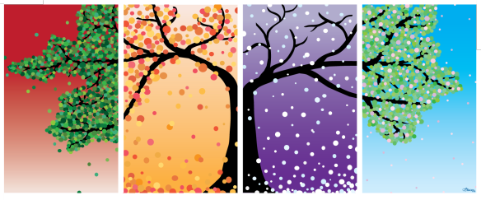
#3. Celebrate the Seasons
Identify a monthly seasonal event (church year or calendar year) and developing a webpage for each season
Organize a seasonal family festival / gathering (virtual or physical) to support the seasonal plan.
Jan: ML King Jr. (justice and peace, serving)
Feb: Valentine’s Day (loving)
March: Lent (praying, fasting, almsgiving)
April: Earth Day (caring for creation)
May: Mother’s Day (honor parents, love, care)
June: Father’s Day (honor parents, love, care)
July: Independence Day (freedom)
August: Back to school (new beginnings)
Sept: Fall Harvest (grateful, generosity)
Oct: St. Francis (care for creation and animals)
Nov: Thanksgiving (grateful, generous)
Dec: Advent and Christmas

Slide 69
#4. Connect Sunday Mass to the Home
Weekly Lectionary-Based Playlist on the Website
  family conversation questions
  weekly table ritual
  podcast or video of the sermon with a study guide for the parents,
  children’s creative Bible activities
  storybooks
  videos presenting the Bible story
  daily prayer
  weekly family devotion

Slide 71
#5. Parent Education & Formation
Parent Lifecycle Workshops / Webinars / Online Resources
Family Life / Parenting Skills Development Workshops / Webinars / Online Resources
Parent Mentors
Support Groups (life cycle, kindred)
Add a Parent Component to Existing Programs (Embed) – VBS, Children and Youth Program, etc.
Script a Plan for Parents at Each Stage of Life

