Slide 1

Part Two
Strategies for 21st Century Faith Formation
John Roberto
jroberto@lifelongfaith.com www.LifelongFaith.com

Slide 2
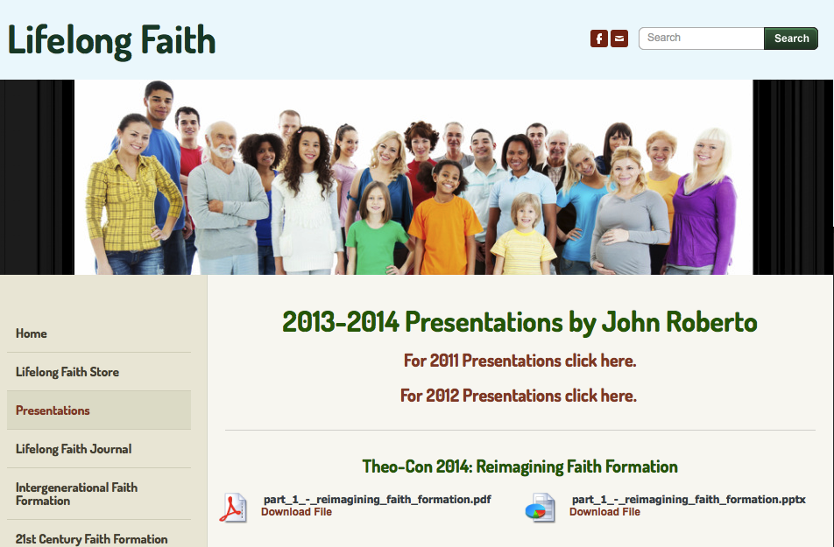
Handouts & Mailing List

Slide 3



Slide 4
Twin Challenges
Foster, Support, Encourage, Equip for… intergenerational religious transmission through the family and congregation
Connect with, Build relationships with, Engage with the …
Religiously unaffiliated and the spiritual but not religious by expanding our reach and our “campus” to the wider world

Slide 5
Lifelong Faith Formation Network
Intergenerational
Faith Community
Older Adults
Children & Parents
Mature Adults
Young Adults
Mid-Life Adults
Adolescents & Parents

Slide 6
Intergenerational Core
Intergenerational Faith Community
Children Parents
Teens & Parents
Young Adults
Mid-Life Adults
Mature Adults
Older Adults

Slide 7
Intergenerational Core
Caring
Celebrating
Learning
Praying
Serving

Slide 8
Intergenerational Core
Caring: Community building activities, storytelling, mentoring, social events
Celebrating: Intergenerational Sunday Worship, whole community sacramental celebrations, milestones celebrations, church year feasts and seasons
Learning: Structured IG learning programs (weekly, monthly, small group); incorporating IG learning into age group programming
Praying: IG prayer experiences, prayer partner, IG prayer groups, spiritual guides
Serving: IG service projects and mission trips (local, global), church-wide service day, monthly IG service, IG service nights at church

Slide 9
Intergenerational: Learning
Engaging all ages and generations together in learning experiences that teach scripture and the Christian tradition, informing and forming disciples of all ages in Christian identity.
Intergenerational Learning (James White)
    In-Common All Ages Experiences
    Parallel Learning
    Contributive Occasions
    Interactive Sharing
Weekly, Bi-Weekly, and Monthly Models
Small Group & Large Group Models

Slide 10
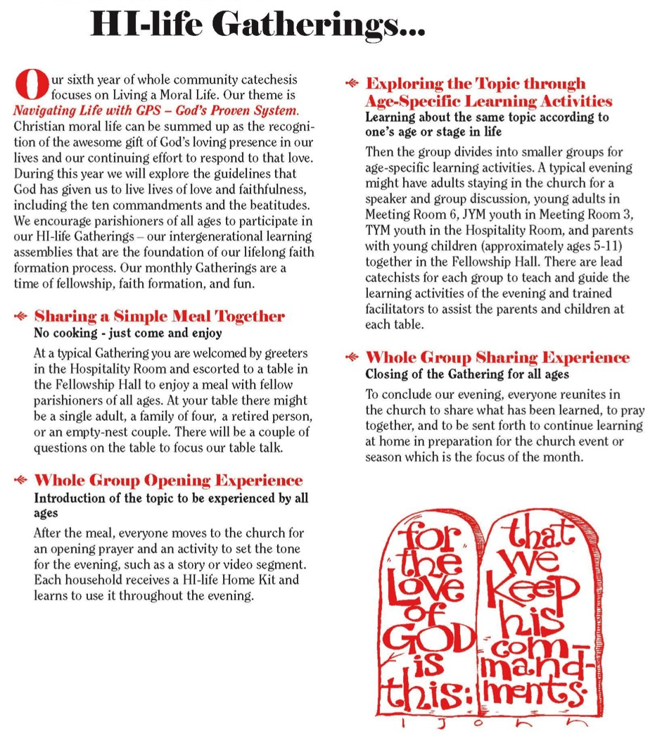

Slide 11
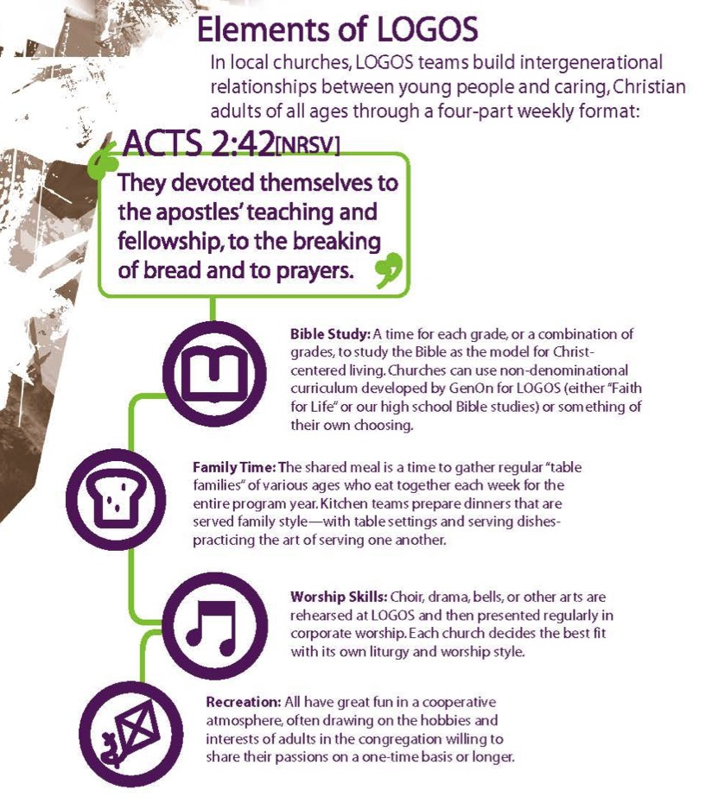
Elements of LOGOS
Bible Study
Family Time
Worship Skills
Recreation
GenOn Ministries
www.genonministries.org

Slide 12
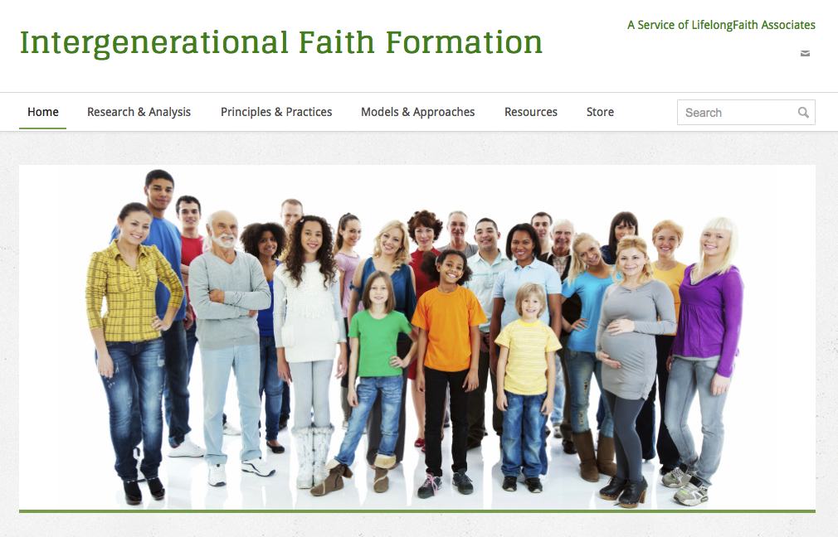
Intergenerational Faith Website
www.IntergenerationalFaith.com

Slide 13
A Network Approach
Connected
Features
Diversity of faith formation experiences
Targeted to religious and spiritual needs
Tailored to people’s busy lives
Multiple formats
Anytime - 24x7x365
Anywhere - Mobile
Online Life
Church Life
Daily & Home Life
Community Life

Slide 14
Generational Network
Age Group
Family
All Ages
Online Activities & Resources
On Your Own & Small Groups
Community Programs, Events, & Activities
Large Group: Course,
Workshop, Retreat
Church Life & Events
At Home

Slide 15
Three Seasons of Programming
Fall Season: September 1 – January 1
Winter/Spring Season: January 1 – May 1
Summer Season: May 1 – September 1
Fall
Winter-Spring
Summer

Slide 16
Families with Children
Faith
Formation
Network
Intergenerational Experiences & Connections
For Parents
Seasons of the Year
Milestones
Practicing Our Faith
Sunday Worship
@ Home
Family Life
Children’s Programs & Events

Slide 17
Developing Network Programming
Network Theme
Activity 1
Resource
Resource
Activity 3
Resource
Resource
Activity 2
Resource
Resource
Current Activities & Programs
New Activities & Programs

Slide 18
Faith Practices
@ Home
Daily Devotion
Resources
Serving Others
Resources
Reading the Bible
Resources
Caring Conversations
Resources
Church Year Seasonal
Learning about Faith
Resources
Resources
Rituals
Resources
Children & Families
Network

Slide 19
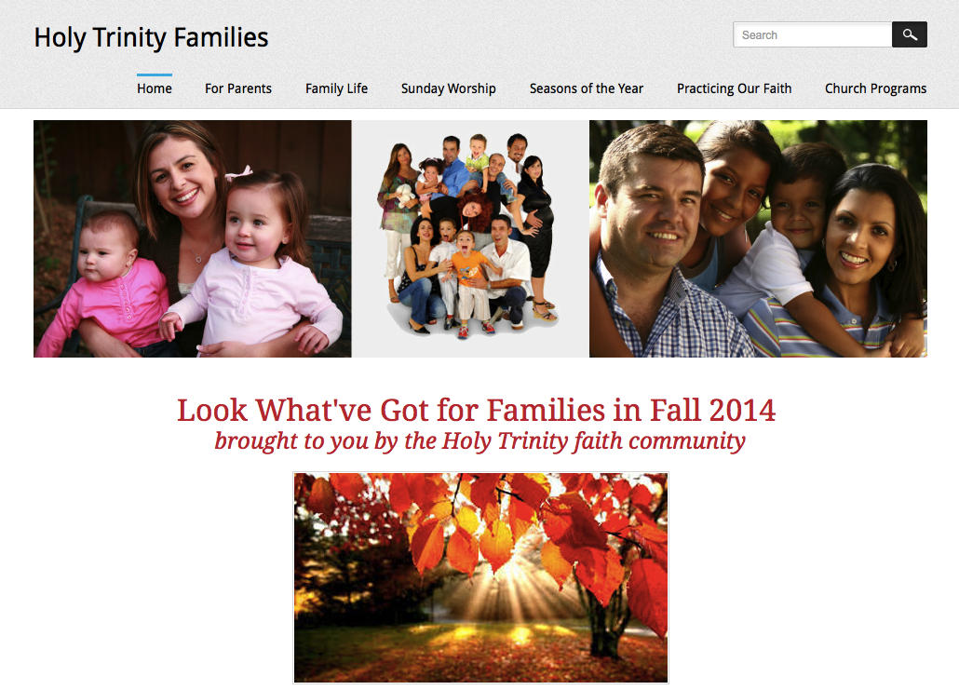
Family Faith Formation Network

Slide 20
Youth Faith Formation
Network
Service Projects Mission Trips
Intergenerational Experiences & Connections
Parent-Teen Activities & Resources
Prayer &
Spiritual Formation
Youth Leadership
Youth Group
Adolescent Life Issues
Bible Study & Religious Learning
Parent Education & Support Groups
Milestones
Confirmation Program

Slide 21
Prayer & Spiritual Life
Daily Devotion
Resources
Prayer Group
Resources
Spiritual Mentoring
Resources
Spiritual Practices Course
Resources
Retreat
Day at the Monastery
Online Prayer Intentions
Resources
Resources
Youth
Network

Slide 22
Young Adult Faith
Formation
Network
Justice, Service, Mission
Scripture Enrichment
Intergenerational Experiences & Connections
Discovering Faith (Alpha Course)
Faith Enrichment
Spiritual Enrichment
Third Place Care
Weekly Gathering & Worship
Life Issues, Transitions, & Milestones
Social Media Connections
YA Community Events

Slide 23
Adult
Faith Formation
Network
Faith Enrichment
Sunday Worship through the Week
Intergenerational Experiences & Connections
Service & Mission
Spiritual Enrichment
Scripture Enrichment
Life Issues
Discovering Faith
Grand-parents

Slide 24
Adult
Faith Formation
Network
Spiritual Enrichment
Online Courses
Retreats
Small Group Bible Study
Spiritual Book of the Month Club
Monthly Spiritual Practices Series
Apps & E-newsletters
Day at the Monastery
Online Prayer & Spirituality
Resource
Resource
Resources
Resources
Resource
Resource
Resource
Resource

Slide 25
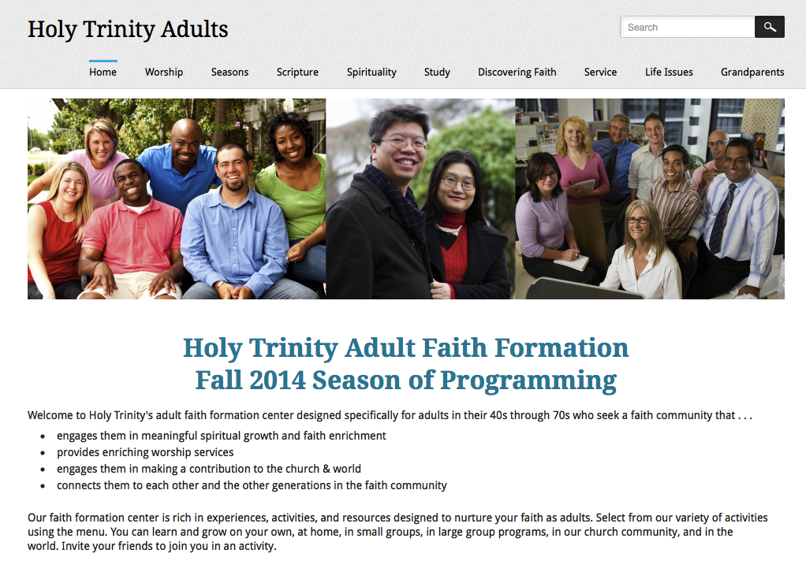
Adult Faith Formation Network

Slide 26
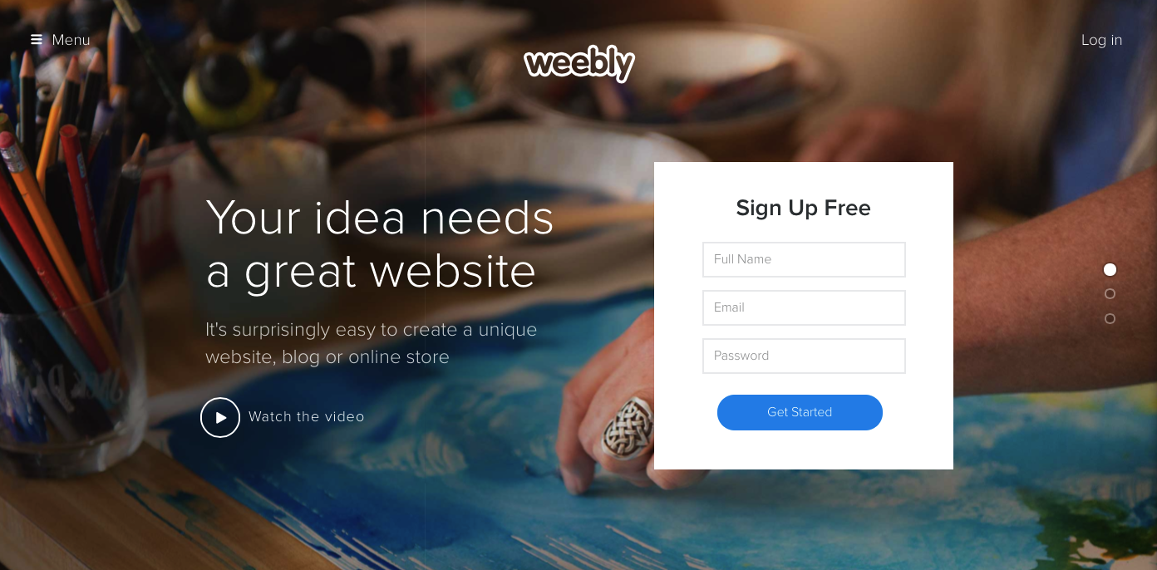
Digital Platform
Other Platforms
www.wordpress.org www.wix.com www.squarespace.com

Slide 27
Connected & Blended
Faith Formation
Online Faith Formation
Mostly Online with Regular Interaction in Gathered Sessions
Online Faith Formation & Gathered Sessions (Flipped Classroom)
Gathered Program with Supportive Online Content
Gathered Program with Online Components beyond the Program

Slide 28
Connected Faith Formation
Online Life
Church
Life
Daily & Home Life
Community Life

Slide 29
Connected Flows
Church Life ➔ Daily & Home Life via Online Life
Online Life ➔ Daily & Home Life ➔ Church Life
Community Life ➔ Daily/Home Life via Online Life
Online Life ➔ Church Life ➔ Daily & Home Life

Slide 30
Church–Home–Via Online
You can extend. . . .
Sunday worship
Church year feasts and seasons
Sacrament and ritual celebrations
Children, teen, or family programming
VBS and summer camp
Mission trips and service projects
Retreat experiences
. . . . and more
Event or Program
TALK
Conversation Activities
LEARN
Read
Listen
Watch
ACT
Practices
Service
Projects
PRAY
Devotions Bible Reading Daily Prayer
SHARE
Blog Facebook
Video
Projects

Slide 31
Example: Sacraments & Milestones
Parent Faith Formation Before Baptism
Preparation for and Celebration of Baptism
Family Faith Formation After Celebration of Baptism

Slide 32
After Baptism
BAPTISM
Prayer, Rituals, Bible, Family Conversation, Service
PARENT FAITH ENRICHMENT
MILESTONES
FAITH PRACTICES
@ HOME
Workshops, Courses
Online Resources
Support Groups
FAMILY EXPERIENCES
Baptism Anniversary, First Prayers, Start of School
Church Gatherings
Small Groups
Workshops
PARENTING SKILLS
Workshops, Courses,
Online & Digital Resources

Slide 33
Connected Faith Formation: Worship
Church Life ➔ | Daily & Home Life | ⬅ Online Life
Experience of Worship in the Congregation Sunday worship and lectionary Church year feasts and seasons Church rituals: baptism, communion, funerals, etc. | Experience of Sunday worship, rituals, and church year seasons in daily life Reflecting on the sermon and readings at home Practices: Lectio, etc. Application to daily living | Online worship, church year, and lectionary resources on the church’s faith formation website Lectionary commentaries online Video reflections and commentary Online activities and projects

Slide 34
Example: Sunday Worship
Sunday Worship
Share It
Blog/Facebook Question
After Worship Sharing
@Home Conversation Activity
Live It
Living the Message Daily
Living Christian Practices
Service/Mission Idea
Action Project
Study It
“Taking Faith Home”
Sermon Video + Study Guide
Daily Readings
Scripture Commentaries Online Bible Study
Pray It
Weekly Table Prayer
Praying with the Saints
AM & PM Prayer
Lectio Divina

Slide 35
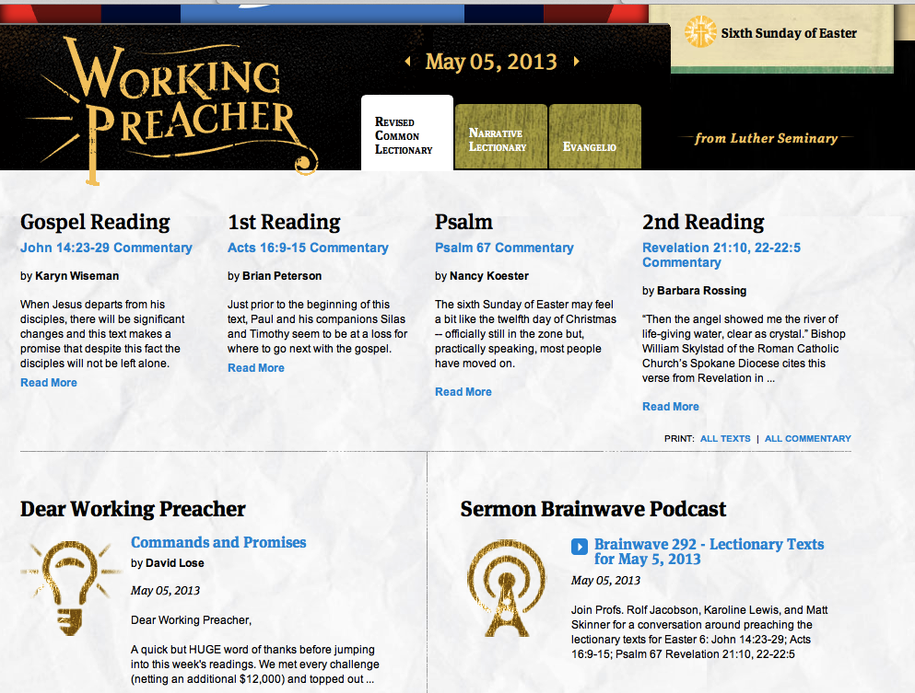

Slide 36
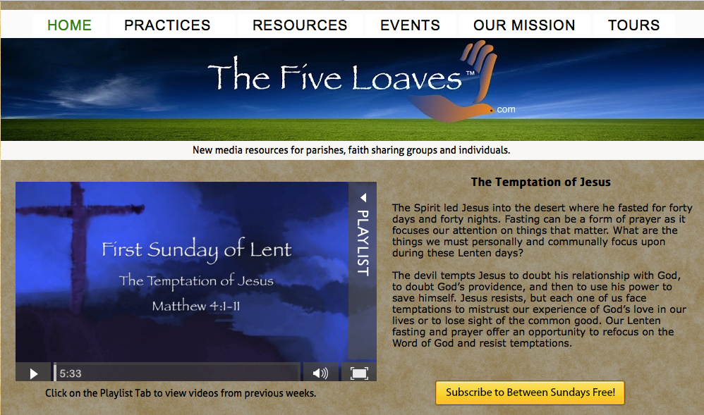

Slide 37
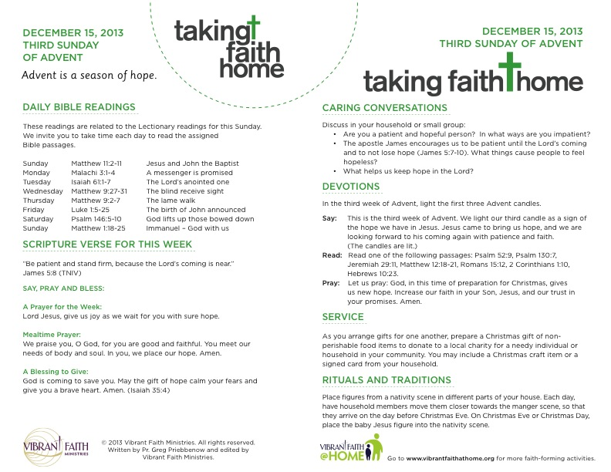

Slide 38


Slide 39
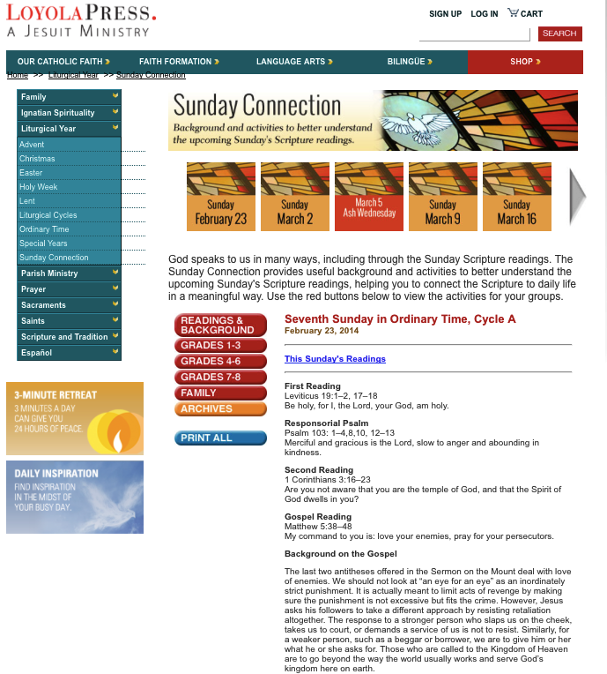

Slide 40
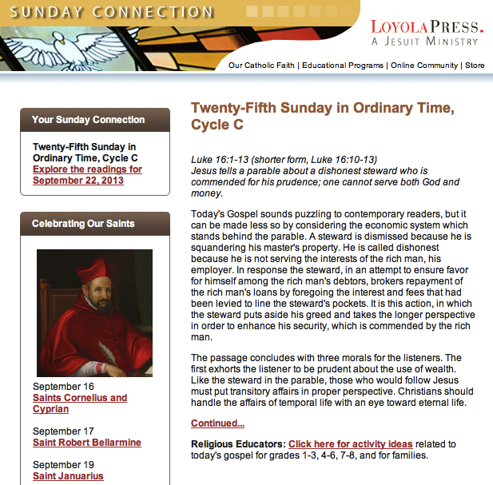

Slide 41
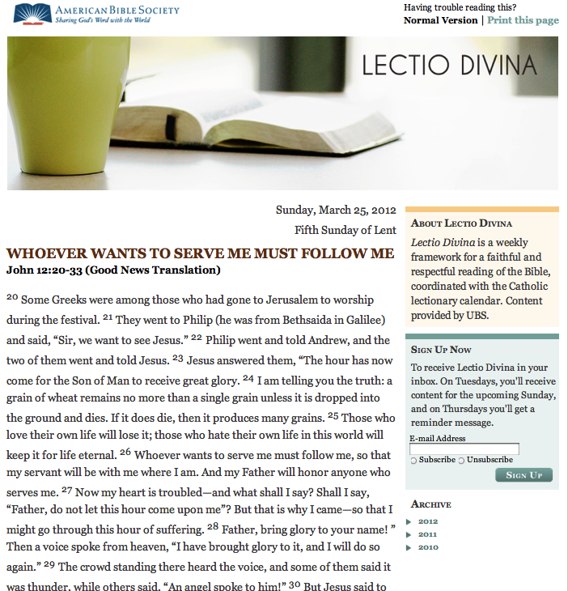

Slide 42
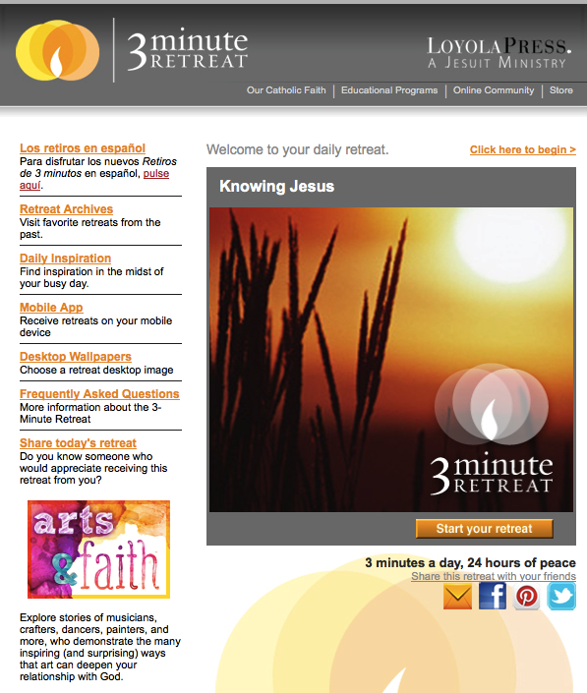

Slide 43
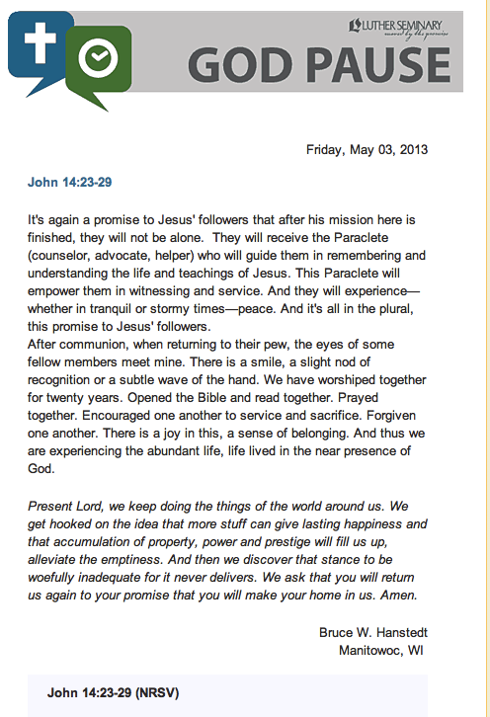

Slide 44
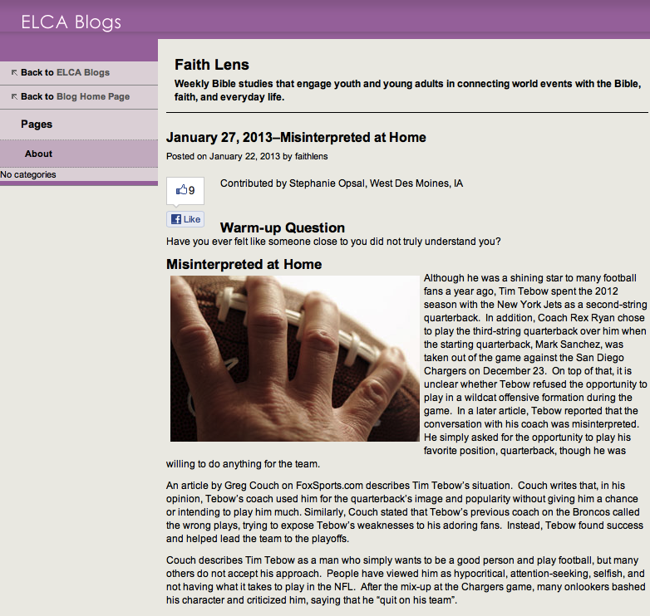

Slide 45
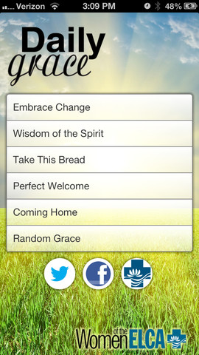
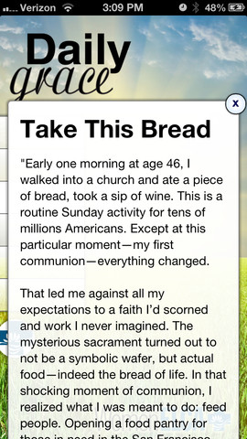

Slide 46
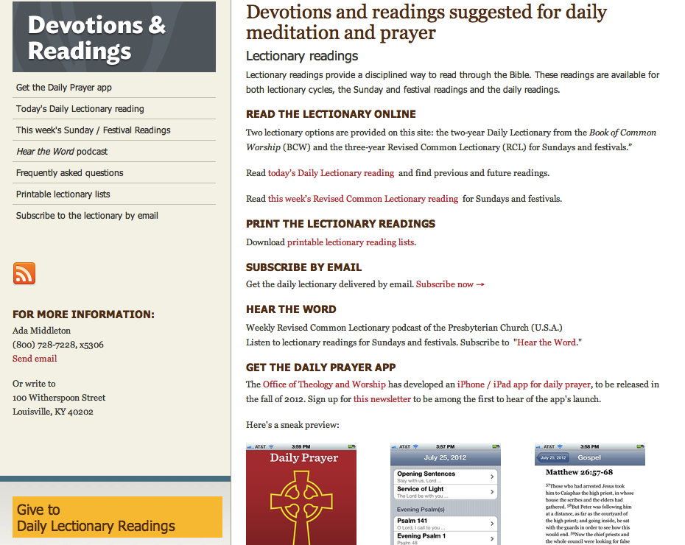

Slide 47

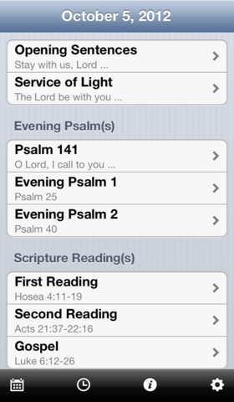

Slide 48
Example: Advent
Church Life ➔ | Daily & Home Life | ⬅ Online Life
Advent Sunday liturgies Advent prayer services Giving Tree Advent-Christmas service projects | Lectionary reflection Advent wreath Daily prayer Advent rituals and blessings Service Alternative gift-giving ⬅ Sharing stories ➔ church and online | Advent calendar Advent devotional Lectionary resources Advent daily prayer Weekly table prayer Video resources Alternative gift-giving ideas Service project ideas

Slide 49

Advent 2014 in 2 Minutes!

Slide 50
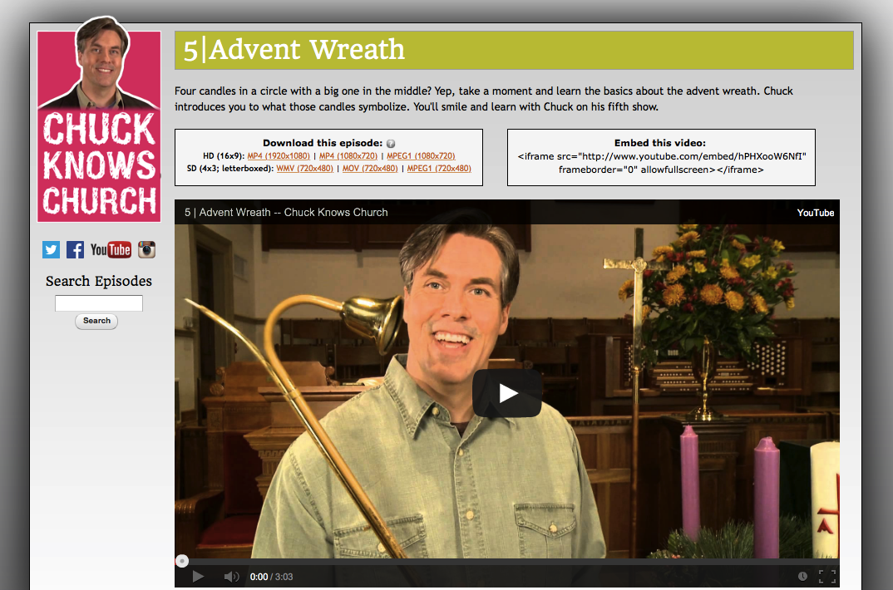
Advent Wreath

Slide 51
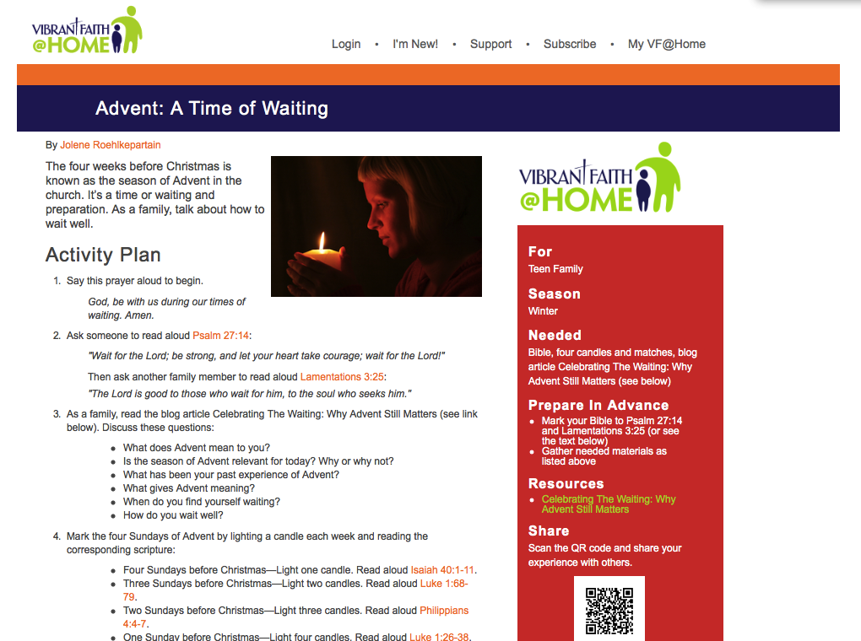
Advent: A Time of Waiting
(Vibrant Faith @ Home)

Slide 52
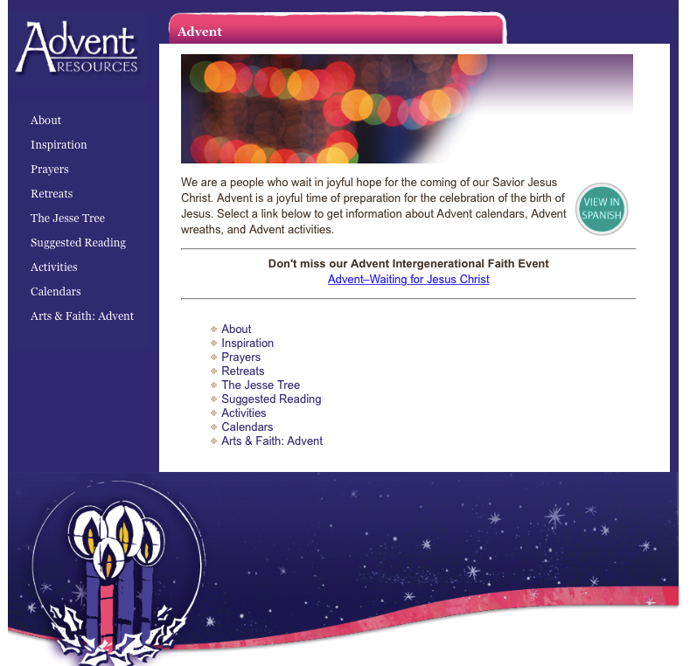
Advent Resources (Loyola Press)

Slide 53
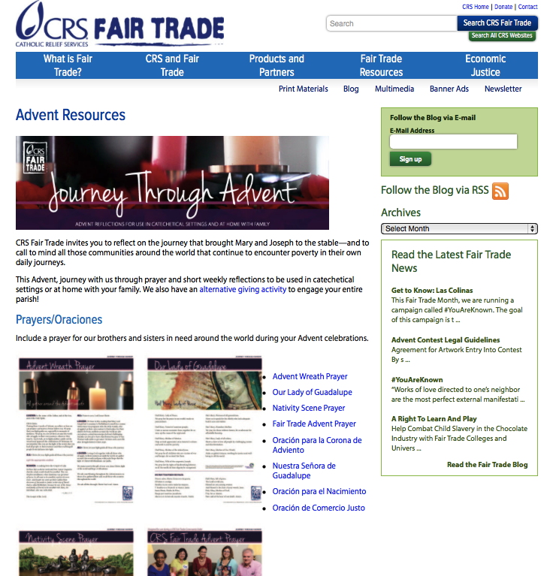
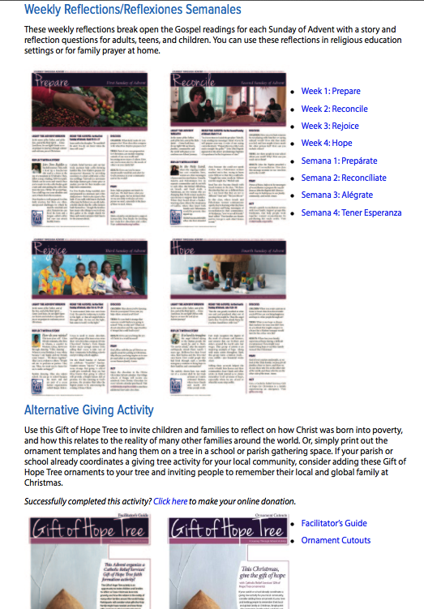
Journey through Advent

Slide 54
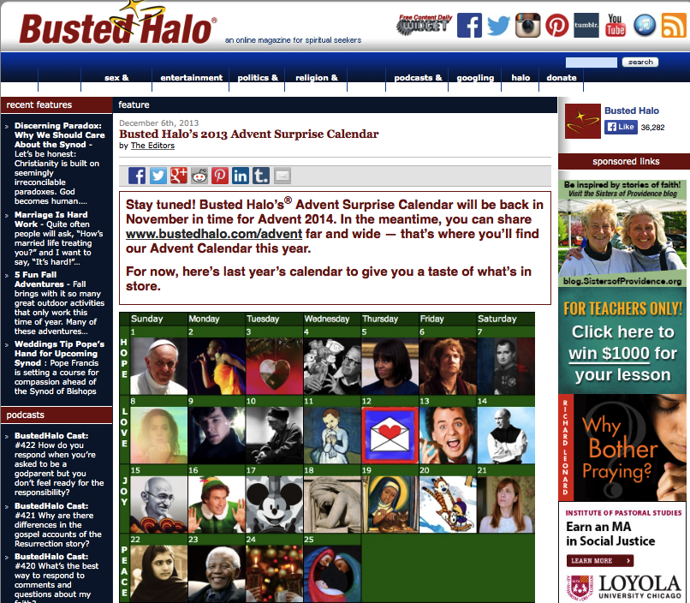
Advent Calendar

Slide 55


Advent Devotional

Slide 56
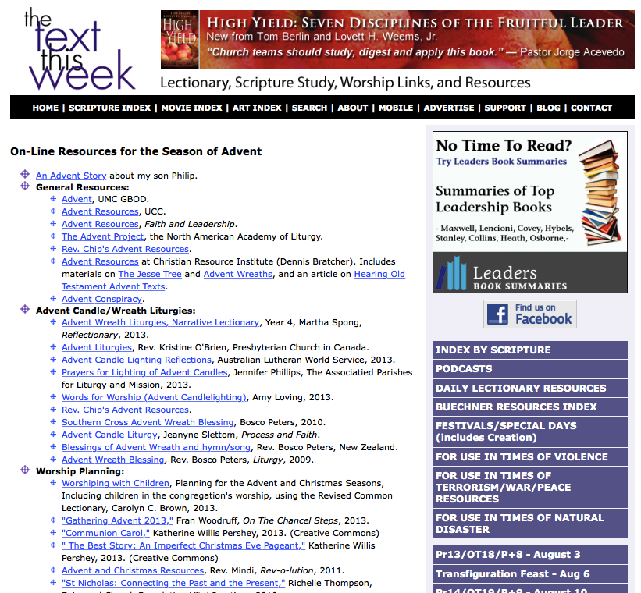
The Text This Week

Slide 57
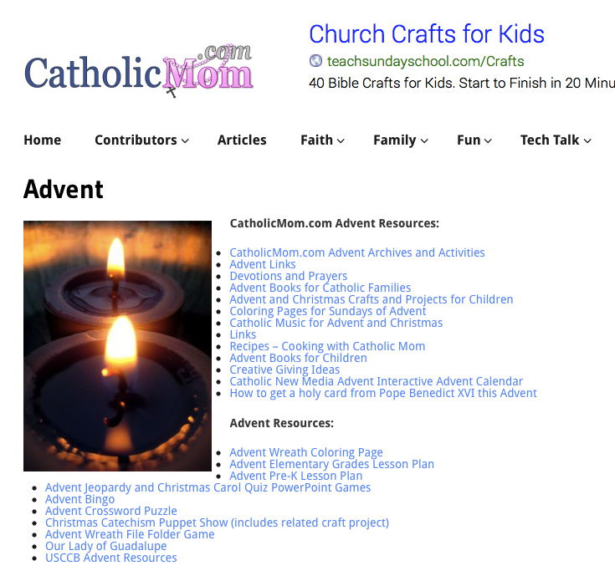
Catholic Mom

Slide 58
Design Format
Church Life ➔ | Daily & Home Life | ⬅ Online Life

Slide 59
Connected & Blended
Faith Formation
Online Faith Formation
Mostly Online with Regular Interaction in Gathered Sessions
Online Faith Formation & Gathered Sessions (Flipped Classroom)
Gathered Program with Supportive Online Content
Gathered Program with Online Components beyond the Program

Slide 60
One Program, Multiple Formats
Create new formats and delivery systems for church-based programs
Sunday sermon
Church event: worship, rituals, church year
celebrations
VBS – updates & presentations
Adult enrichment
Parent programs
And more. . . .
Stream it Live
Watch on Your Own
Use it in a Small Group
Put in the Online Library
Develop Supporting Online Content

Slide 61
Blended Strategy: Flip the Classroom
“Flipping the classroom” so that children and teens are doing project-centered learning with their parents or peers—accessing content online through the network website and connecting via a secure social network such as Edmodo AND then refocusing “class time” on practicing, demonstrating, and performing.

Slide 62
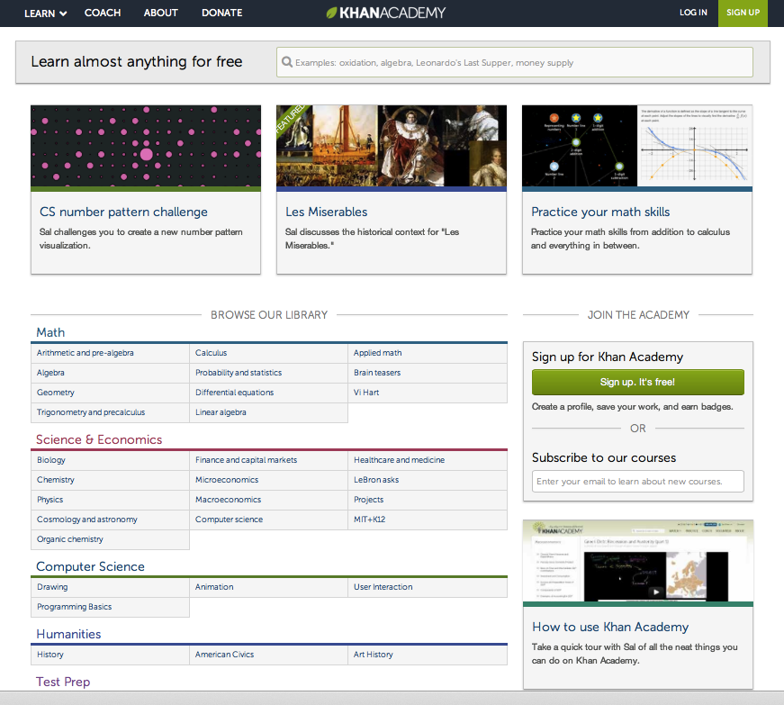
Khan Academy

Slide 63
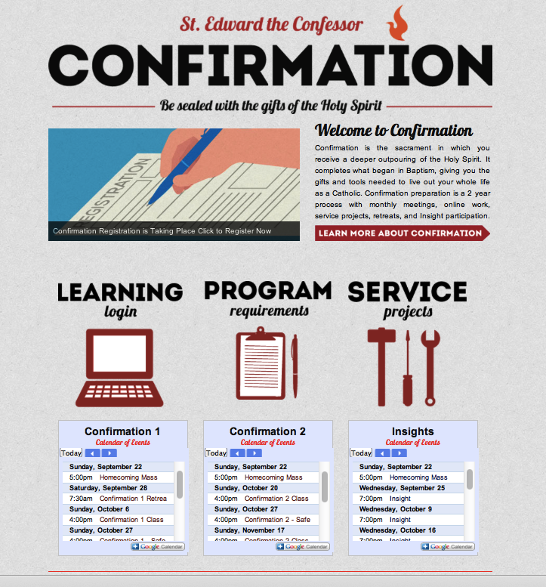
Flipped Classroom

Slide 64
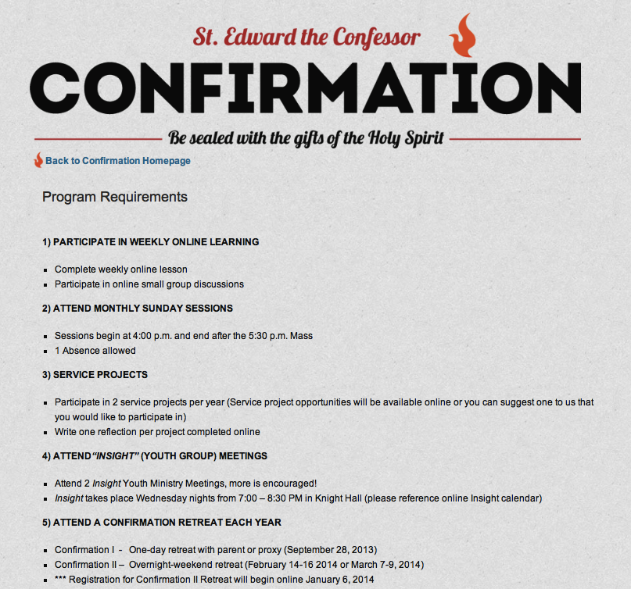
Flipped Classroom

Slide 65
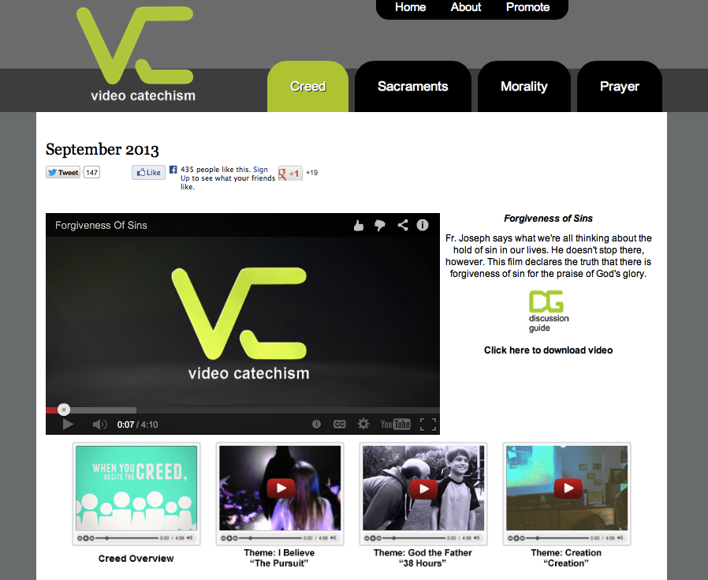
Online Faith Formation Centers

Slide 66
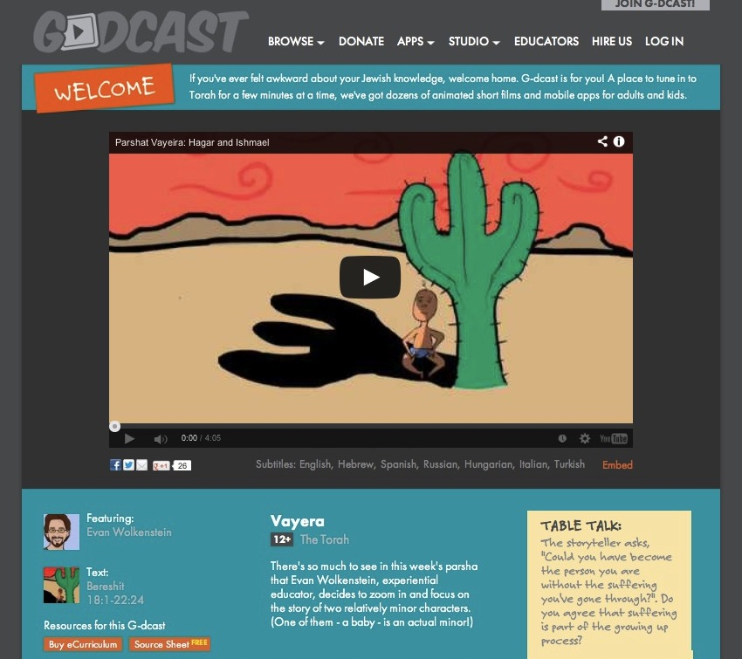

Slide 67
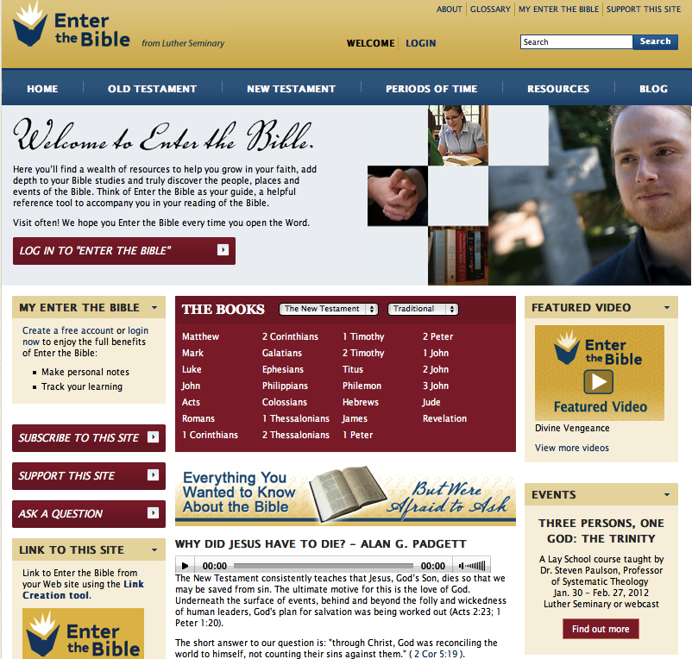

Slide 68
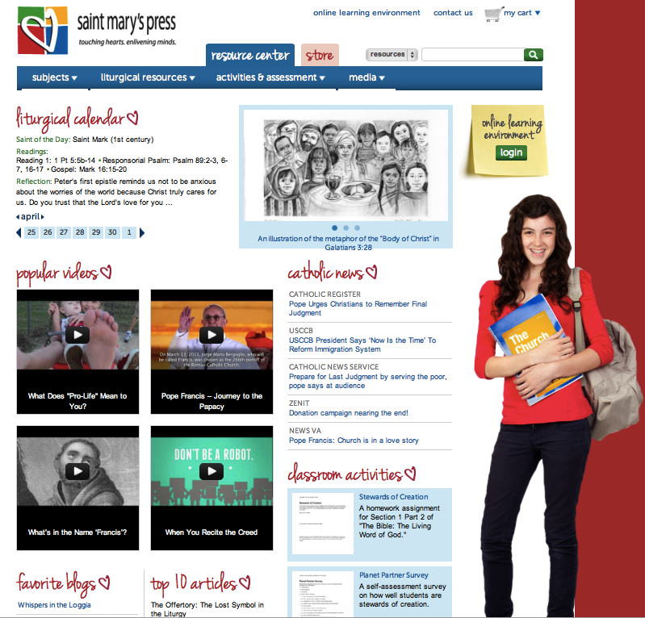
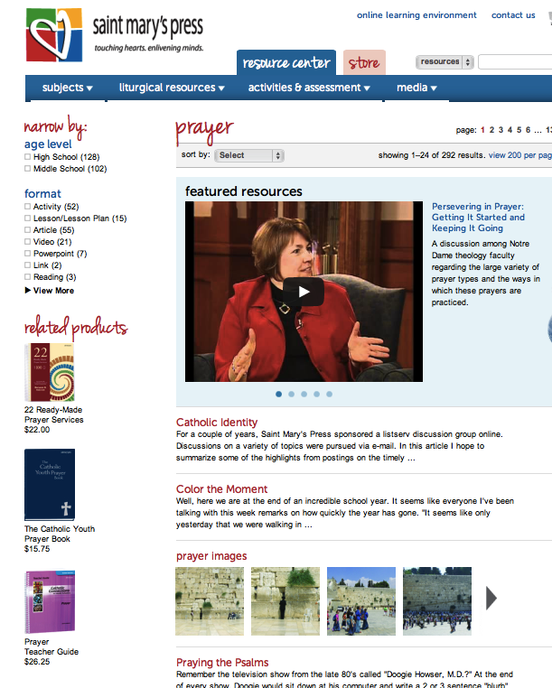

Slide 69
Connected & Blended
Faith Formation
Online Faith Formation
Mostly Online with Regular Interaction in Gathered Sessions
Online Faith Formation & Gathered Sessions (Flipped Classroom)
Gathered Program with Supportive Online Content
Gathered Program with Online Components beyond the Program

Slide 70
Online Programs
Online video conference with online content
Online courses and activities
Online learning and resource center

Slide 71
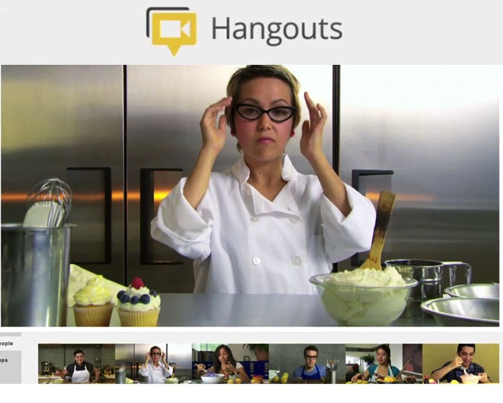
Google+ Hangout
Online Course, Small Group,
Workshop, or 1-1 Mentoring
Broadcast a Presentation
Record the Presentation (YouTube)

Slide 72
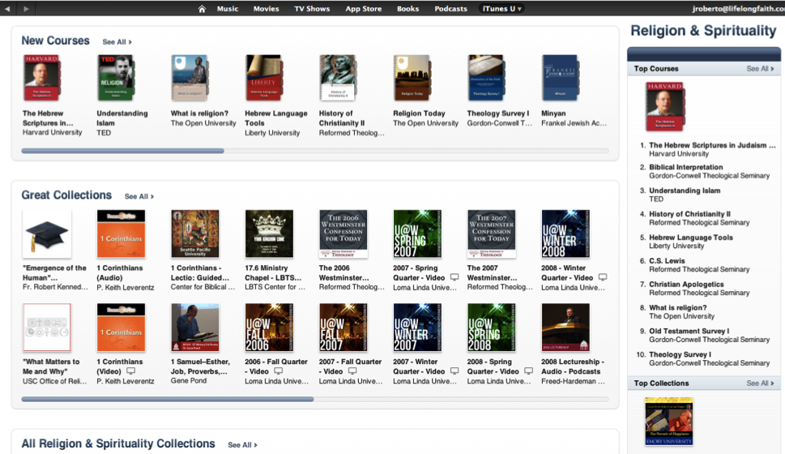

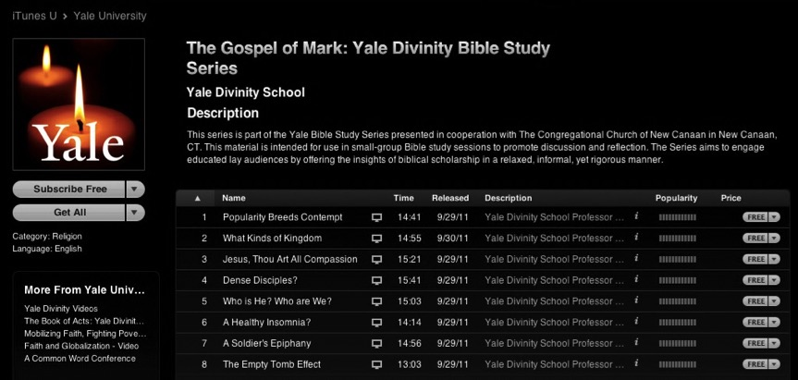
Online Learning & Courses

Slide 73

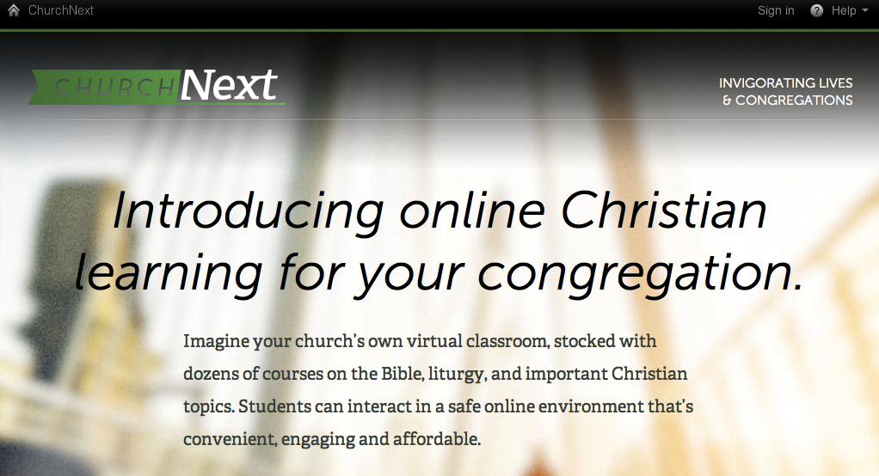

Slide 74
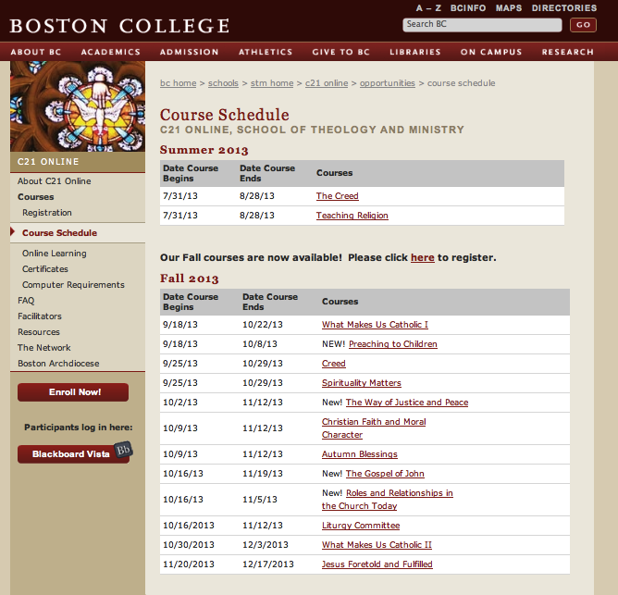

Slide 75
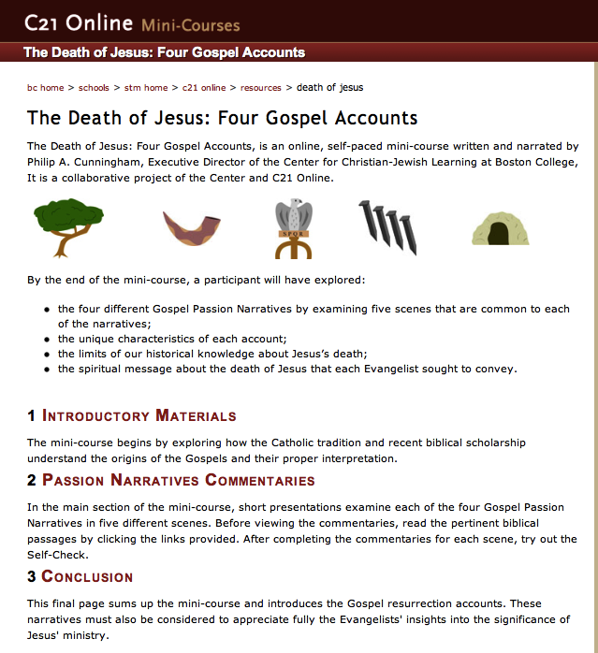

Slide 76
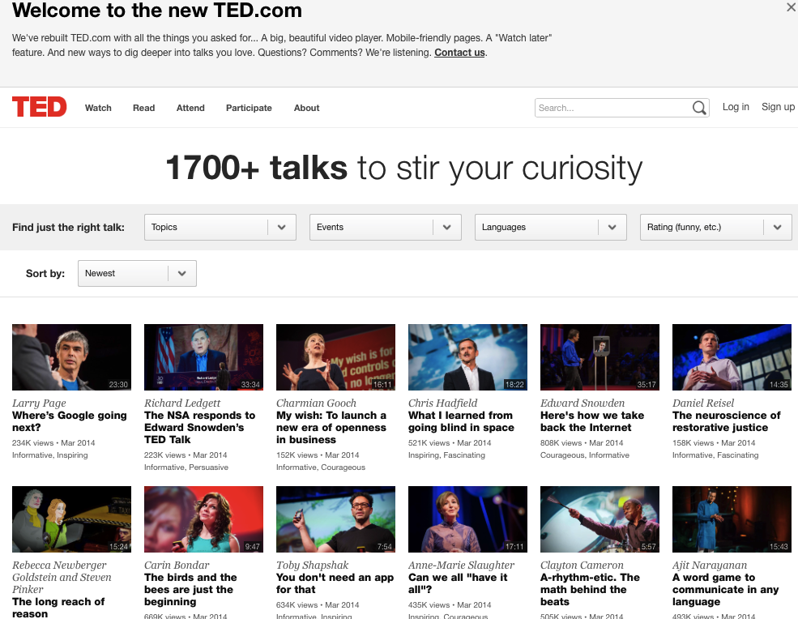

Slide 77
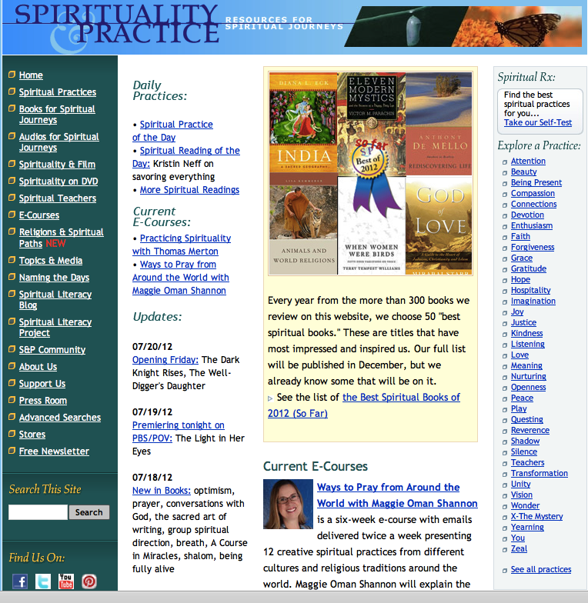
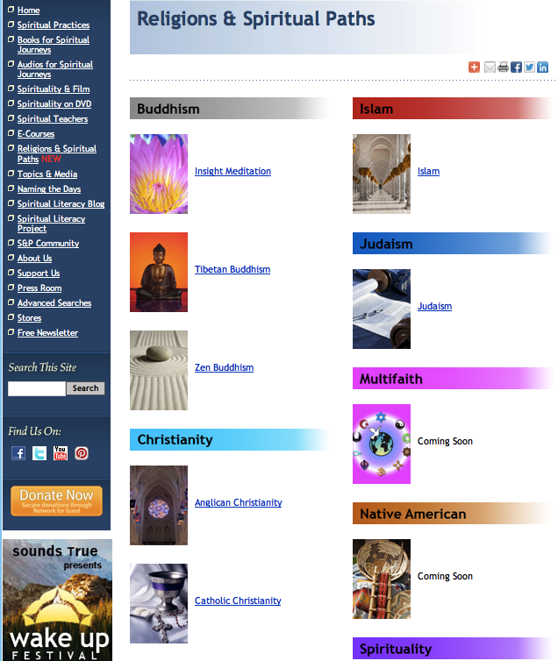

Slide 78
Connected & Blended
Faith Formation
Online Faith Formation
Mostly Online with Regular Interaction in Gathered Sessions
Online Faith Formation & Gathered Sessions (Flipped Classroom)
Gathered Program with Supportive Online Content
Gathered Program with Online Components beyond the Program

Slide 79

Personalized Faith Formation
Resource
Resource
Resource
Resource
Resource
Resource

Slide 80
Personalized Faith Formation
Personalized pathways for discipleship & faith growth. . . .
Guide people in discerning their religious and spiritual needs
Equip people with the resources and tools to learn and grow at their own pace
Provide mentoring and support for the journey

Slide 81
Faith Growth Plan
Create expectations for participation in faith formation and church life by providing a seasonal/yearly growth plan with a variety of options for experiencing the Christian faith through community life. For example:
  Sunday worship
  Church year feasts and seasons
  Service/mission projects
  Retreat experience
  Faith practices @ home, e.g. reading the Bible, praying, rituals, and more

Slide 82
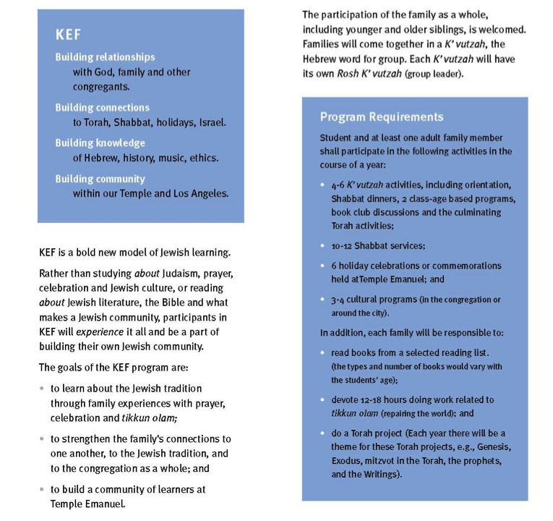

Slide 83
Missional Faith Formation
Receptive to Organized Religion
Scenario 3 Unaffiliated & Uninterested
Scenario 1 Vibrant Faith & Active Engagement
Scenario 4 Variable Commitment & Occasional Participation
Scenario 2 Spiritual but Not Religious
Low Hunger & Commitment to Spiritual Life
High Hunger & Commitment to Spiritual Life
Resistant to Organized Religion

Slide 84
Missional Faith Formation
Who we are addressing or involving or reaching?
Ways we are currently responding/involving/reaching?
Ways we could respond/involve/reach more effectively?
Scenario #4 | Scenario #1
Scenario #3 | Scenario #2

Slide 85
Example: Families with Children
Scenario #4 Parent faith formation at Baptism & First Communion Parent mentoring / small groups Milestone & church year celebrations VBS, family service, family camp Early childhood programming Online family resource center | Scenario #1 Whole family programs at church Faith practices at home (rituals, Bible reading, devotions, service, prayer) Parent faith formation & mentoring Milestones celebrations VBS, family camp, family service Online family resource center
Scenario #3 Family life center / early childhood center Family events sponsored in the community: movie nights, concerts, children’s festivals VBS, family camp, family service Parenting programs & resources Online family resource center | Scenario #2 Family life center / early childhood center Small group family experiences VBS, family camp, family service Parenting programs & resources Family events in the community Parent faith (e.g., Alpha) Online family resource center

Slide 86
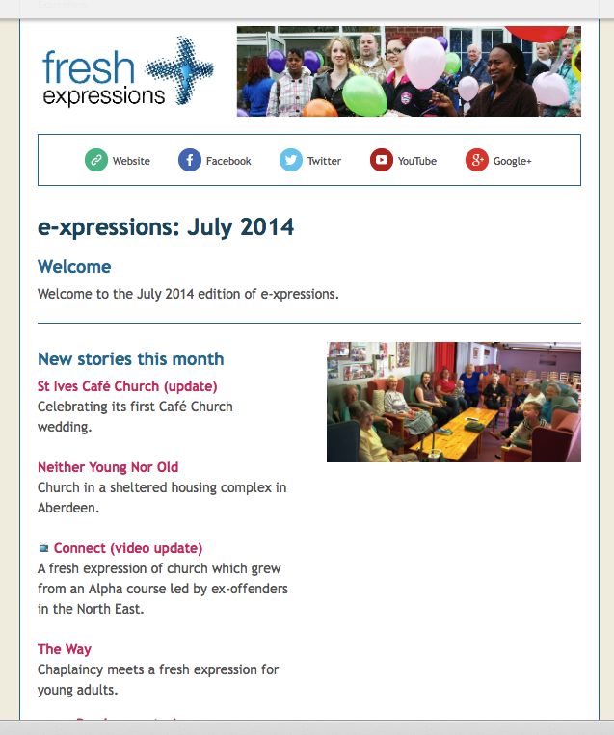

Slide 87
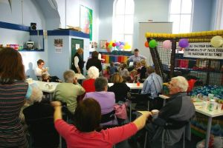
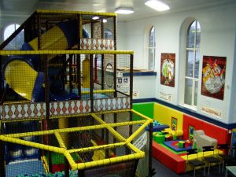
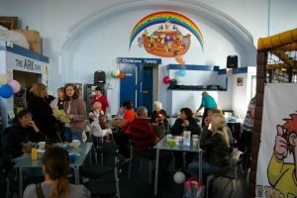
The Wesley Playhouse
www.freshexpressions.org.uk/stories/playhouse

Slide 88

A Third Place gathering space in the community, offers hospitality, builds relationships, hosts spiritual conversations, provides programs and activities, and nourishes the spiritual life of people.

Slide 89


Slide 90
Reaching People in the Community
Community Life ➔ Daily/Home Life via Online Life
“Just for Parents” Fall 2014
Parent Webinar Series
Learn more about Parenting
Small Group Book Study: “Secrets of Happy Families”
On Your Own Video: Parenting for the Long Haul
http://holytrinityfamilies.weebly.com/for-parents.html

