Slide 1
Building sustainability & Managing transition &
John Roberto, LifelongFaith Associates
www.LifelongFaith.com jroberto@lifelongfaith.com

Slide 2
Building Sustainability & Managing Transition
Focus: Strategies for PLCs when encountering changes in leadership: how to navigate, what to be prepared for, and how to frame past experience as transition to new framework,
Part 1. How to Building Sustainable Systems
Part 2. How to Manage Transitions

Slide 3
Building Sustainability for Faith Formation in a Parish
Have a clearly articulated vision statement, rooted in the GDC and NDC, and a 2-minute elevator speech for faith formation.
Have clearly developed outcomes for faith formation – the impact it will make on people’s lives: for age groups, for families, for the church community, etc.
Build support systems: teams, advisory group, specialists

Slide 4
Building Sustainability
Teams
Advisory Group
Specialists

Slide 5
Building Sustainability
Develop a systems view of faith formation:
connected to parish life and the faith forming power of the parish community
intentionally intergenerational
lifelong – addressing every stage of life
engaging families – at church and at home
Develop metrics for measuring effectiveness
How are you counting?
How are measuring impact?

Slide 6
Doing the Math of Mission
Counting – what are you counting?
Use the right verbs
Count more comprehensively
Measuring: what are you measuring
Impact on people’s lives
Change that can be measured over time

Slide 7
Outcomes & Benefits
How will participants benefit from and be affected or changed by their involvement in faith formation?
Initial or immediate impact
Intermediate impact
Long-term impact
How will you develop and document evidence?
Surveys (SurveyMonkey)
Focus Groups
Videos
How will you communicate the results?

Slide 8
Building Sustainability
Develop multi-audience communication:
Communication to target audiences
Communication to whole parish community
Communication to the wider community
Use multiple communication approaches to promote, to share stories, experiences:
Print, Audio, Video
Email, Email Newsletters, Text (Constant Contact, Mail Chimp, Flocknote)
Website
Social Media: Facebook, Twitter, Instagram
Live Streaming: Facebook, Zoom Web Conferencing
YouTube Channel

Slide 9
Building Sustainability
Connect to social networks in the parish community—in person and online.
You
Your Friends
Your Friends
Your Friends’ Friends
Your Friends’ Friends
Your Friends’ Friend’s Friends
Your Friends’ Friend’s Friends
Your Friends’ Friend’s Friends
Your Friends’ Friends
Your Friends’ Friends

Slide 10
Building Sustainability
Utilize digital approaches to extend the reach and impact of faith formation
Build a digital platform for faith formation
Extend on-campus events/programs/activities into daily and home life through digital media and activities on your website
Develop multi-versions of the same program using digital strategies and your website
Use digital media and activities to prepare for… and to live out… a gathered experience/event.

Slide 11
Extend the Event
Church Event or Program
At Home & Daily Life

Slide 12
One Event/ Program, Multiple Formats
Multiple Formats
Digital Content to Extend & Provide New Ways to Experience
Social Media
Interaction
Communication
Demonstration
Connection
Gathered
Website
Small Group
Independent
Online
Event/Program

Slide 13
Build on an Event/Experience (Sacraments, VBS, Mission Trip, and much more)
Preparing
Experiencing
Living
How will you sustain/extend the event?
How will you design the event?
What types of experiences, programming, activities, and resources will you develop to prepare people for the event?
How will you engage age groups, families, and the faith community?
What types of experiences, programs, activities, and resources will you offer people?

Slide 14
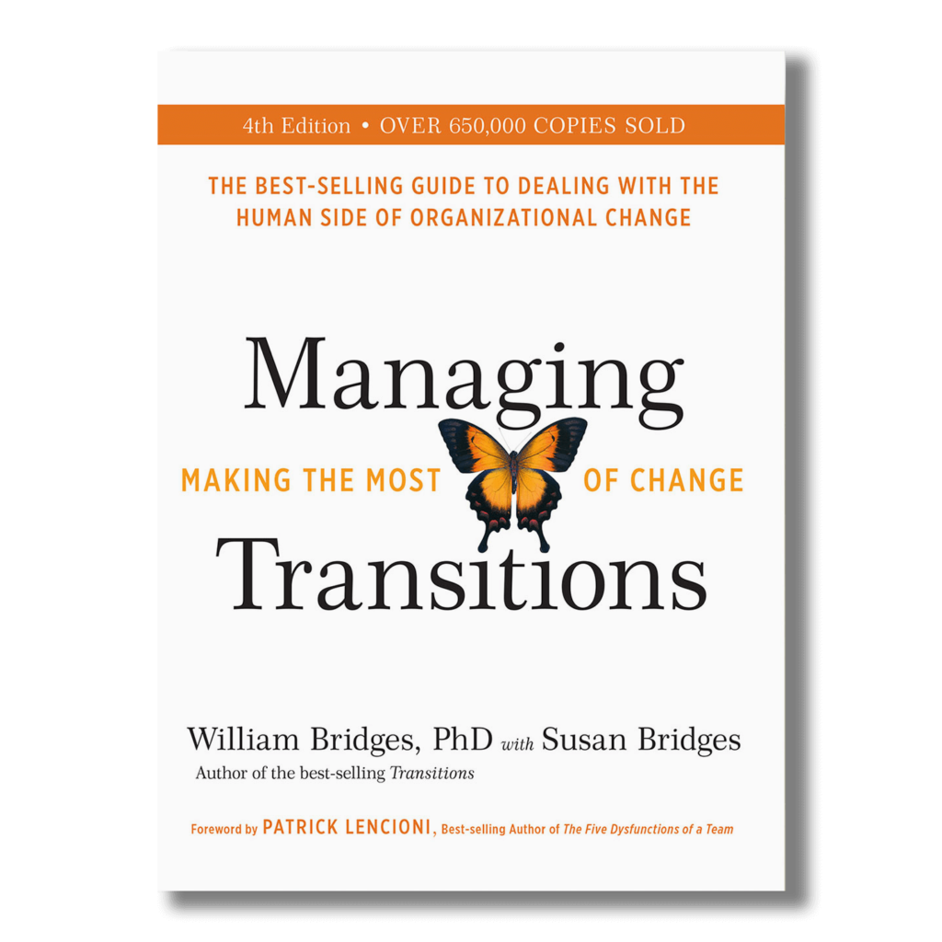
Managing Transitions
It isn’t the changes that will do you in; it’s the transitions. They aren’t the same thing.
Change is situational.
Transition, on the other hand, is psychological; it is a three phase process that people go through as they internalize and come to terms with the details of the new situation that the change brings about.

Slide 15
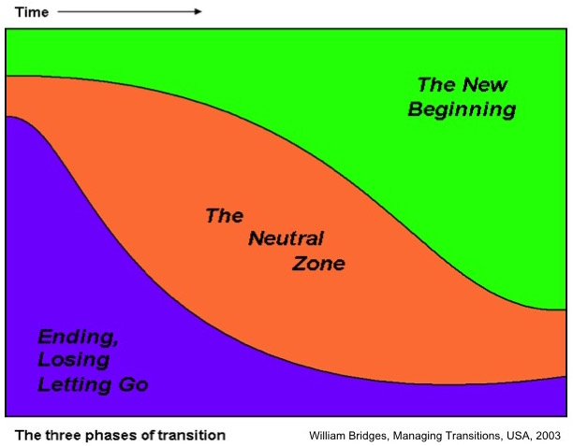
“Transition begins with an ending and finishes with a beginning” (William Bridges)

Slide 16
Managing Transitions: Endings
Transition starts with an ending. This is paradoxical but true. This first phase of transition begins when people identify what they are losing and learn how to manage these losses. They determine what is over and being left behind, and what they will keep. These may include relationships, processes, team members or locations.
What is actually ending, and who is losing what?
Acknowledge losses openly.
Work through the signs of grieving
Define what’s over and what isn’t
How will individual’s behavior and attitudes change?
Mark endings and treat the past with respect

Slide 17
Managing Transitions: Neutral Zone
The second step comes after letting go: the neutral zone.
People go through an in-between time when the old is gone but the new isn’t fully operational. It is when the critical psychological realignments and re-patternings take place. It is the very core of the transition process. This is the time between the old reality and sense of identity and the new one. People are creating new processes and learning what the new roles will be, but it’s in flux and doesn’t feel comfortable yet. It is the seedbed of the new beginnings that are sought.

Slide 18
Managing Transitions: Neutral Zone
A difficult time. . .
Anxiety rises and motivation falls
People are overloaded
Polarization: some what to move ahead, others hold on
A creative time. . . innovation, creativity
Normalize the neutral zone – think Moses and the people in the desert for 40 years
Time to “take stock”
Time to live with ambiguity
Time for learning and experimentation – testing new ideas and projects
Time for developing new patterns

Slide 19
Managing Transitions: New Beginnings
Beginnings involve new understandings, new values and attitudes.
Beginnings are marked by a release of energy in a new direction – they are an expression of a fresh identity. Well-managed transition allows people to establish in new roles with an understanding of their purpose, the part they play, and how to contribute and participate most effectively. They are reoriented and renewed.

Slide 20
Managing Transitions: New Beginnings
Deal with the promise and fear of new beginnings
New beginnings. . . .
Clarify and communicate Purpose
After purpose, a Picture
Create a Plan
Identify the Part people play
Reinforce New Beginnings
Be consistent
Ensure quick success
Symbolize the new identity
Celebrate the success

Slide 21
How do I get rid of the fear?
Alas, this is the wrong question.
The only way to get rid of the fear is to stop doing things that might not work, to stop putting yourself out there, to stop doing work that matters.
No, the right question is, "How do I dance with the fear?"
Fear is not the enemy. Paralysis is the enemy.
(Seth Godin)

