Slide 1
Queensland Clergy Conference 2018 Reimagine Faith Formation for the 21st Century Session 2. Intergenerational

Slide 2
Throughout Scripture there is a pervasive sense that all generations were typically present when faith communities gathered for worship, for celebration, for feasting, for praise, for encouragement, for reading of Scripture, in times of danger, and for support and service. . . . To experience authentic Christian community and reap the unique blessings of intergenerationality, the generations must be together regularly and often—infants to octogenarians.
(Allen and Ross, 84)

Slide 3
. . . . The best curriculum for forming children, youth, and anyone else in Christian faith is guided participation in a community of practice where people are vibrantly, passionately risking themselves together in lives of faith in a world crying out for the love of Christ.
(Joyce Mercer)

Slide 4
Guided participation in a community of practice puts a premium on both participation and practice. . . . We become Christian, taking on the identity of one who is a disciple of Jesus, by acting the way Christians act, and by talking the way Christians talk. Over time through practice, even our hearts and minds are formed in this way of life.
(Joyce Mercer)

Slide 5
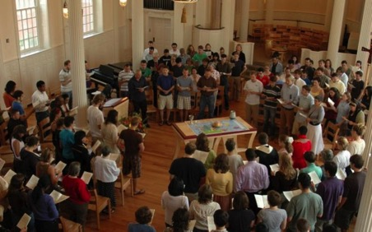
Intergenerational Faith Formation
Utilize intergenerational events in the faith community
Connect the generations through all events and programs
Infuse multiple generations into age group programs
Create new intergenerational programs & experiences (learning, service, community life)

Slide 6
Intergenerational Approaches
Utilizing the intergenerational events and experiences of church life (community life events, worship and the lectionary, seasons of the year, service and mission projects, prayer and spiritual formation) as a primary “content” in faith formation.
Infusing intergenerational experiences and relationships into existing programs and activities.
Connecting the generations through new intergenerational programs and experiences that bring together all of the generations for learning, celebrating, praying, reading the Bible, serving and working for justice, and worshipping.

Slide 7
Utilizing Events
1 - Preparation: knowledge & practices for participating fully
2 - Guided Participation: in the events of church life & the Christian Faith
3- Reflection: on the experience and living its meaning in daily life

Slide 8
Intergenerational & Age-Specific
Worship
Learn about worship and how to worship
Experience Sunday worship with the faith community
Live the Sunday worship experience at home and in daily life
Bible
Learn about the Bible and how to read it, interpret it, and apply it
Experience the Bible at Sunday worship and at home
Develop their own practice of Bible study and reading.

Slide 9
Intergenerational & Age-Specific
Christian Tradition
Learn about Jesus and the Christian tradition
Experience the life of Jesus and the tradition through participation in the lectionary and church year feasts and seasons
Live the Christian faith today at home and in daily life
Service & Justice
Learn about the justice issues of our day and the biblical and church teachings on justice, service, and care for creation
Experience acts of justice and service with the faith community—locally and globally
Engage in the practices of serving those in need, caring for creation, and working for justice

Slide 10
Connecting Generations
Incorporate intergenerational dialogues into programming
Develop mentoring relationships
Involve the community in praying for each generation,
Organize social and recreational activities that build intergenerational relationships
“Intergenerationalize” age-group programming
Integrate intergenerational programming into an age-group program plan and calendar
Offer service projects and mission trips for all ages
Offer simple, one-time intergenerational experiences: arts, music/concerts, drama, social events, service projects, sports, educational experiences

Slide 11
Infusing Intergenerationality
Infusing intergenerational experiences and relationships into existing programs and activities, such as bringing mature adults into children and youth programs for interviews, storytelling, and mentoring; and transforming age-group programs (vacation Bible school, service projects) into intergenerational experiences.
Worship
Service projects and mission trips
Age group learning programs
Social / community program
Sacramental preparation

Slide 12
Creating Intergenerational Programs
Intergenerational Service
Intergenerational Mission Trips
Churchwide Service Day
Intergenerational Monthly Project
Intergenerational Service Nights
Intergenerational Service Projects
Intergenerational Learning
Weekly or Bi-Weekly
Monthly
Seasonal
Small Group & Large Group

Slide 13
Intergenerational Learning
Engaging all ages and generations together in learning experiences that teach scripture and the Christian tradition, informing and forming disciples of all ages in Christian identity.
Intergenerational Learning
In-Common All Ages Experiences
Parallel Learning
Contributive Occasions
Interactive Sharing
Weekly, Bi-Weekly, and Monthly Models
Small Group & Large Group Models

Slide 14
Intergenerational Learning
Meal and Community Building
Part 1. Gathering and Prayer
Part 2. All Ages Learning Experience
Part 3. In-Depth Learning Experience
Option 1. Whole Group (together)
Option 2. Age Group (parallel)
Option 3. Activity Center
Part 4. Sharing Learning Experiences and
Home Application
Part 5. Closing Prayer

Slide 15
Intergenerational Learning
Creed
Sacraments
Morality
Bible
Justice
Prayer
Christian Practices
Engaging all ages and generations together in informing and forming disciples of all ages in Christian identity.
Intergenerational Learning
Weekly, Bi-Weekly, and Monthly Models
Small Group & Large Group Models

Slide 16
Content: Liturgy & Lectionary St. Elizabeth of Hungary, Acton, MA
September: Stewardship - 25th Sunday in Ordinary Time (Luke 16: 19-31)
October: Pray Always - 29th Sunday in Ordinary Time (Luke 18: 1-8)
November: Last Things and Heaven - 33rd Sunday in Ordinary Time (Luke 21: 5–19)
December: Mary - Immaculate Conception (Luke 1: 26-38)
January: The Baptism of the Lord (Matthew 13-17)
February: You are the Salt of the Earth - 5th Sunday in Ordinary Time (Matthew 5: 13-16)
March: The Temptation of Jesus - First Sunday of Lent (Matthew 4: 1–11)
April: Palm Sunday (Matthew 26: 14-27)

Slide 17
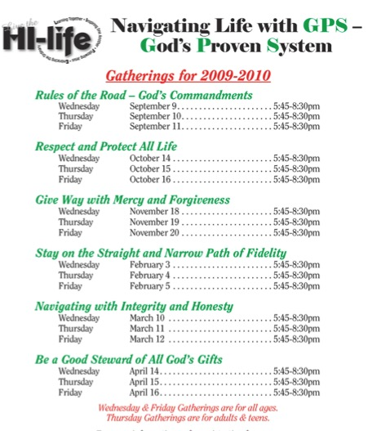
Content: Thematic Holy Infant Catholic Parish, Durham, NC

Slide 18
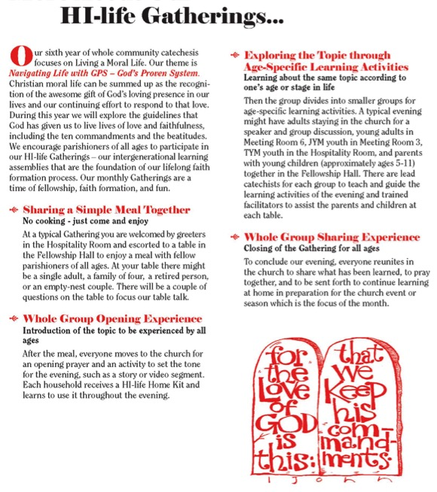

Slide 19
Content: Christian Practices
Caring for the Body
Celebrating Life
Discernment
Dying Well
Eating Well
Forgiving
Hospitality
Keeping Sabbath
Managing Household Life
Participating in Community
Praying
Reading the Bible
Transforming the World.

Slide 20
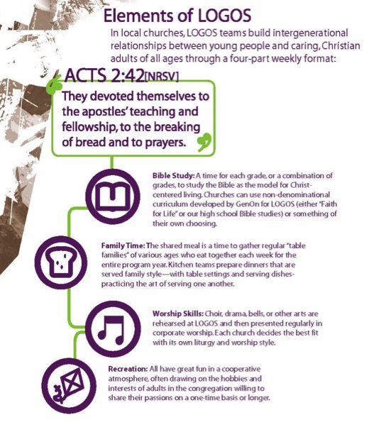
Elements of LOGOS
Bible Study
Family Time
Worship Skills
Recreation
GenOn Ministries
www.genonministries.org

Slide 21
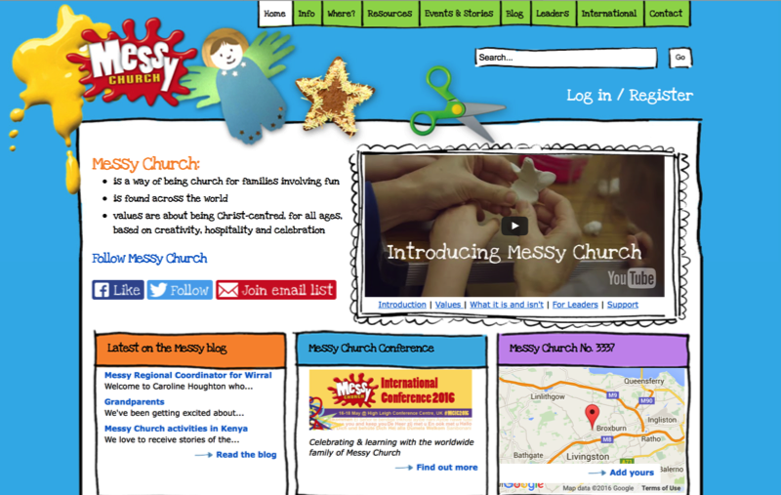
www.messychurch.org.uk

Slide 22
Intergenerational Learning
A flexible, relaxed arrival time with drinks and snacks
Creative exploration of a Bible story/theme through creative experiences for people of different learning styles and of all ages. Children and adults are not separated and are encouraged to explore the story/theme together
A short but explicit time of worship with story, music and prayers that builds on the creative exploration.
A generous welcome and hospitality is expressed through a delicious home-cooked, sit-down meal with others

Slide 23
Intergenerational Learning
Meal and Community Building
Part 1. Gathering and Prayer
Part 2. All Ages Learning Experience
Part 3. In-Depth Learning Experience
Option 1. Whole Group (together)
Option 2. Age Group (parallel)
Option 3. Activity Center
Part 4. Sharing Learning Experiences and
Home Application
Part 5. Closing Prayer

Slide 24
Whole Group Format
The Whole Group Format provides. . .
Learning activities for everyone using small groups or table groups
Intergenerational learning activities and age-appropriate learning activities for families with children, teens, young adults, and adults
Lead facilitator or team guides the entire group through the learning program—giving presentations and leading activities

Slide 25
Age Group Format
The Age Group Format provides parallel, age-appropriate learning activities on the same theme for…
young children (4 and 5 year olds)
families with children (grades 1-5)
adolescents (middle school and high school)
young adults
adults

Slide 26
Learning Center Format
The Learning Activity Center Format provides. . .
Learning stations or centers with structured learning activities on a common theme
Age-specific or intergenerational
Facilitated by leaders

Slide 27
Example: Called to Pray
Gathering and Opening Prayer
All Ages Learning: I’m Ready God, Where Are You? (Drama)
In-Depth Learning: Paths of Prayer
Activity 1: Creating a Space for Prayer
Activity 2: Praying with Scripture
Activity 3: Praying with the Psalms
Activity 4: Intercessory Prayer
Activity 5: The Jesus Prayer
Part 4. Sharing Learning Experiences and Home Application
Part 5. Closing Prayer

Slide 28
Example: Identity of Christ
Gathering and Opening Prayer
All Ages Learning: Gospel Portraits of Jesus (multimedia experience)
Age-Appropriate Learning: Exploring the Gospel Portraits of Jesus Christ
Families with Children Learning Plan
Adolescent Learning Plan
Adult Learning Plan
Part 4. Sharing Learning Experiences and Home Application
Part 5. Closing Prayer

Slide 29
Example: Jesus Son of God
What is Jesus saying/doing?
What is Jesus teaching us about the qualities of God?
Activity Centers
Jesus is Born (Infancy Narratives)
Jesus Is God ‘s Beloved Son (Baptism and Transfiguration)
Jesus Teaches Parables of the Kingdom of God
Jesus Heals People
Jesus Forgives Sin
Jesus Raises People from the Dead
Jesus Feeds People

Slide 30
Example: Jesus Son of God
Methods for Exploring Gospel Stories
Presenting the Gospel story: proclamation, reading, media
Dramatic presentations & role plays
Creative art activities
Storytelling & Scripture imagination activities
Music
Prayer and ritual
Group discussion & family conversations

Slide 31
Example: Jesus Son of God
Jesus is Born: Creative Activity & Discussion
Jesus Is God’s Beloved Son (Baptism and Transfiguration): Ritual/Prayer Activity
Jesus Teaches Parables of the Kingdom of God: Rewriting Parables for Today; Creative Art Activity
Jesus Heals People: Role Play/Dramatic Reading, Praying for the Sick
Jesus Forgives Sin: Drama and Reflection Activity
Jesus Raises People from the Dead: Dramatic Re-enactment; Creative Activity
Jesus Feeds People: Imagination Activity and Prayer Activity

Slide 32
Application
How can you utilize the intergenerational events and experiences of church life as a primary “content” in faith formation?
How can you infuse intergenerational experiences and relationships into existing programs and activities?
How can you connect the generations through new intergenerational programs and experiences?

