Slide 1
2020-2021

Slide 2
Family Program
The whole family works together to grow in our Catholic faith.
Works well for families with multiple children in the program. (grades 1-8)
Based on seven themes on roughly a month-by-month basis:
The Bible
Jesus
Sacraments
Prayer
Mass
Service
Discipleship

Slide 3
Family Program
Each of these themes is explored on a three-week cycle.
Week 1: Attend a large-group Zoom session facilitated by Dr. Sozek
Week 2: Complete an activity as a family, chosen from a menu of options
Week 3: Each child completes and submits an age-appropriate individual project
The submissions are received by the Faith Formation Office as well as one of our experienced catechists

Slide 4
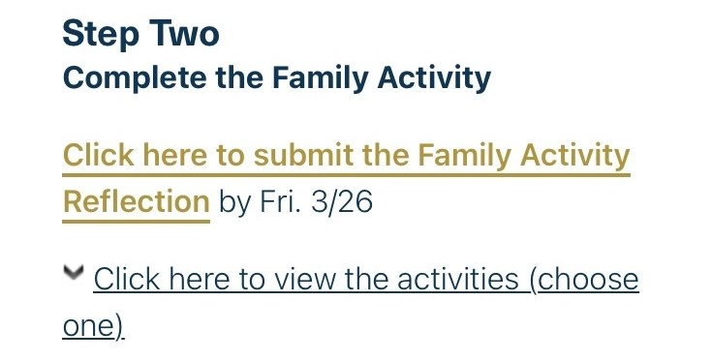
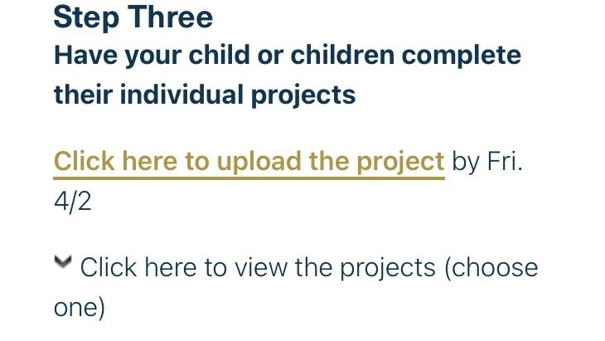
Family Program

Slide 5
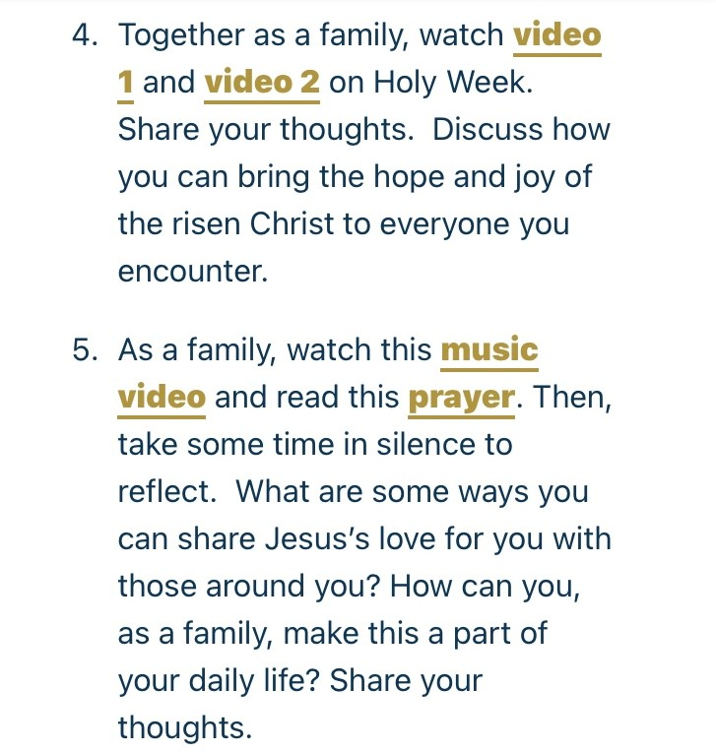
Family Program

Slide 6
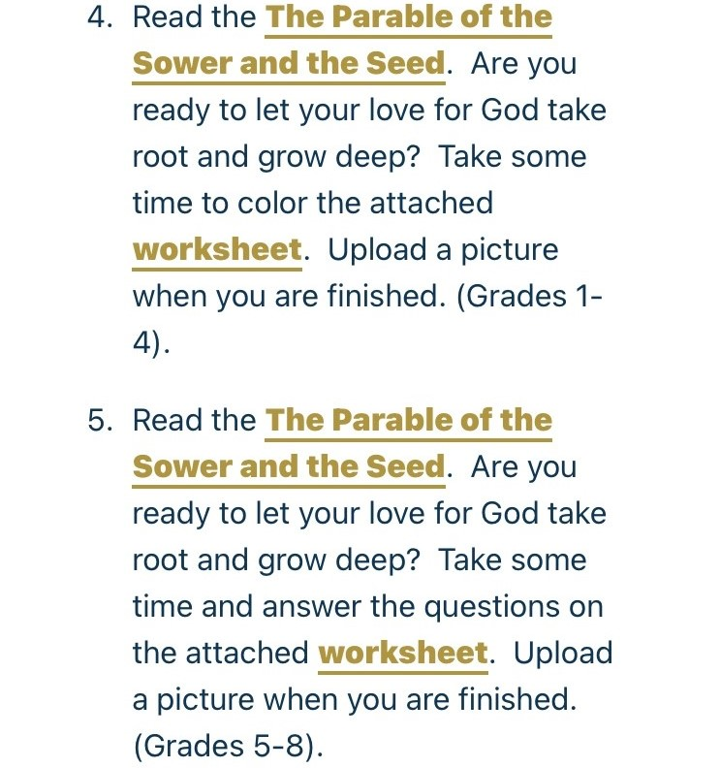
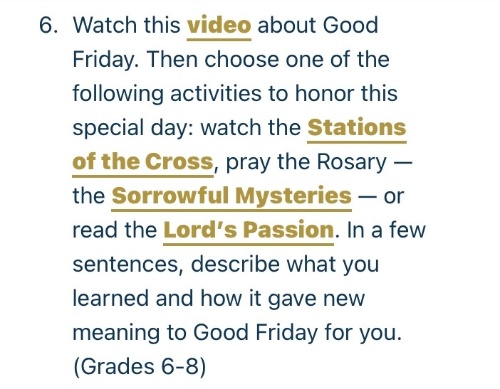
Family Program

Slide 7
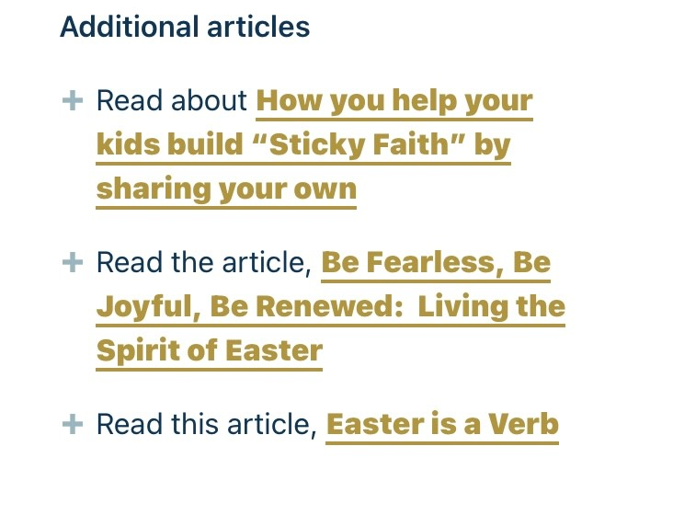
Family Program

