Slide 1
Creating Smallthingswithgreatlove.info
by Joyce Crandley
DRE, St. Anthony of Padua, Litchfield, CT
For Kelly Henderschedt
Archdiocesan Director of Faith Formation-Archdiocese of Hartford's
Virtual Workshop Highlighting Websites 4/20/2021

Slide 2
WHY WIX?
Time and efficiency.
A standard complaint I've heard from DRE's is that they could never use their church website efficiently.
The DRE stress is real when they're waiting for the person in charge of a church website to act on a request to add or change something... by then an event could be over!
I can easily change something
24/7
on smallthingswithgreatlove.info.
We chose WIX over other website companies, solely because my husband uses it for his business website, www.barnstarcustom.com (not mentioned here for advertising but to show another layout). He already knew it was easy to set up and manage. His tip: expect a learning curve. It took about a week or two to learn and create what we posted. Don't (like me) expect to start it on Friday and post it online on Sunday :) .
One of his favorite points is he's able to track when someone from a certain area looks at his site, what page they've looked at, and for how long. I haven't used this feature yet but as a DRE if you post an assignment, you can get a sense of who looked at it...did they glance, or stay and read...
I love that people can fill out my forms online, (no more scheduling a registration event with photocopies and volunteers) ...and I love how quick and easy it is to change up the website and forms.

Slide 3
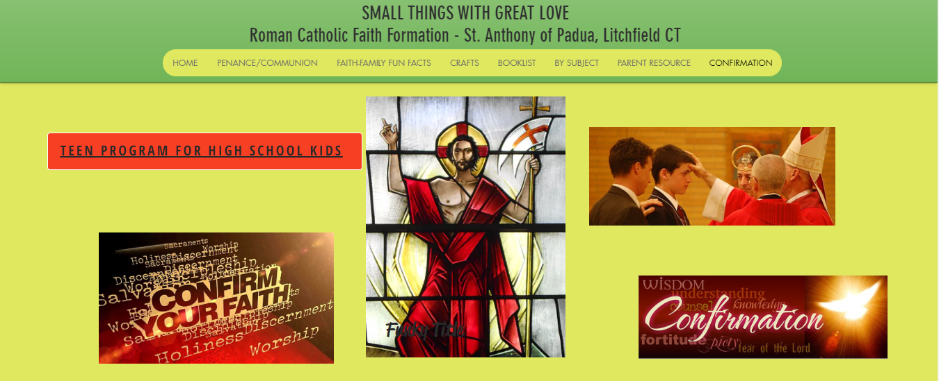
GRAPHICS
For graphics...we downloaded cell phone pics we took at church. This personalized the site. For example the background of the home and booklist page is the banner that hangs from the ambo. The center of the Confirmation tab is the stained glass window in the Confession room...
I plan to add more building-specific pics to the website then make a
“hunt-through-church” activity where they have to match up the pics on the website to parts of our church. Every other graphic was a copy and paste from online.

Slide 4
FORMS
Live and learn...less is more.
I began with a Registration Form & a Check-In form at the bottom of each page. (When clicked, it brings you to the form.) The forms were created in Google Forms. Then in WIX you create a link leading to that form. (You do the same when you're linking in a movie or a web-page from the internet.)
The Registration Forms were self-explanatory and worked great. Parent feedback suggested they were thankful that they could fill them out on their time rather than at a Registration event—and the eco-friendliness was well received.
What I called a Check-In Form was my pie-in-the-sky idea that parents would fill in that form once a week with how they or their child used the Website. I would get feedback, and they would have an incentive to use the website more so they could “say” more on their weekly form. Yea. No. No-one ever used it, and I didn't ask. I re-thought it after the first night. Parents don't have time or inclination to track their kids' use – and since they are their child's primary faith teacher—that form
doesn't need to exist.

Slide 5
FORMS
Live and learn...less is more.
I began with a Registration Form & a Check-In form at the bottom of each page. (When clicked, it brings you to the form.) The forms were created in Google Forms. Then in WIX you create a link leading to that form. (You do the same when you're linking in a movie or a web-page from the internet.)
The Registration Forms were self-explanatory and worked great. Parent feedback suggested they were thankful that they could fill them out on their time rather than at a Registration event—and the eco-friendliness was well received.
What I called a Check-In Form was my pie-in-the-sky idea that parents would fill in that form once a week with how they or their child used the Website. I would get feedback, and they would have an incentive to use the website more so they could “say” more on their weekly form. Yea. No. No-one ever used it, and I didn't ask. I re-thought it after the first night. Parents don't have time or inclination to track their kids' use – and since they are their child's primary faith teacher—that form
doesn't need to exist.

Slide 6
TABS/CLASSES
Early-covid simplified child church-activity to Penance/Communion class, Confirmation class, and one class for all other ages...
so we began with those three tabs.
Mid-covid, enough children were attending zoom that I split the “other-ages” class into 3 parts, all taught within one long Zoom where they would show up at their class-time, but where different age siblings could just switch seats to attend class.
More recently, because First Holy Communions are over and Summer is looming, I'm adding a parent tab and have a book tab
for those parents who wish to use the website as an assistant to look toward for faith direction for their kids.

Slide 7
Streamlining Tasks
The Morning of a Class:
We'd post the Zoom link on the Home Page
and the Penance/Communion Tab
and would e-mail the Zoom link to parents the night before, or morning of.
I'd post a pic of the cover of any book or item I'd be using in class (cut and pasted from online).
I'd post a quick note of G'Morning we'll be covering/doing/practicing A-B-C & remember to D-E-F...
Each Month – I'd post the Monthly Crafts on the Penance/Communion Page and the Crafts Page
with short commentary about tying in the craft to their faith... At the monthly in-church class they'd get a zip lock bag filled with “craft ingredients” for that month that matched the website pics. I'd get the ideas for crafts and the pics of them from the internet. I had to discipline myself to make a list in my head of what I needed that month so as not to get sucked into the internet time-drain. For example, one month Water was my theme. I'd carefully type Parting of the Red Sea Catholic Craft, Moses Water From Rock Catholic Craft etc., then click images, then scan the pictures for a cost-effective least-work-on-my-part craft, then copy and save that pic to my computer. I may not have picked what my brain calls the “perfect” crafts, but time-efficient picking was important. When I had one pic for each subject of water (Moses sea, Moses rock, rainbow, Jonah, baptism, walking on water, wine to water, washing feet), Each of those 8 pics went onto the first tab – I typed quick commentary next to each, then copy and pasted the whole thing onto the crafts tab. Done. Then I made up craft bags to hand out. I only handed out “ingredients” to the First Holy Communion class, but the craft tab was there for children from any classes to try to create those crafts at home.

Slide 9
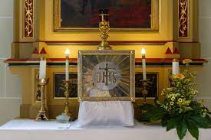
BRANDING
You wouldn't be the first to ask...we're .info instead of the usual .com or .net because the domain name for those was already taken. Nice to know that Mother Teresa's phrasing is that popular :) !
I originally didn't put the Church's name on the site at all—I was just using it as a tool.
It's not internet linked to our parish's main site although smallthingswithgreatlove.info is always in the bulletin...
We don't want the Faith Formation site to become the place families look to instead of the bulletin. We consistently and clearly impart to parents that going to Mass is more important than going to class. Unfortunately we have families that throughout covid, consistently come to class, but haven't gone to Mass yet. I'm hoping that not having Mass times and church happenings on our smallthingswithgreatlove.info website, will have them seeking out a bulletin for such things. That's one for the Holy Spirit ! :)

