Slide 1
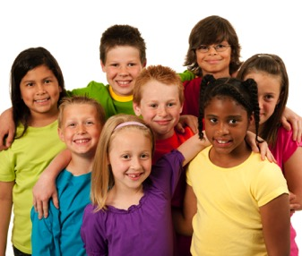
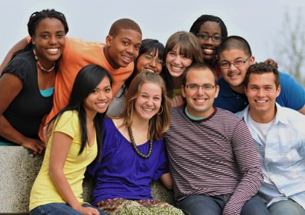
2017 symposium faith formation with a new generation
Session 2 21st Century Learning

Slide 2
Key Concept: 21st Century Learning

Slide 3
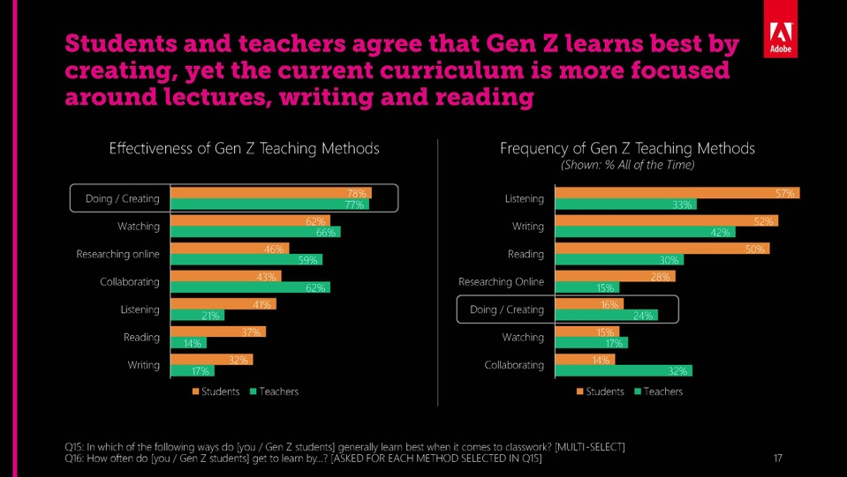
Generation Z Learners

Slide 4
Generation Z Learners

Slide 5
21st Century Learning Characteristics
Personalized
Individualized
Immersive learning environments
Interactive
Engaged
Participatory
Experiential
Visual and multimedia
Multi-Sensory
Abundant content, on demand
Episodic experiences
Micro-learning
Practice-Performance-Feedback
Seamless Learning across multiple platforms
Production-centered

Slide 6
Virtual Learning Academy

Slide 7
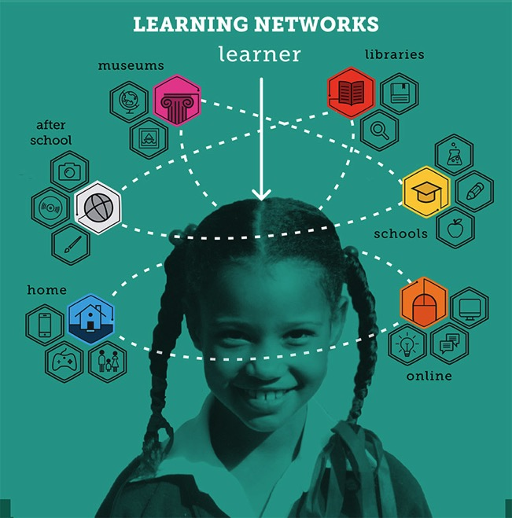

Slide 8
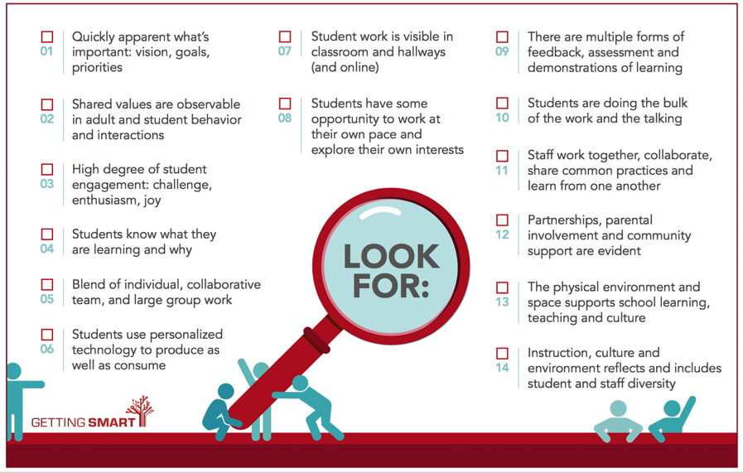
Student-Centered

Slide 9
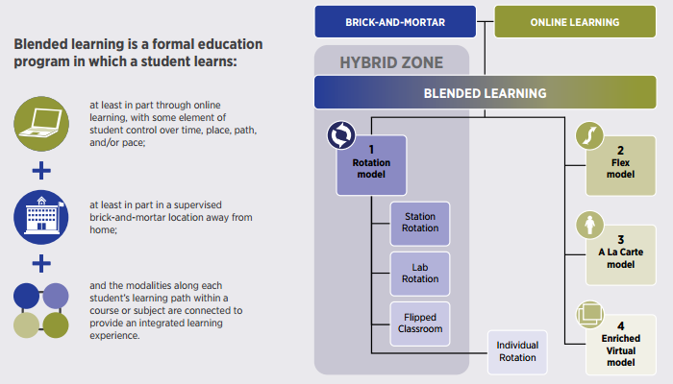
Blended Learning

Slide 10
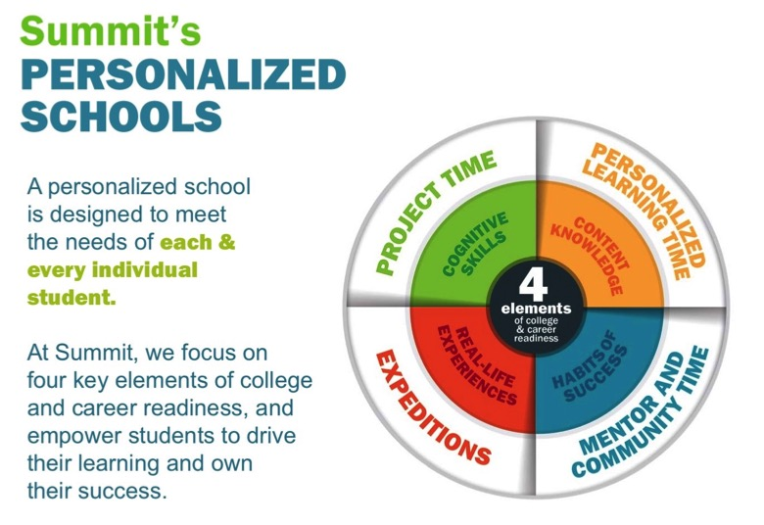
Summit Schools

Slide 11
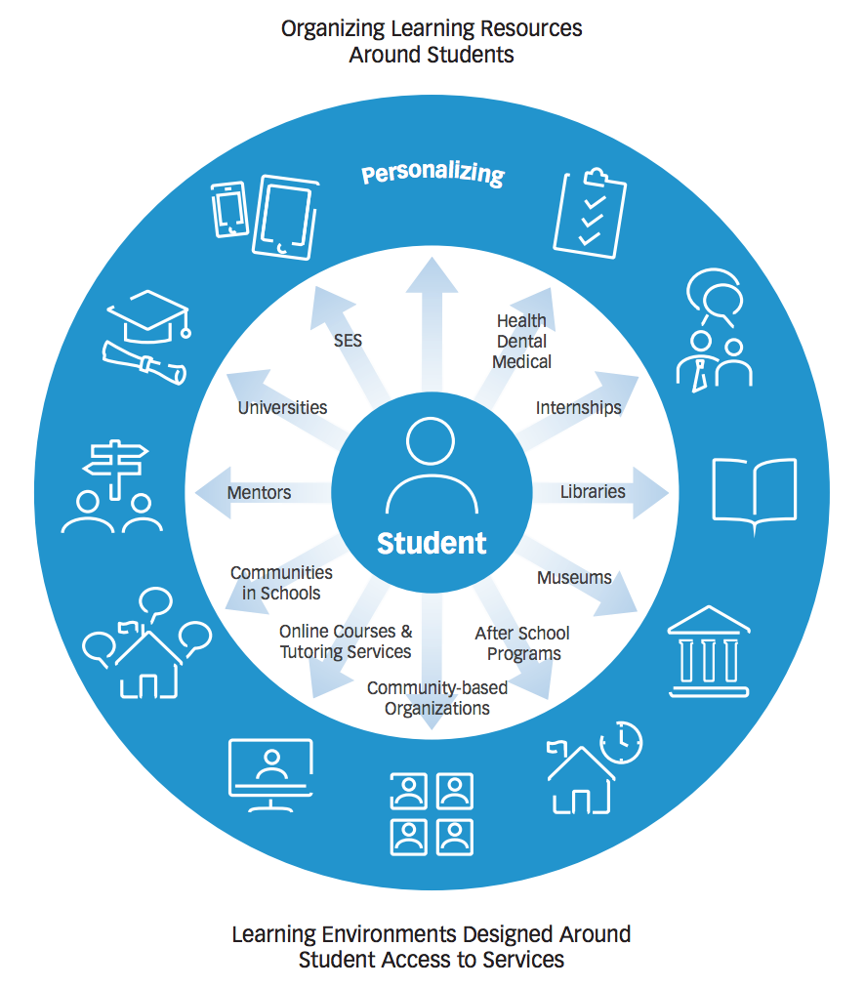
Personalizing Learning
Personalized learning is tailoring learning for each student’s strengths, needs and interests— including enabling student voice and choice in what, how, when and where they learn— to provide flexibility and supports to ensure mastery of the highest standards possible.

Slide 12
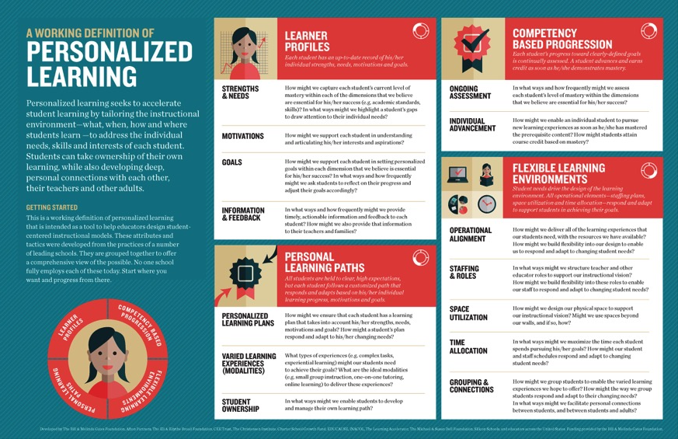
Personalized Learning

Slide 13
Digitally Enabled & Digitally Connected Faith Formation

Slide 14
Extend the Event
Church or School Event or Program
At Home & Daily Life

Slide 15
One Event/ Program, Multiple Formats
Multiple Formats
Digital Content to Extend & Provide New Ways to Experience
Social Media
Interaction
Communication
Demonstration
Connection
Gathered
Website
Small Group
Independent
Online
Event/Program

Slide 16
Build on an Event/Experience
Preparing
Experiencing
Living
How will you sustain/extend the event?
How will you design the event?
What types of experiences, programming, activities, and resources will you develop to prepare people for the event?
How will you engage age groups, families, and the faith community?
What types of experiences, programs, activities, and resources will you offer people?

Slide 17
Flip the Model
@ Home / Daily Life
Exploring the Content - print, audio, video, activities
@ The Program
Applying the Content: Create – Practice - Perform - Participate

Slide 18
Our Confirmation preparation program has two components: Once a month in-person classes and an online study. The online study is a place for students to develop their faith weekly by completing multi-media lessons which include videos, reading, Saint reflections, multiple-choice questions and online small group discussions. Each small group has their own online space to discuss faith topics, ask questions, and pray for one another. By having both in person classes and an online study we hope to help families learn more about their faith while respecting the many demands for their time.

Slide 19
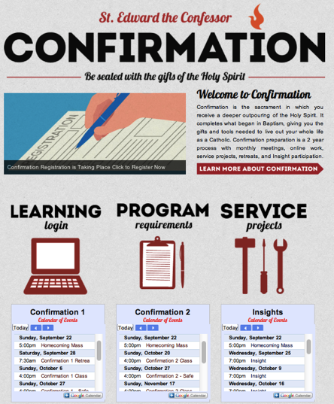
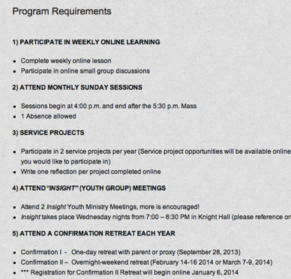
Confirmation

Slide 20
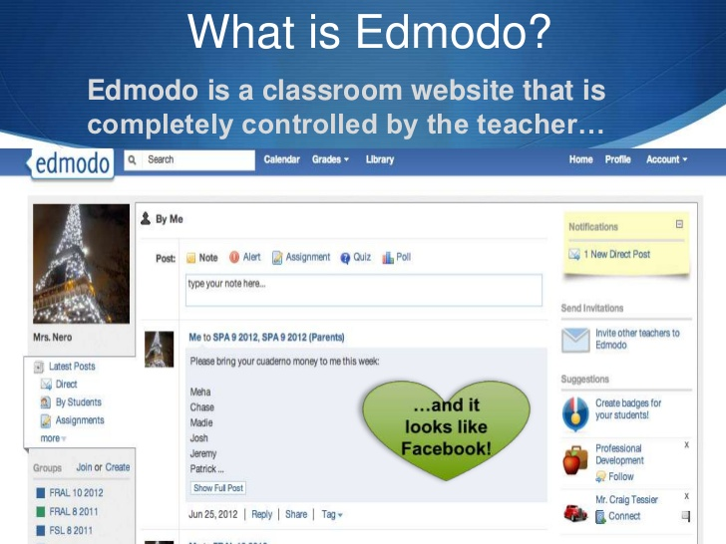

Slide 21
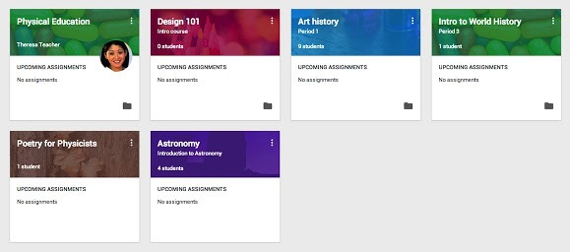
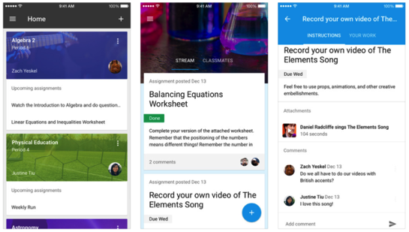

Slide 22
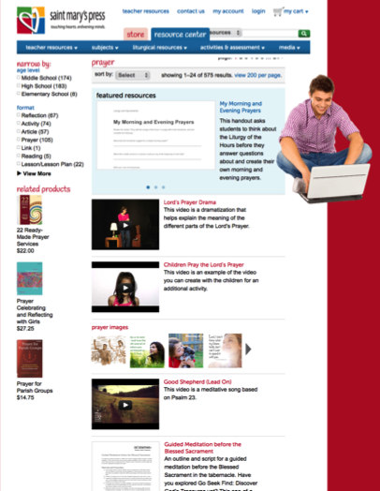
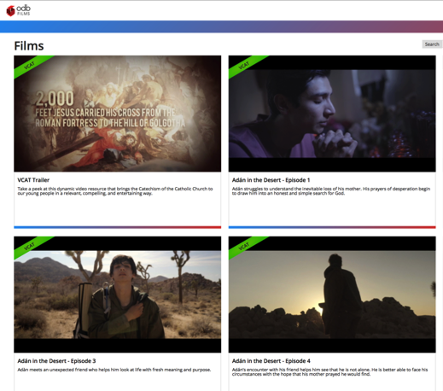
Online Libraries of Content

