Slide 1
Interpreting the Challenges Facing Faith Formation & Church Life in the 21st Century
Southwest Indiana
Center for Congregations

Slide 2
Outside-In Thinking

Slide 3
Shape of the World Activity

Slide 4
Shape of the World Activity
As individuals. . . .
Name 2-3 things that you believe are having an impact on your community/world now, and over the next few years will continue to affect it strongly.
Name 2-3 things that are dying out in your community/world now or will continue to do so in the next few years.
Name 2-3 things that you believe will one day have an impact on your community/world, but which are now 5 or 10 years away.

Slide 5
Shape of the World Activity: Group
Impact on the community/world now, and over the next few years will continue to affect it strongly.
Put arrows into the circle and label them.
Arrows into the center of the circle show the most direct impact; toward the outer edge, less impact.

Slide 6
Shape of the World Activity: Group
Things that are dying out in the community/world now or will continue to do so in the next few years
Put arrows coming our of the circle and label them.
Arrows leaving the center of the circle represent important influences dying out; toward the outer edge, weaker influences.

Slide 7
Shape of the World Activity: Group
Things that one day will have an impact – think 5-10 years in the future.
Show these arrows adjacent to the circle, and label them.

Slide 8
Shape of the World Activity: Group
As a group. . . .
Name 2-3 things that you believe will one day have an impact on the community/world, but which are now 5 or 10 years away.

Slide 9
Shape of the World Activity: Group
Reflect and then Discuss:
What is the significance of our profile of things that are having an impact, dying-out, and emerging?
What are the implications of this profile for the life and future of our congregation?

Slide 10
Four Big Adaptive Challenges

Slide 11
4 Big Adaptive Challenges
Increasing diversity throughout American society in the length of the lifespan, in generational identities, in family structures and marriage patterns, and in the ethnic makeup of America
Rise of new digital technologies that are reshaping society, and the emergence of a connected, networked society
Dramatic changes and increasing diversity in the religious beliefs, practices, and affiliation of Americans
Decline in religious transmission from generation to generation

Slide 12
Ethnic Diversity

Slide 13
Generational Diversity
Generational Differences
Relationship to Institutions
Relationship to Authority
Family Relationships
Work-Life Balance
Communication Style
Technology Usage
Learning Style
Religious Expression
Worship Style
Millennials (1980-99)
Generation X (1961-79)
Baby Boomers (1946-60)
Builders (pre 1946)
iGeneration (2000 - )

Slide 14
Life Span Diversity
0-10
50s
20s
30s
40s
60s
70s
80s
90s
11-19

Slide 15
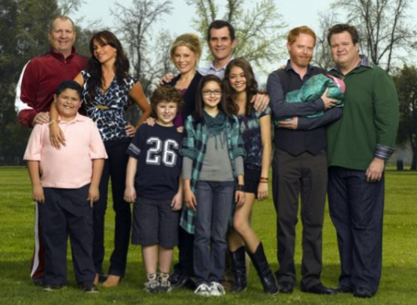
Family Diversity
The 1950s Family
The 2010s Family

Slide 16
Family Diversity
Married Couple with Children
Married Couple with Children (blended family)
Single Parent with Children
Unmarried Couple with Children
Unmarried Couple without Children
Same Sex Couple with Children
Same Sex Couple without Children
Grandparents & Parents with Children
Grandparents as Primary Caregivers
Parents with Single Young Adults Living at Home

Slide 17
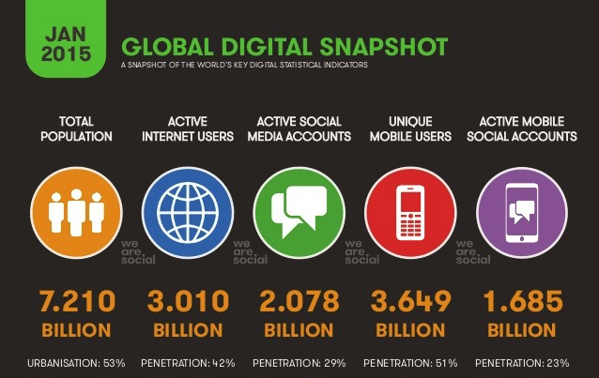
Digital Transformation

Slide 18
Triple Revolution
Internet Revolution
Mobile Revolution
Social Media Revolution
Information is now. . .
Portable
Personal
Participatory

Slide 19
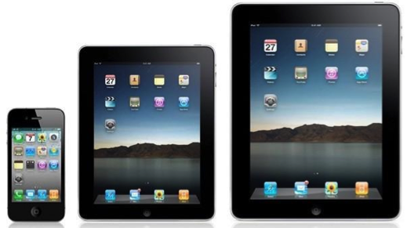

Slide 20
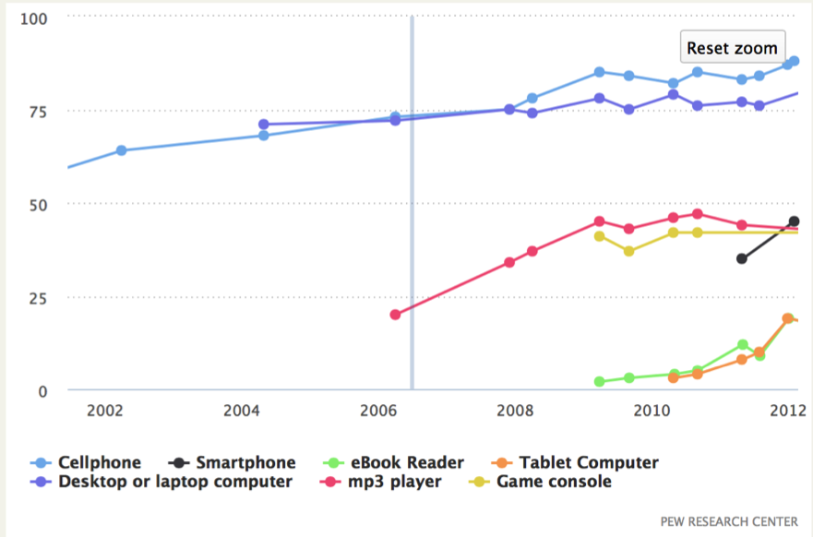
Digital Device Usage

Slide 21
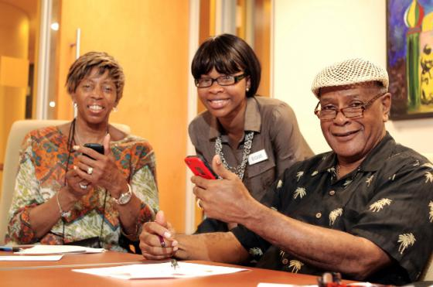
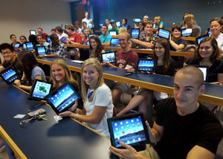

Slide 24
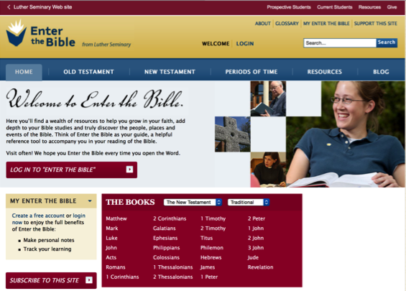
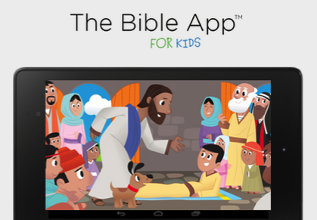

Slide 25
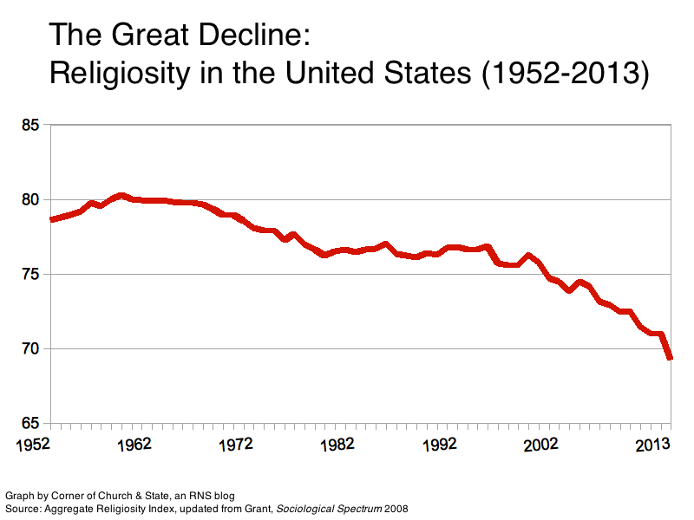
Religious Decline

Slide 26
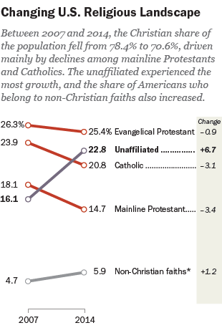

Slide 27
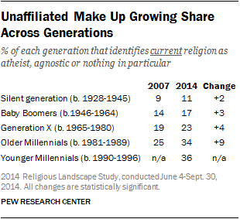

Slide 28
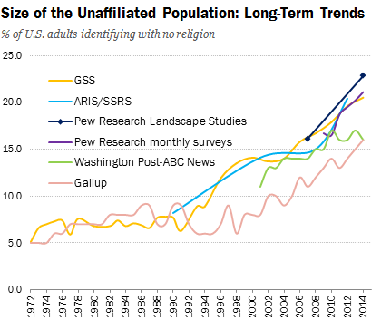

Slide 29
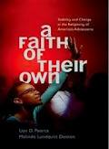
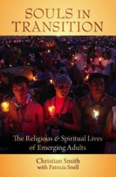
Youth & Young Adults
Youth (teens)
Abiders Adapters Assenters Avoiders Atheists
20% 20% 31% 24% 5%
Emerging Adults (20s)
Committed Selected Spiritually Religiously Religiously Irreligious
Traditionalists Adherents Open Indifferent Disconnected
15% 30% 15% 25% 5% 10%

Slide 30
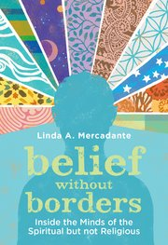
Types of SBNR People
Dissenters are people who largely stay away from institutional religion (“protesting dissenters” or “drifted dissenters”)
Casuals are people whose religious or spiritual practices are primarily functional (makes me feel better).
Explorers are like spiritual tourists who enjoy the journey but do not plan to settle anywhere (theological hybrids).
Seekers are searching for a spiritual home (reclaiming an earlier religious identities or moving on to something new).
Immigrants have moved to a new spiritual “land” and are trying to adjust to this new identity and community (tension between commitment, constancy, and group loyalty – and SBNR ethos of independence, freedom, non-dogmatism, and an open and questing attitude).

Slide 31
Catholic Family Study (CARA, 2015)
Do any of your children currently attend…
A Catholic elementary or middle school: 8%
A Catholic high school: 3%
A parish-based Catholic religious education program: 21%
A youth ministry program: 5%
None of the above: 68%

Slide 32
Religious Diversity
Not Religiously Affiliated
Spiritual but Not Religious
Minimal Engagement with Faith and Community
Vibrant Faith & Active Engagement

Slide 33
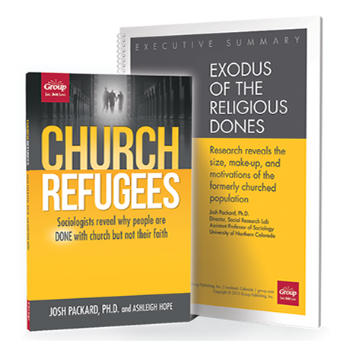

Slide 34
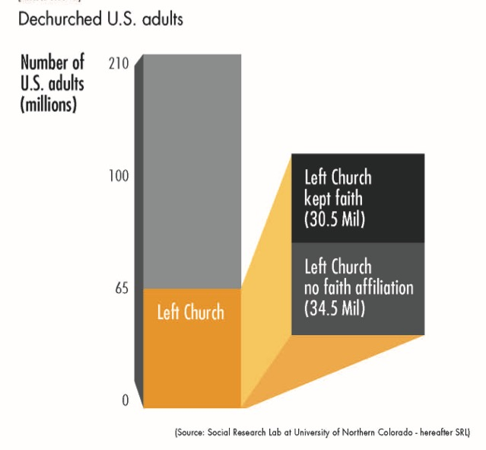

Slide 35
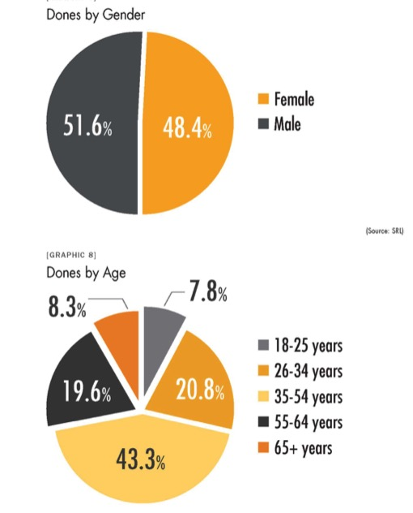

Slide 36
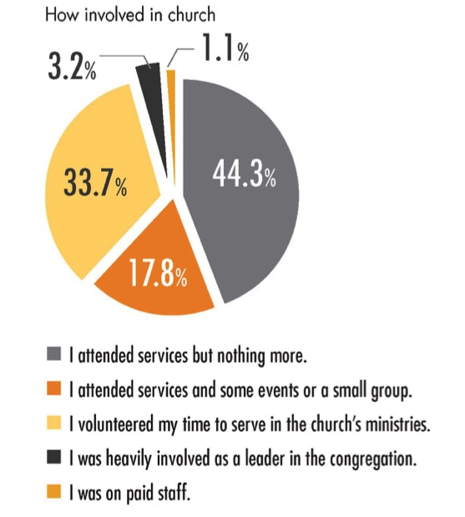

Slide 37
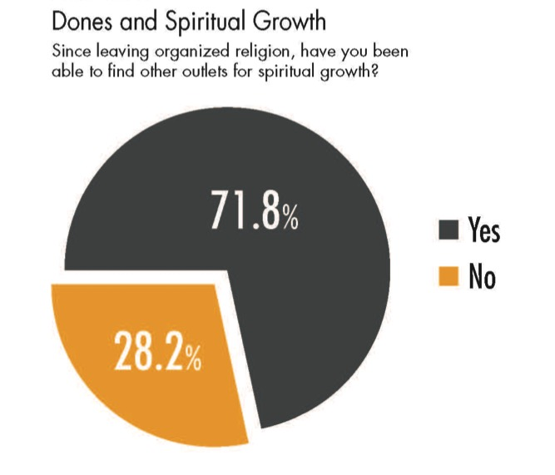

Slide 38
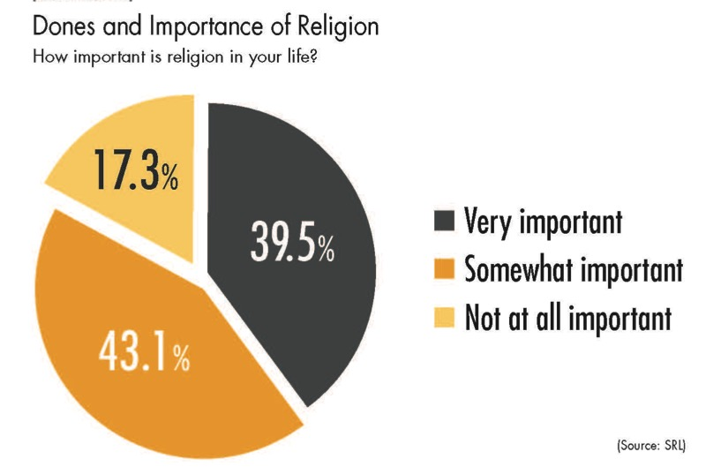

Slide 39
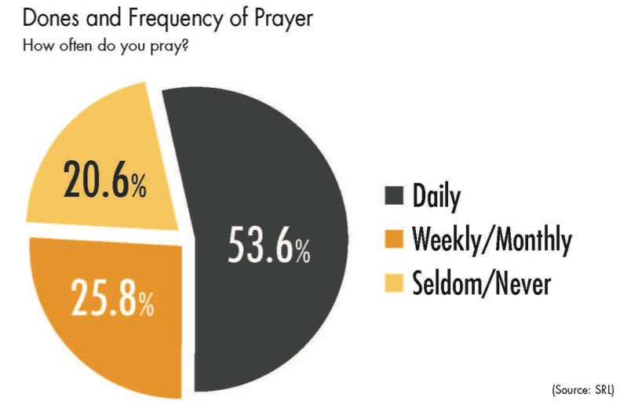

Slide 40
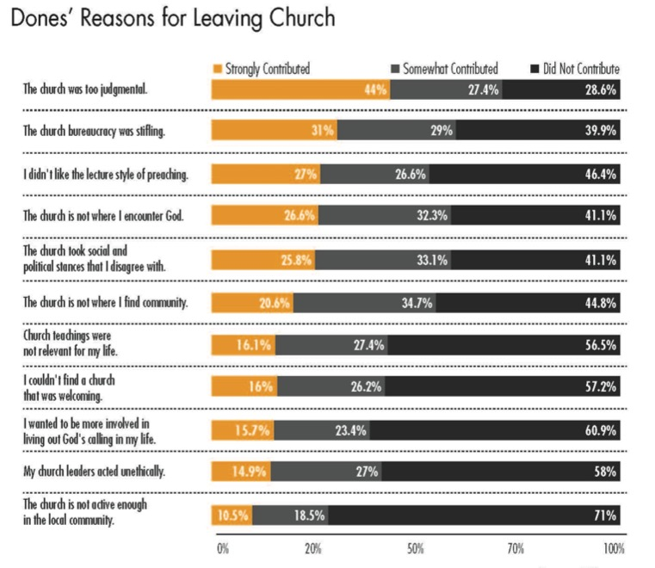

Slide 41
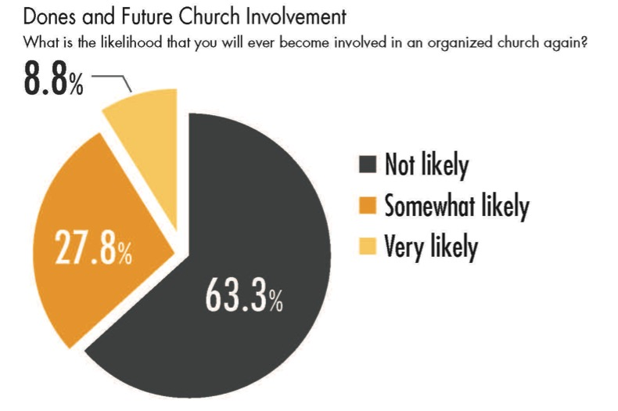

Slide 42
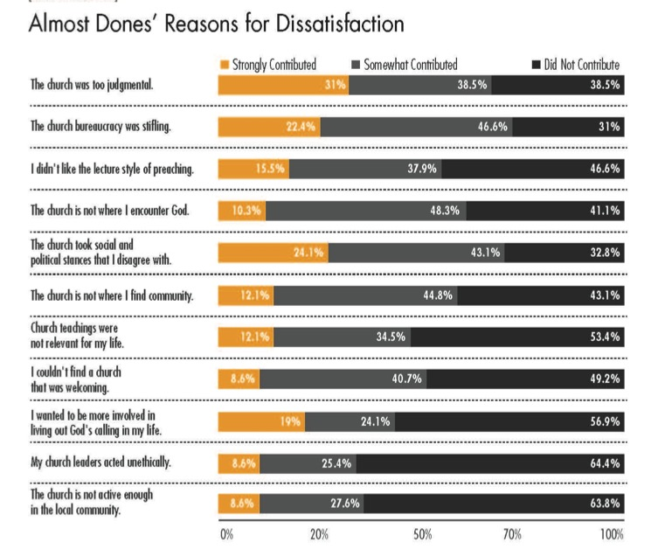

Slide 43
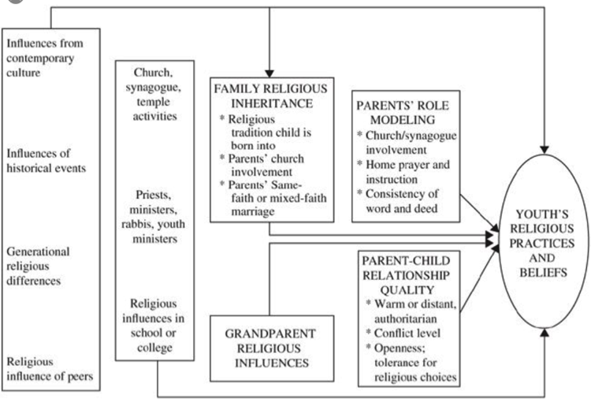
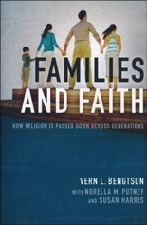
Religious Transmission

Slide 44
Religious Transmission
“Emerging adults who grew up with seriously religious parents are through socialization more likely (1) to have internalized their parents religious worldview, (2) to possess the practical religious know-how needed to live more highly religious lives, and (3) to embody the identity orientations and behavioral tendencies toward continuing to practice what they have been taught religiously.”

Slide 45
Religious Transmission
“At the heart of this social causal mechanism stands the elementary process of teaching—both formal and informal, verbal and nonverbal, oral and behavioral, intentional and unconscious, through both instruction and role modeling. We believe that one of the main ways by which empirically observed strong parental religion produced strong emerging adult religion in offspring is through the teaching involved in socialization.”
(Souls in Transition: The Religious & Spiritual Lives of Emerging Adults by Christian Smith with Patricia Snell)

Slide 46
Analysis

Slide 47
Generational Transition
Younger generations more unaffiliated and less involved in faith communities
Older generations more affiliated and more involved and supportive
Generational transition: as younger generations replace the older generations there will be fewer engaged and more unaffiliated

Slide 48
Importance of Religion
40% of the “no religion in particular” say it is “very” or “somewhat” important in their lives
The overwhelming majority of religiously unaffiliated believe in God
Less about people “losing their religion” than dissatisfaction with available institutional options
Young generations seem allergic to large-scale institutions that demand not only spiritual allegiance but financial commitment. None of these things are “religion” for these people.

Slide 49
Importance of Religion
Corporate, mega-church dominated models of religious & spiritual activity are starting to be replaced by smaller, more locally oriented church communities, and by larger churches that attract the masses for a spiritual or musical performance, and a sense of belonging to something much larger than themselves.
Young people are looking for intimacy and personal connections, deep spiritual experiences, service to others, and the opportunity to create their own community.

Slide 50
Importance of Religion
Religion is not going away anytime soon, regardless of how people may identify themselves. But business as usual among existing religious institutions will not stem the losses we are seeing.
(Richard Flory, USC)
(http://religiondispatches.org/u-s-christianity-is-dead-long-live-u-s-christianity)

Slide 51
Religious Transmission
Value & religious transmission is a family affair (research by Bengston & Smith)
Families can transmit a particular religious faith tradition or not
Declining levels of family religious transmission and faith practice at home are a result of non-affiliation
1st generation & 2nd generation
If the pattern continues, expect higher levels of non-affiliation and lower levels of church involvement in younger families

Slide 52
Concluding Thought
The world is now changing at a rate at which the basic systems, structures, and cultures built over the past century cannot keep up with the demands being placed on them. Incremental adjustments to how you manage and strategize, not matter how clever, are not up to the job. You need something very new to stay ahead in a age of tumultuous change and growing uncertainties.
(John Kotter, Accelerate: Building Strategic Agility for a Faster-Moving World

