Slide 1
Reimaging faith formation for the 21st Century
Topic 1
A Faith Forming Ecosystem
Presenter: John Roberto

Slide 2
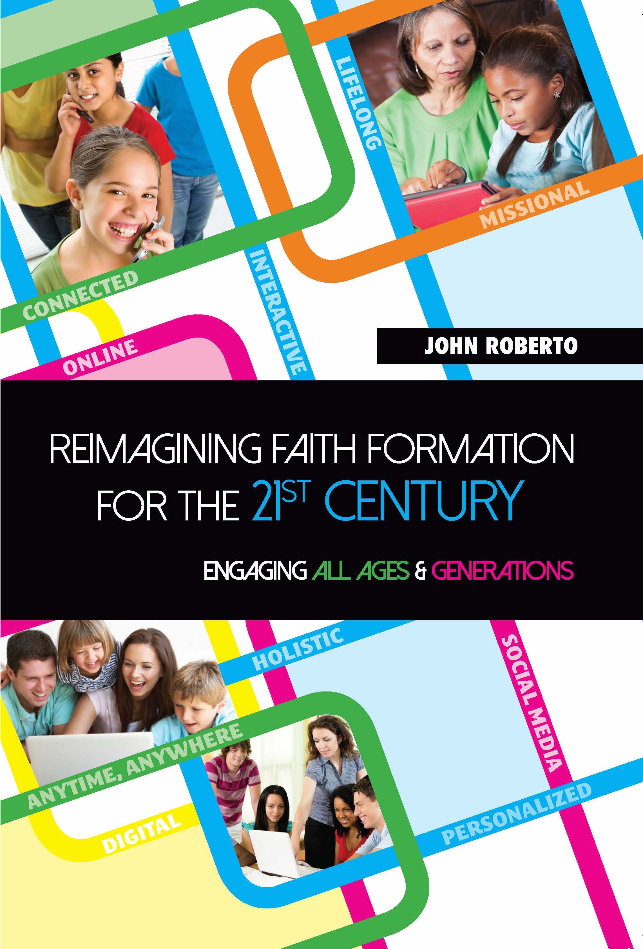
Lifelong faith Books

Slide 4
Not Just an Era of Change but a Change of Eras

Slide 5
Accelerating change
The world is now changing at a rate at which the basic systems, structures, and cultures built over the past century cannot keep up with the demands being placed on them. Incremental adjustments to how you manage and strategize, no matter how clever, are not up to the job. You need something very new to stay ahead in a age of tumultuous change and growing uncertainties.
(John Kotter, Accelerate: Building Strategic Agility
for a Faster-Moving World

Slide 6
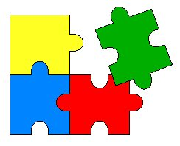
Changing Ecosystem of Faith



Slide 7
Four Perspectives on our changing world
Social
Generational
Religious/Spiritual
Educational

Slide 8
4 Big Adaptive Challenges
Increasing diversity throughout society in the length of the lifespan, in generational identities, in family structures and marriage patterns, and in ethnic makeup
Rise of new digital technologies that are reshaping society, and the emergence of a connected, networked society
Dramatic changes and increasing diversity in the religious beliefs, practices, and affiliation of Americans
Decline in religious transmission from generation to generation

Slide 9
Life Span Diversity
0-10
50s
20s
30s
40s
60s
70s
80s
90s
11-19

Slide 10
Five Generation Diversity
iGeneration (2000-
Millennials (1980-99)
Generation X (1961-1979)
Builders (before 1946)
Baby Boomers (1946-60)
Relationship to Institutions
Relationship to Authority
Family Relationships
Work-Life Balance
Communication Style
Technology Usage
Learning Style
Spiritual Expression
Worship Style

Slide 11
Family Diversity
Married Couples with no children
Married Couple with Children (biological family)
Married Couple with Children (blended family)
Single Parent with Children
Unmarried Couple with Children
Unmarried Couple without Children
Same Sex Couple with Children (married / unmarried)
Same Sex Couple without Children (married / unmarried)
Grandparents & Parents with Children
Grandparents as Primary Caregivers
Parents with Single Young Adults Living at Home

Slide 12
Spiritual-Religious Diversity
The Unaffiliated
The Spiritual
The Occasional
The Active

Slide 13
Spiritual-Religious Diversity
Church too judgmental
Church bureaucracy
Lecture style of preaching
Church is not where I encounter God
Social & political stances of the church
Church is not where I find community
Couldn’t find a church that was welcoming
I wanted to be more involved in living out God’s calling in my life

Slide 14
Spiritual-Religious Diversity
Dissenters are people who largely stay away from institutional religion (“protesting dissenters” or “drifted dissenters”)
Casuals are people whose religious or spiritual practices are primarily functional (makes me feel better).
Explorers are like spiritual tourists who enjoy the journey but do not plan to settle anywhere (theological hybrids).
Seekers are searching for a spiritual home (reclaiming an earlier religious identities or moving on to something new).
Immigrants have moved to a new spiritual “land” and are trying to adjust to this new identity and community (tension between commitment, constancy, and group loyalty – and SBNR ethos of independence, freedom, non-dogmatism, and an open and questing attitude).

Slide 15
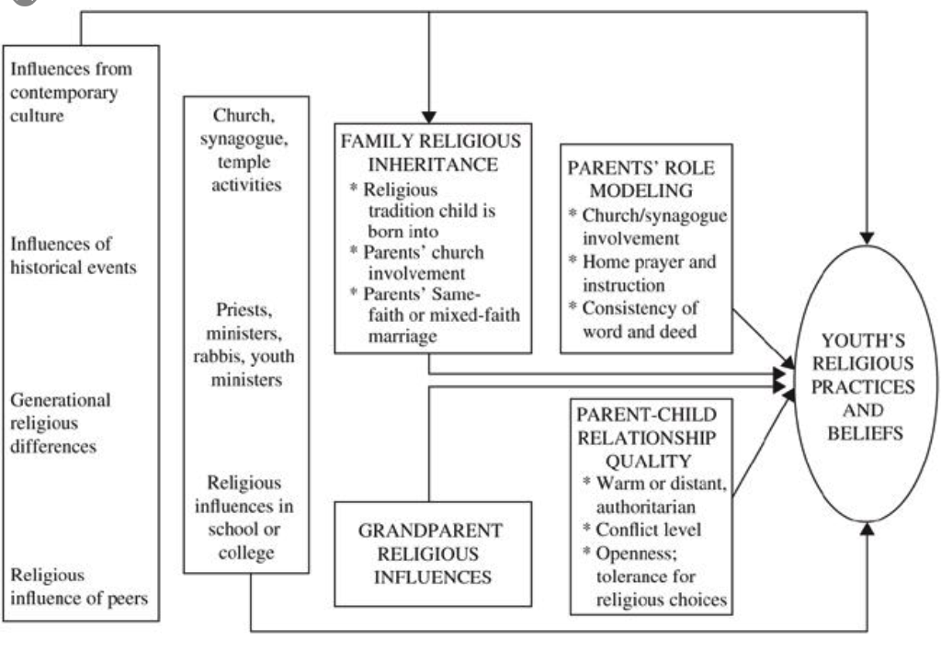
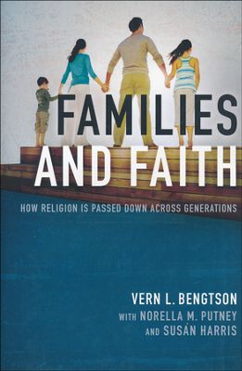
Religious Transmission

Slide 16
Religious Transmission
Value & religious transmission is primarily a family affair. Families can transmit a religious faith tradition or not.
Keys:
Family Religious Inheritance
Grandparents
Parental Role Modeling
Parent-Child Relationship

Slide 17
Why These Trends will continue
Younger generations more unaffiliated and less involved in faith communities
Older generations more affiliated and more involved and supportive
Generational transition: as younger generations replace the older generations there will be fewer engaged and more unaffiliated

Slide 18
Why These Trends will continue
Declining levels of family religious transmission and faith practice at home are a result of non-affiliation.
1st generation & 2nd generation
If the pattern continues, expect higher levels of non-affiliation and lower levels of church involvement in younger families.

Slide 19
Why these trends will continue
Increase in individualism – more focus on the self, less on others and society. Religious affiliation is low when the culture is high in individualism and low in social support.
Increase in religious pluralism—questioning or minimizing of all faiths.
Increase in diversity

Slide 20
Religion is not going away anytime soon, regardless of how people may identify themselves. But business as usual among existing religious institutions will not stem the losses we are seeing.
(Richard Flory, USC)
(http://religiondispatches.org/u-s-christianity-is-dead-long-live-u-s-christianity)

Slide 21
Imagining a new future The Ecosystem

Slide 22
Ecosystem
A system, or group of interconnected elements, formed by the interaction of a community of organisms with their environment
Science defines an ecosystem as being a community where organisms interact with one another and with their physical environment.
Every organism has a role to fulfill and there must be a harmonious balance between all aspects of the ecosystem in order for the organisms to flourish and evolve.

Slide 23
The “Old” Faith Forming Ecosystem
Church
Family
Ethnic Traditions
Community
Religious School or Sunday School

Slide 24
Building a New Faith Forming Ecosystem
Intergenerational Faith Community
Age Group/Generational Faith Formation
Family Faith Formation
Missional Faith Formation
Online & Digitally-Enabled Faith Formation

Slide 25
Eight Faith Forming Process for lifelong faith formation
GROWTH IN FAITH
Caring Relationships
Rituals & Milestones
Church Year Seasons
Worshipping
Learning the Tradition
Praying
Spiritual Formation
Reading the Bible
Serving Working for Justice Caring for Creation

Slide 26
Intergenerational Faith Formation
Intergenerational faith formation and whole community faith experiences are at the center of faith formation – engaging all ages and generations in the life and events of church life and the Christian faith and participation in intergenerational faith experiences.
How to become intentionally intergenerational in church life & faith formation as the foundation for lifelong faith formation and discipleship?

Slide 27
Intergenerational Faith Formation
Throughout Scripture there is a pervasive sense that all generations were typically present when faith communities gathered for worship, for celebration, for feasting, for praise, for encouragement, for reading of Scripture, in times of danger, and for support and service. . . . To experience authentic Christian community and reap the unique blessings of intergenerationality, the generations must be together regularly and often—infants to octogenarians.
(Allen and Ross, Intergenerational Christian Formation)

Slide 28
Intergenerational Faith Formation
Caring Relationships
Celebrating
Learning
Praying
Serving
Create intergenerational experiences
Infuse intergenerational experiences & relationships into existing ministries & programs
Connect generations

Slide 29
Family Faith Formation
Faith formation recognizes that parents and the family are the most powerful influence for virtually every child and youth outcome—personal, academic, social, and spiritual-religious; and that parents are the most important influence on the social and religious lives of children, youth, and emerging adults.
Given the central role of families in shaping the lives of children and youth, the value of engaging, supporting, and educating families should be self-evident to all of us.

Slide 30
Family faith formation
Seeing the home as the essential & foundational environment for faith nurture, faith practice, and the healthy development of young people.
Building faith formation around the lives of the today’s families and parents, rather than having the congregation prescribe the programs and activities that families will participate in.
Church Life & Ministries
Family & Parents
Community

Slide 31
Family Faith Formation
Discovering God in Everyday Life
Forming Faith at Home through the Life Cycle
Forming Faith through Milestones
Celebrating Seasonal Events through the Year
Encountering God in the Bible through the Year
Connecting Families Intergenerationally
Developing a Strong Family Life
Empowering Parents and Grandparents

Slide 32
Life Cycle Faith Formation
Age group and generational faith formation addresses the unique life tasks, needs, interests, and spiritual journeys of people at each stage of life.
Intergenerational Faith Community
Children & Parents
Youth & Parents
Young Adults
Mid-life Adults
Mature Adults
Older Adults

Slide 33
Eight Faith Forming Process for lifelong faith formation
GROWTH IN FAITH
Caring Relationships
Rituals & Milestones
Church Year Seasons
Worshipping
Learning the Tradition
Praying
Spiritual Formation
Reading the Bible
Serving Working for Justice Caring for Creation

Slide 34
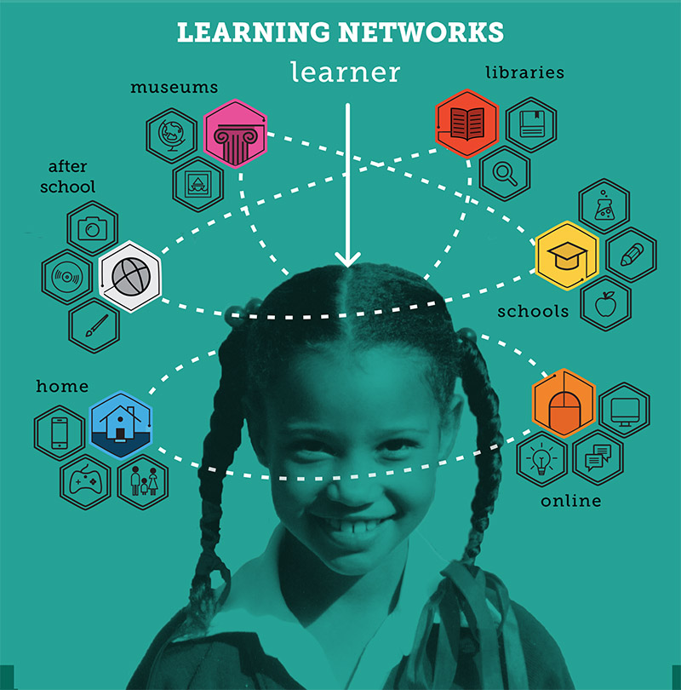

Slide 35
Missional Faith Formation
Missional faith formation expands and extends the church’s presence through outreach, connection, relationship building, and engagement with people where they live—moving faith formation out into the community. For example:
Moving worship and faith formation into the community
Opening programs to everyone
Life skills: parenting, careers, training, mentoring
Small group programs on a variety of topics
Community-wide service
Community events: arts, music, theater

Slide 36
Missional Faith Formation
Missional faith formation provides pathways for people to consider or reconsider the Christian faith, to encounter Jesus and the Good News, and to live as disciples in a supportive faith community.

Slide 37
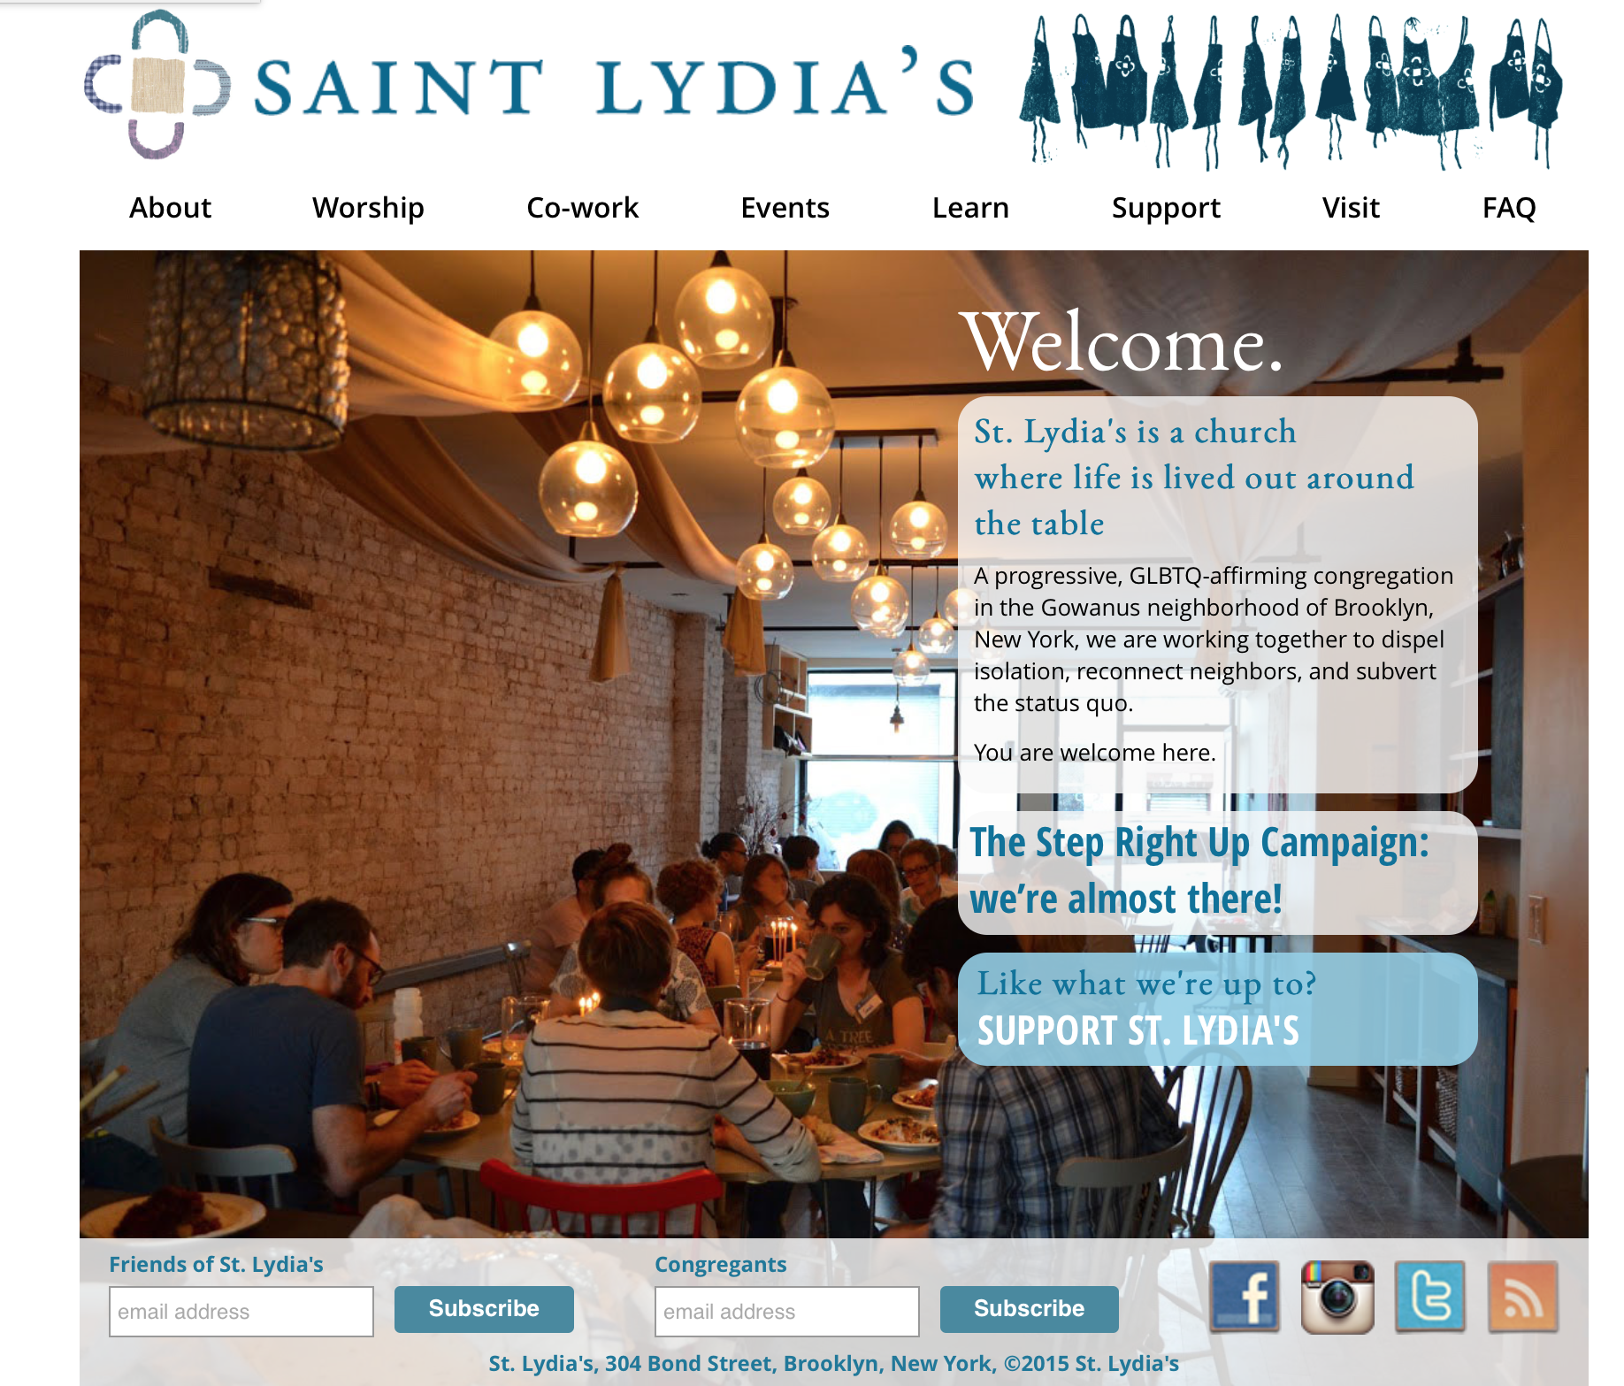

Slide 38
Imagining a new future The Network

Slide 40
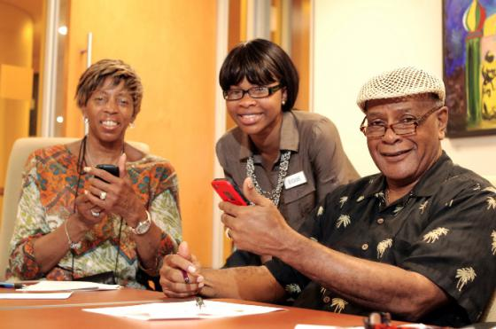
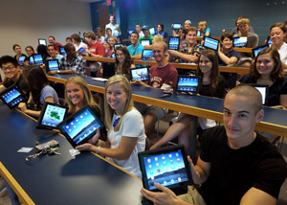

Slide 41
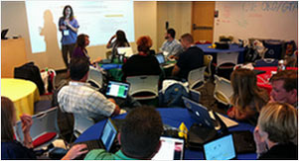
A shift from education to learning anywhere, anytime.
A shift from consumption of information to participatory learning.
A shift from institutions to networks.

Slide 42
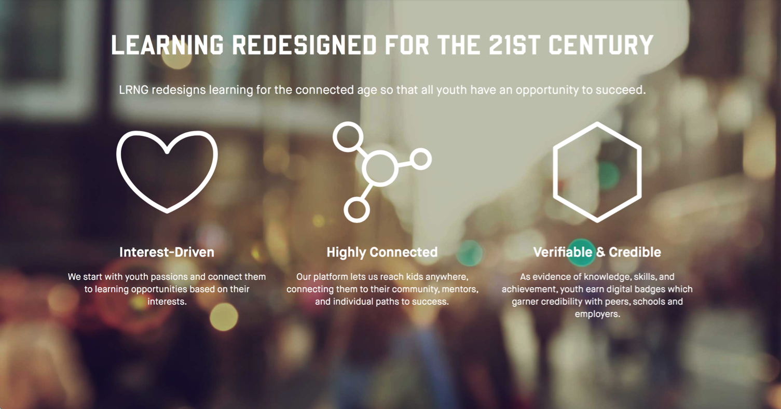

Slide 44
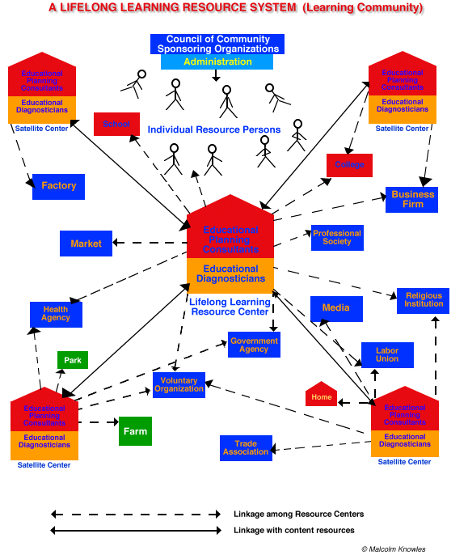

Slide 46
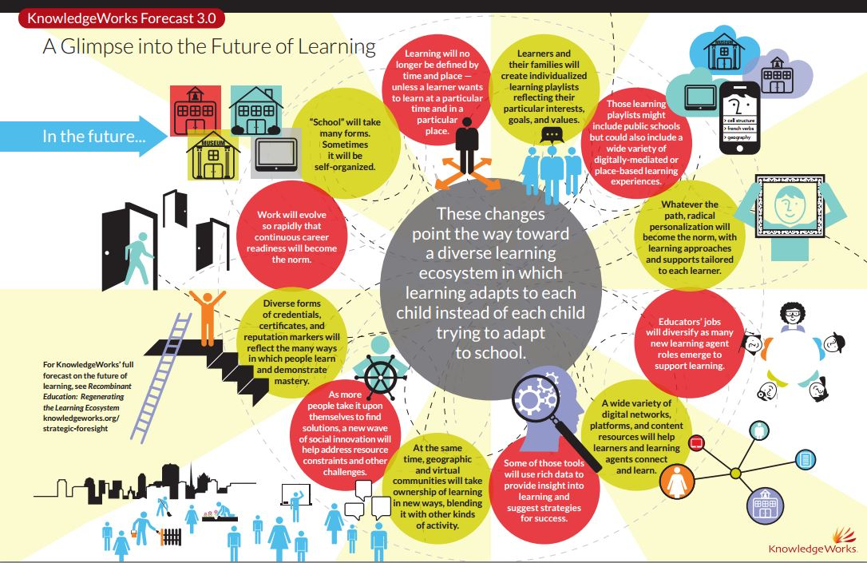

Slide 47
A Network Approach to Learning
Bible
Course
Online course
Book
Mentor
Video Program
Bible study group
Bible app
Audio book/podcast
Organize a study group

Slide 48
Faith Formation Networks
A network of relationships, content, experiences, & resources. . . .
Offering a variety of content, methods, formats, and delivery systems (online & physical settings) to address the diverse life tasks and situations, needs and interests, and spiritual and faith journeys of people.
Offering content and experiences that is responsive to the diverse religious and spiritual needs of people today—from the spiritually committed and engaged to the spiritual but not religious and the unaffiliated.
Offering multiple environments to address people’s busy lives and providing more ways to participate: self-directed, mentored, at home, in small groups, in large groups, church-wide, in the community, and in the world.

Slide 49
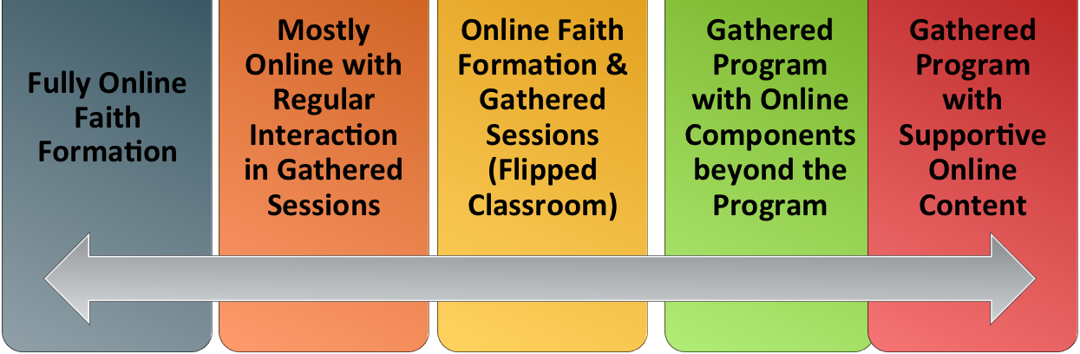
Faith Formation Networks
Blending gathered community settings with online learning environments and utilizing the abundance of digital media and tools for learning & faith formation

Slide 50
Faith formation Network: Content
GROWTH IN FAITH
Caring Relationships
Rituals & Milestones
Church Year Seasons
Worshipping
Learning the Tradition
Praying
Spiritual Formation
Reading the Bible
Serving Working for Justice Caring for Creation

Slide 51
Faith Formation Network: Content
Faith Community
Content Area
Content Area
Content Area
Content Area
Content Area
Content Area
Caring Relationships
Celebrating the Seasons
Celebrating Rituals & Milestones
Learning the Christian Tradition
Praying & Spiritual Formation
Reading the Bible
Serving, Working for Justice, & Caring for Creation
Worshipping God
Life Stage Issues
Missional

Slide 52
Faith Enrichment
Sunday Worship
Adult Faith Formation Network
Grand-parents
Spiritual Enrichment
Life Issues & Milestones
Scripture Enrichment
Liturgical Seasons
Service & Mission
Discovering Faith

Slide 53
Sample Themes –Adults
Dealing with retirement
Making life plans, finances, health
Becoming a grandparent
Making a difference in the community and world
Incorporating family changes and transitions
New ways of living and relating as a married couple
Caring for aging parents
Taking time to read the Bible and learn more about my faith
Growing spiritually; spirituality for the 2nd half of life
Connecting with people my age; talking about things that matter
Dealing with loss

Slide 54
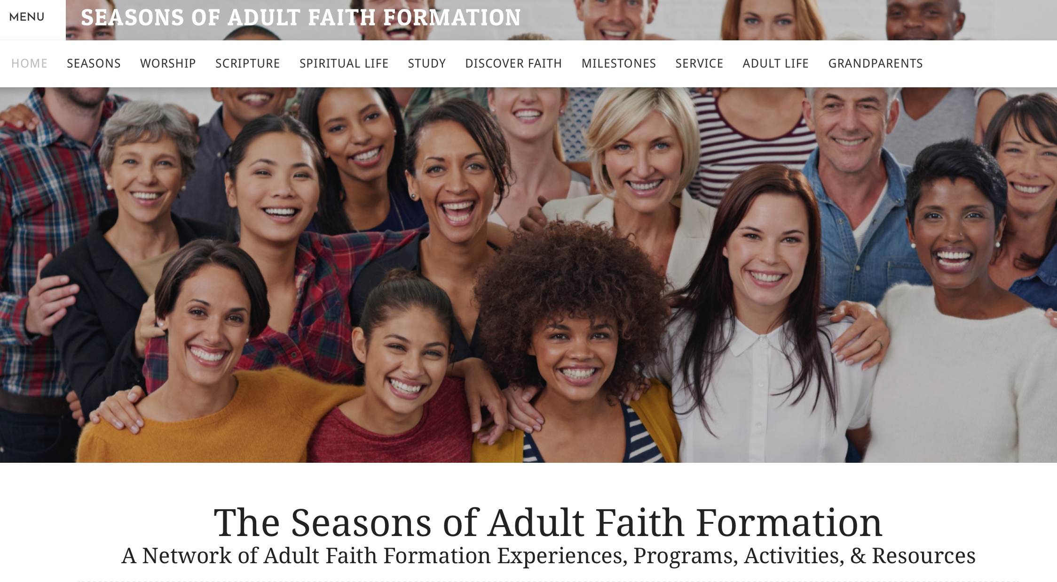
TheSeasonsofAdultFaithFormation.com

Slide 55
Faith Formation Playlists
Content Area
Activity 1
Resource
Resource
Activity 3
Resource
Resource
Activity 2
Resource
Resource

Slide 56
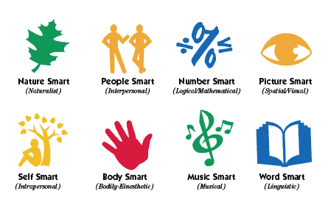
Faith Formation Playlists
Variety of Environments: Self-directed, mentored, at home, in small groups, in large groups, church-wide, in the community, and in the world.
Variety of Ways
to Learn

Slide 57
Adult Faith Formation Playlist
Spiritual Enrichment
Online Courses
Retreats
Small Group Bible Study
Spiritual Book of the Month
Spiritual Practices Series
Apps & E-newsletters
Day at the Monastery
Online Prayer & Spirituality
Resource
Resource
Resources
Resources
Resource
Resource
Resource
Resource

Slide 58
Adult Faith Formation Playlists
Playlists are thematic learning plans that integrate a variety of ways to learn, multiple learning environments, and online and physical spaces—from which people can create their own faith formation plan.
Example: Spiritual Enrichment for Adults
Theme: “Spiritual Practices”
Spiritual Practices Course (5 sessions at church in one month)
Spirituality Over 50 Book Group (variety of times & places)
Online Daily Devotion Resources
Online Prayer Practices Resources
Online Course or Retreat with a Spiritual Master
Online Retreat

