Slide 1

Reimaging faith formation for the 21st Century
Topic 3
Family Faith Formation
Presenter: John Roberto

Slide 2
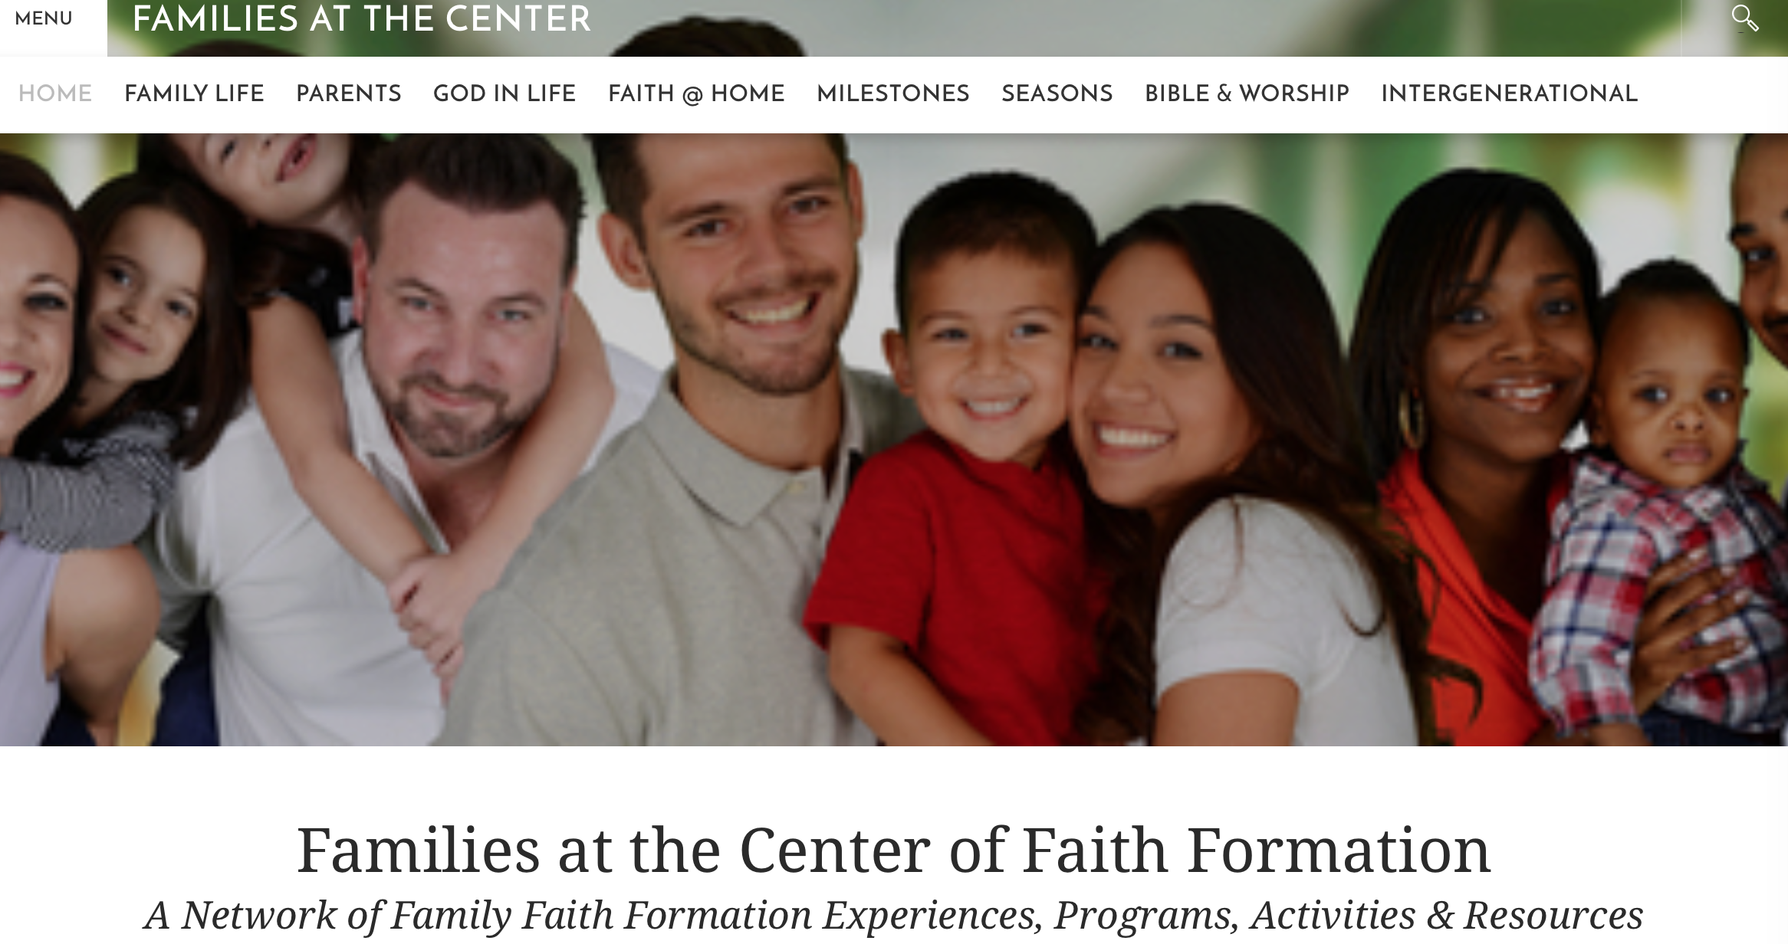
FamiliesAtTheCenter.com

Slide 3
The Changing family

Slide 4
The Changing Family
Married Couple with no children
Married Couple with Children (biological family)
Married Couple with Children (blended family)
Single Parent with Children
Unmarried Couple with Children
Unmarried Couple without Children
Same Sex Couple with Children (married/unmarried)
Same Sex Couple without Children (married/unmarried)
Grandparents & Parents with Children
Grandparents as Primary Caregivers
Parents with Single Young Adults Living at Home

Slide 5
Changing Parenting Styles
Parents Have Generational Parenting Styles
In general Gen X parents approach child-rearing as a set of tangible practices that will keep their children safe, reasonably happy, well-behaved, and ready to take on life’s challenges. They practice protective parenting.

Slide 6
Changing Parenting Styles
Parents Have Generational Parenting Styles
In general, Millennial parents, reflecting their values of individuality and self-expression, focus more on a democratic approach to family management, encouraging their children to be open-minded, empathetic, and questioning—and teaching them to be themselves and try new things. They are moving away from the overscheduled days of their youth, preferring a more responsive, less directorial approach to activities. (Responsive Parenting)

Slide 7
Changing Parental religiosity
Parents Have a Diversity of Spiritual-Religious Identities
Parents reflect an increasing diversity in religious beliefs, practices, and affiliation.
Increasing numbers are not religiously affiliated and the number of unaffiliated Millennials is growing.
Families of Generation X and Millennial parents are participating less in church life and Sunday worship. Religion and spirituality may be important to families today, but for many it is not usually expressed by participation in churches.

Slide 8
Changing family religiosity
Unaffiliateds
Occasionals
(Minimal Engagement with Faith and Community)
Spirituals
(but Not Religious)
Actives
(Vibrant Faith
& Active Engagement)

Slide 9
CHANGING RELIGIOUS TRANSMISSION
Religious Socialization & Transmission Is More Complex.
Significant indicators, such as religious identification as a Christian, worship attendance, marriages and baptisms in the church, and changing generational patterns, point to a decline in family religious socialization across all denominations.
There is also a decline in religious traditions and practices at home. Younger parents often lack the religious literacy and religious experiences necessary for faith transmission.

Slide 10
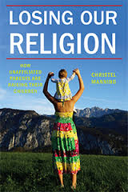
Changing religious transmission
Religious Socialization & Transmission Is More Complex
In her book Losing Our Religion: How Unaffiliated Parents Are Raising their Children identifies four distinct worldviews among unaffiliated parents:
      Secular (believes there is no God that influences the world or human life)
      Seeker Spirituality (believes there is no God but there is a higher power or life force)
      Unchurched Believer (believes in a personal God who listens and can intervene in human affairs; and prays or attends services)
      Indifferent (no beliefs or practices).

Slide 11
Changing religious transmission
She identifies 5 different strategies that parents use to incorporate religion in the lives of their children.
Nonprovision
Outsourcing: These are parents who rely on other people to incorporate religion into their children’s life.
Self-provision: These are parents who try to incorporate religion into their children’s upbringing without institutional support.
Alternative: These are parents who were unaffiliated before they had children and reported searching for and eventually affiliating with a community.
Traditional: These are parents who after having children return to the community they were raised in and re-affiliate, enroll a child in conventional religious education program, and incorporate religion in the home.

Slide 12
Changing religious transmission
Manning found that in most cases, there was a great deal of consistency between the parent’s religious or secular identity and how they raised their children.
She observes, “the fact that most parents in the study took steps to incorporate religion into the lives of their children is surprising only if we take None to mean the absence of any religious, spiritual, or philosophical worldview. Once we discover the more substantive dimensions of unaffiliated parents’ worldviews, we see that they transmit those beliefs and practices to their children much as affiliated parents do.”

Slide 13
Faith & Families

Slide 14
What are the practices that make a difference in faith transmission?
Parents’ personal faith and practice
Parent-child relationship: close, warm
Parents’ modeling and teaching a religious faith
Parents’ involvement in church life
Grandparents’ religious influence & relationship
Religious tradition a child is born into
Parents of the same faith
Family conversations about faith
Embedded family religious practices

Slide 15
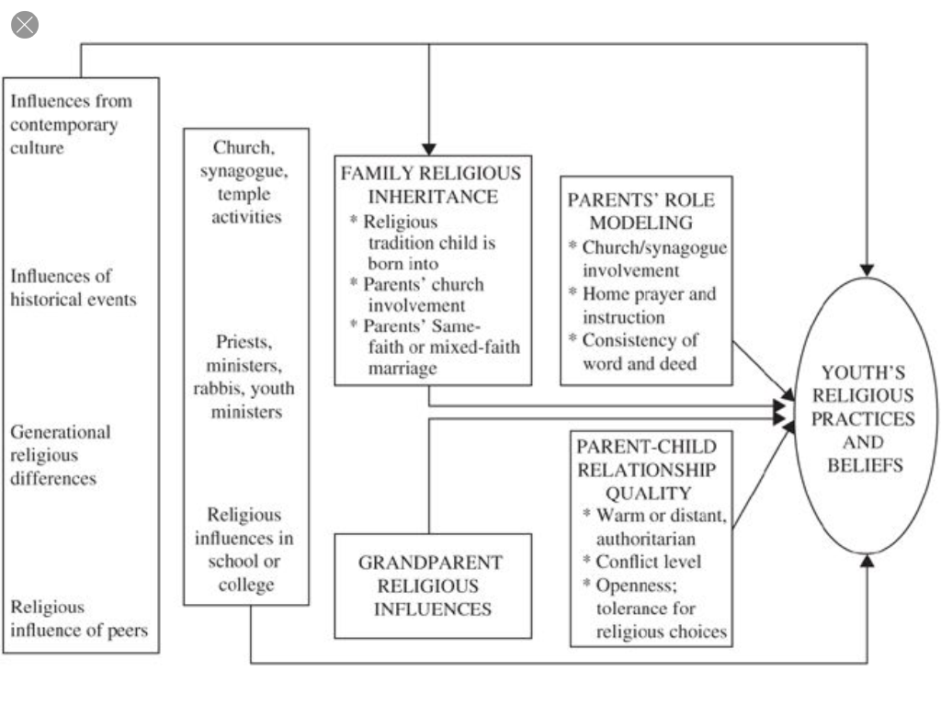
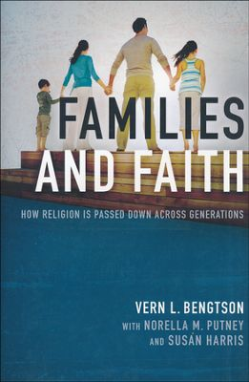
What are the practices that make a difference?

Slide 16

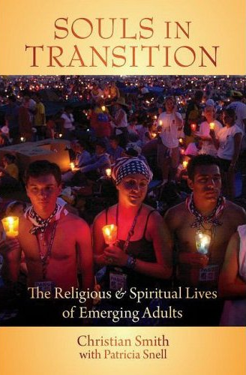
What are the practices that make a difference?
    85% chance of being Highly Religious as an emerging adult if you were in the top 25% on the scales of:
    parental religion
    prayer
    importance of faith
    Scripture reading

Slide 17
What are the practices that make a difference?
Approximately 70% of youth who at some time or other before mid-emerging adulthood commit to live their lives for God, the vast majority appear to do so early in life, apparently before the age of 14.
Most make their first commitments to God as children or during the preteen or very early teen years.
Many religious trajectories followed in the course of life’s development seemed to be formed early on in life.

Slide 18
What are the practices that make a difference?
“Emerging adults who grew up with seriously religious parents are through socialization more likely (1) to have internalized their parents religious worldview, (2) to possess the practical religious know-how needed to live more highly religious lives, and (3) to embody the identity orientations and behavioral tendencies toward continuing to practice what they have been taught religiously.”
(Christian Smith & Patricia Snell)

Slide 19
What are the practices that make a difference?
“At the heart of this social causal mechanism stands the elementary process of teaching—both formal and informal, verbal and nonverbal, oral and behavioral, intentional and unconscious, through both instruction and role modeling. We believe that one of the main ways by which empirically observed strong parental religion produced strong emerging adult religion in offspring is through the teaching involved in socialization.”
(Souls in Transition: The Religious & Spiritual Lives of Emerging Adults by Christian Smith with Patricia Snell)

Slide 20

What are the practices that make a difference?
Parental Faith Life & Practice
Family Harmony
Parental Affection toward Children
Parental Help with Problems

Slide 21
What are the practices that make a difference?
Parents possess and practice a vital and informed faith – understanding the Christian faith, participating in worship, praying, and engaging in service and mission.
Family members’ expressions of respect and love create an atmosphere promoting faith.
Parents engage youth and the whole family in conversations, prayer, Bible reading, and service that nurture faith and life.

Slide 22
What are the practices that make a difference?
How have your parents influenced your faith life?
Values are focused on serving others and God.
Positive influence on my religious faith
Talk with me about my relationship with Jesus Christ
Attending Sunday worship
Talked with my parent about religious faith
Reading the Bible

Slide 23
What are the practices that make a difference?
“Effective religious socialization comes about through embedded practices; that is, through specific, deliberate religious activities that are firmly intertwined with the daily habits of family routines, of eating and sleeping, of having conversations, of adorning spaces in which people live, of celebrating the holidays, and of being part of a community. Compared with these practices, the formal teachings of religious leaders often pale in significance. Yet when such practices are present, formal teachings also become more important.”
(Robert Wuthnow, Growing Up Religious).

Slide 24
What are the practices that make a difference?
Eating together – especially the power of Sunday meals and holidays
Praying – bedtime rituals and prayer, grace before meals
Having family conversations, talking about God
Displaying sacred objects and religious images, especially the Bible
Celebrating holidays and rituals
Providing moral instruction
Engaging in family devotions and reading the Bible
Serving others

Slide 25
What are the practices that make a difference?
“The daily round of family activities must somehow be brought into the presence of God. Parents praying, families eating together, conversations focusing on what is proper and improper, and sacred artifacts are all important ways in which family space is sacralized. They come together, forming an almost imperceptible mirage of experience.”
(Robert Wuthnow, Growing Up Religious)

Slide 26
Families at the Center

Slide 27
Transforming Our Narrative
How do we engage meaningfully with today’s complex and diverse families?
How do families transmit faith at home to the next generation in today’s world?
What does a vibrant family faith look like?

Slide 28
Transforming our narrative
From an emphasis on. . . .
Toward an emphasis on. . . .
Programs
Parenting as a strategy
Pathologizing or idealizing families
“Passing on” the faith
Serving families
Congregation-centered ministries
Relationships
Parenting as a relationship
Tapping their strengths and resilience
“Living into” the faith
Empowering families
Community-centered ministries

Slide 29
Transforming Our Narrative:
Families at the Center
Church Life & Ministries
Family & Parents
Community
Seeing the home as the essential & foundational environment for faith nurture, faith practice, and the healthy development of young people.
Building faith formation around the lives of the today’s families and parents, rather than having the congregation prescribe the programs and activities that families will participate in.

Slide 30
Transforming Our Narrative:
Families at the Center
The Family-at-the Center Approach recognizes that parents and the family are the most powerful influence for virtually every child and youth outcome—personal, academic, social, and spiritual-religious; and that parents are the most important influence on the social and religious lives of children, youth, and emerging adults. Given the central role of families in shaping the lives of children and youth, the value of engaging, supporting, and educating families should be self-evident to all of us.

Slide 31
Transforming Our Narrative:
Families at the Center
See the home as the essential and foundational environment for faith nurture, faith practice, and the healthy development of young people.
Reinforce the family’s central role in promoting healthy development and faith growth in children and youth, and enhancing the faith-forming capacity of parents and grandparents.
Build faith formation around the lives of the today’s families and parents, rather than having the congregation prescribe the programs and activities that families will participate in.

Slide 32
Transforming Our Narrative:
Families at the Center
Address the diversity of family life today by moving away from “one size fits all” programs and strategies toward a variety of programs and strategies tailored to the unique life tasks and situations, concerns and interest, and religious-spiritual journeys of parents and families.
Overcome the age-segregated nature of church and its programming by engaging parents and the whole family in meaningful intergenerational relationships and faith formation that involves all ages and families.

Slide 33
Transforming Our Narrative:
Families at the Center
Build upon the assets, strengths, and capacities present in parents and families, rather than focusing on their deficits and solving problems.
Partner with parents in working toward shared goals and aspirations for their young people by supporting, equipping, and resourcing them.

Slide 34
Transforming Our Narrative:
The Family as School of Discipleship
It is in the domestic household that we eat, sleep, bathe, get dressed, relax and converse with others. In the context of the household we learn basic social conventions, from table manners to the demands of hospitality toward guests. In the household we learn how to be accountable for our lives; we learn when we are expected for dinner (or to prepare dinner); we learn what chores and other miscellaneous responsibilities are assigned to us and how the smooth functioning of the household depends on the fulfillment of those chores and responsibilities. More importantly, in many households we learn about the possibilities for committed, appropriately vulnerable relationship with others and the privileges and responsibilities that those relationships bring. It is in this nexus of patterned relationships which constitutes the household that we can better understand the image of the Christian household as a “school of discipleship.”
(Richard Gaillardetz)

Slide 35
Families at the Center:
Eight Strategies
Discovering God in Everyday Life
Forming Faith at Home through the Life Cycle
Forming Faith through Milestones
Celebrating Seasonal Events through the Year
Encountering God in the Bible through the Year
Connecting Families Intergenerationally
Developing a Strong Family Life
Empowering Parents and Grandparents

Slide 36
Families at the Center:
Contextualizing our Strategies
Diversity of Family Forms: no dominant family form in U.S.
Variety of Spiritual-Religious Identities:
Engaged-----Occasionals-----Spirituals-----Unaffiliated
Generational Parenting Approaches
Diversity of Ethnicities: distinctive ethnic identities, histories, and religious traditions and practices

Slide 37
FamiliesAtTheCenter.com

Slide 38

#1. Discovering God in Everyday Life
Everyday experiences are the core resources of spiritual narratives, even for those affiliated with traditional religious institutions
“The 4Fs” of contemporary spirituality: Family, Friends, Food, and Fido.
“People feel most connected to whatever they understand as God, the divine, a Higher Power when they’re deeply engaged in the fabric of everyday life, spending time with family, with friends, preparing and sharing food, enjoying their pets.”

Slide 39
#1. Discovering God in Everyday Life
Spiritually meaningfully practices
enjoying time with family
enjoying time with friends
enjoying time with pets or other animals
preparing and/or sharing food/meals
praying
enjoying nature
listing to/playing music
enjoying/creating art
physical activity/sports
yoga and meditation
On the list of 25 items, the last three items were reading/studying scripture, attending worship, and attending a non-worship activity, event or meeting at church.

Slide 40

# 1. Discovering God in Everyday Life
Spirituality “may be the name for a longing for more meaning, more feeling, more connection, more life. When I hear people talk about spirituality, that seems to be what they are describing. They know there is more to life than what meets the eye. They have drawn close to this ‘More’ in nature, in love, in art, in grief. They would be happy for someone to teach them how to spend more time in the presence of this deeper reality. . . .”
“. . . . the last place most people look is right under their feet, in the everyday activities accidents, and encounters in their lives. . . . .the reason so many of us cannot see the red X that marks the spot is because we are standing on it”.

Slide 41
# 1. Discovering God in Everyday Life
. . . . To make bread or love, to dig in the earth, to feed an animal or cook for a stranger—these activities require no extensive commentary, no lucid theology. All they require is someone willing to bend, reach, chop, stir. Most of these tasks are so full of pleasure that there is no need to complicate things by calling them holy. And yet these are the same activities that change lives, sometimes all at once and sometimes more slowly, the way dripping water changes stone. In a world where faith is often construed as a way of thinking, bodily practices remind the willing that faith is a way of life.”

Slide 42
Discovering God in Everyday Life
Embed and Equip
  Worship, learning, sacraments, retreats, and more
Create and Sponsor
    Family/intergenerational programs
    Small group experiences
Equip and Resource
  Print, audio, and video resources for discovering God and for living practices in everyday life
Connect and Engage
  New settings for spiritual conversations

Slide 43
#2. Forming Faith at Home
A Household Curriculum
Content: Eight Faith Forming Processes
Settings: Home, Intergenerational, Church Life, Parents
  Home: What are families doing to grow in faith and discipleship in each of the eight faith forming processes?
  Intergenerational: How are families connected to the other generations at church?
  Church: How are congregations empowering, resourcing, and supporting families to grow as disciples & practice their faith?
  Parents: How are congregations empowering, resourcing, and supporting parents as faith formers?

Slide 44
2. Faith Forming at Home
  Developmentally-Appropriate: Content accommodated to the needs and interests of each stage and to the way young people think and assimilate information and values at each life stage.
  young children (0-5)
  older children (6-10)
  young adults (11-14)
  older adolescents (15-18)
  emerging adults (19-29)

Slide 45
2. Faith Forming at Home
Stage: | Home | Intergenerational | Church | Parents
Caring Relationships
Celebrating Seasons
Celebrating Rituals & Milestones
Learning the Christian Tradition
Praying & Spiritual Formation
Reading the Bible
Serving/Working for Justice
Worshipping God Together

Slide 46
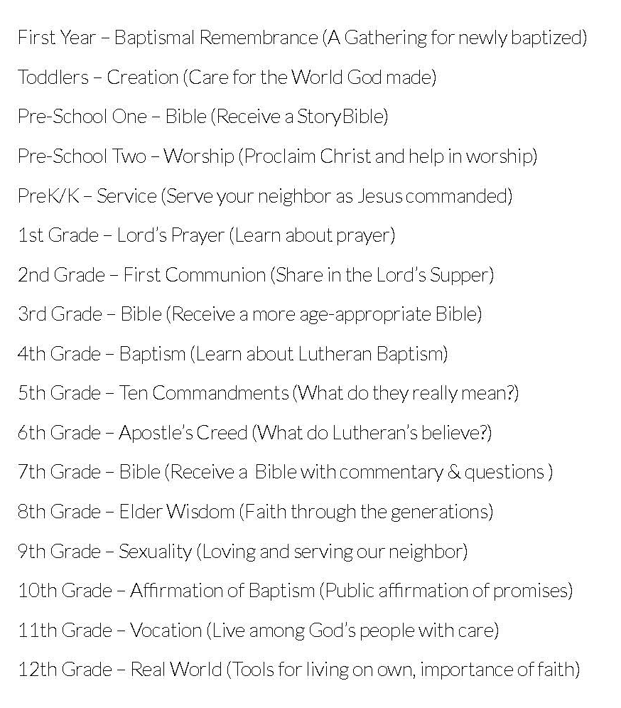

#3. Forming Faith thru Milestones

Slide 47
#3. Milestones Faith Formation
a ritual celebration or a blessing marking the milestone with the whole church community
a home ritual celebration or blessing marking the milestone
a learning program, often for the whole family or intergenerational, that prepares the individual and the whole family for the milestone and for faith practice at home
a tangible, visible reminder or symbol of the occasion being marked
resources to support continuing faith growth and practice after the milestone

Slide 48
#3. Family Milestones: Baptism
Church
Home
Mentors/Coaches
Parent preparation
Family gathering
Ritual
Intergenerational connection
Celebration of Baptism
Reunion
Baptismal anniversaries
Caring conversations and storytelling
Celebrating rituals
Learning
Praying
Reading the Bible
Serving
Worshipping together

Slide 49
#4. Celebrating Seasons
Church Year
Calendar Year
Advent
Christmas
Epiphany
Ash Wednesday
Lent
Holy Week
Easter
Pentecost
St. Francis Day–Blessing the Animals (October 4)
All Saints and Souls (Nov 1-2)
New Year’s Eve and Day
Martin Luther King Jr. Day
Valentine’s Day
St. Patrick’s Day
Earth Day
Mother’s Day
Memorial Day
Father’s Day
July 4 – Independence Day
Labor Day
Start of School
Halloween
Thanksgiving

Slide 50
Example: 40-Day Lent Curriculum
Church Life ➔ | Daily & Home Life | ⬅ Online Life
Ash Wednesday Lenten Sunday liturgies Stations of the Cross Lenten prayer Lenten retreat Lenten service Lenten soup suppers | Fasting Praying Service/Almsgiving Lectionary reflection Family activities | Lenten learning resources Lenten calendar Daily Lenten prayer Weekly table prayer Video resources Online retreat experience

Slide 51
Example: Earth Day
Community | Church | Home
Community cleanup Planting a community garden All ages workshop on caring for creation Story time at the library on environmental awareness | Ecumenical prayer service Intergenerational program on theology of caring for creation Church audit Global project for whole community | Recycling activities Planting a family garden Meal time creation prayer Daily Bible verses for April Children’s activities Storybooks and videos Home audit

Slide 52
#5. Encountering God in the Bible through the year
Scripture in Sunday Worship
    Lectionary
    Sermon Series
Exploring the Bible—Family or Intergenerational Programs
    A Tour of the Old Testament
    A Tour of the Gospels
    Walking with Jesus
    Journeys of Paul

Slide 53
#5. Encountering God in the Bible
Scripture in Sunday Worship
Intergenerational & Home Faith Formation
September: 24th Sunday in Ordinary Time
October: 28th Sunday in Ordinary Time
November: 32nd Sunday in Ordinary Time
December: 2nd Sunday of Advent
January: Baptism of the Lord Sunday
February: 1st Sunday of Lent
March: Palm Sunday
April: 4th Sunday of Easter
May: Holy Trinity Sunday

Slide 54
#5. Encountering God in the Bible
BIBLE
Family Convers-ation
Children’s Bible Activities
Daily Bible Verses
Serving/Action Ideas
Table Ritual
Prayer/Devotion
Going Deeper

Slide 55
#6. Connecting Families intergenerationally
Becoming Intentionally Intergenerational
    Identify ways families are current connected and engaged intergenerationally in the faith community
    Develop ways to strengthen IG connection and engagement
    Create new ways to connect and engage families
Intergenerational and Family Learning
Intergenerational Family Service

Slide 56
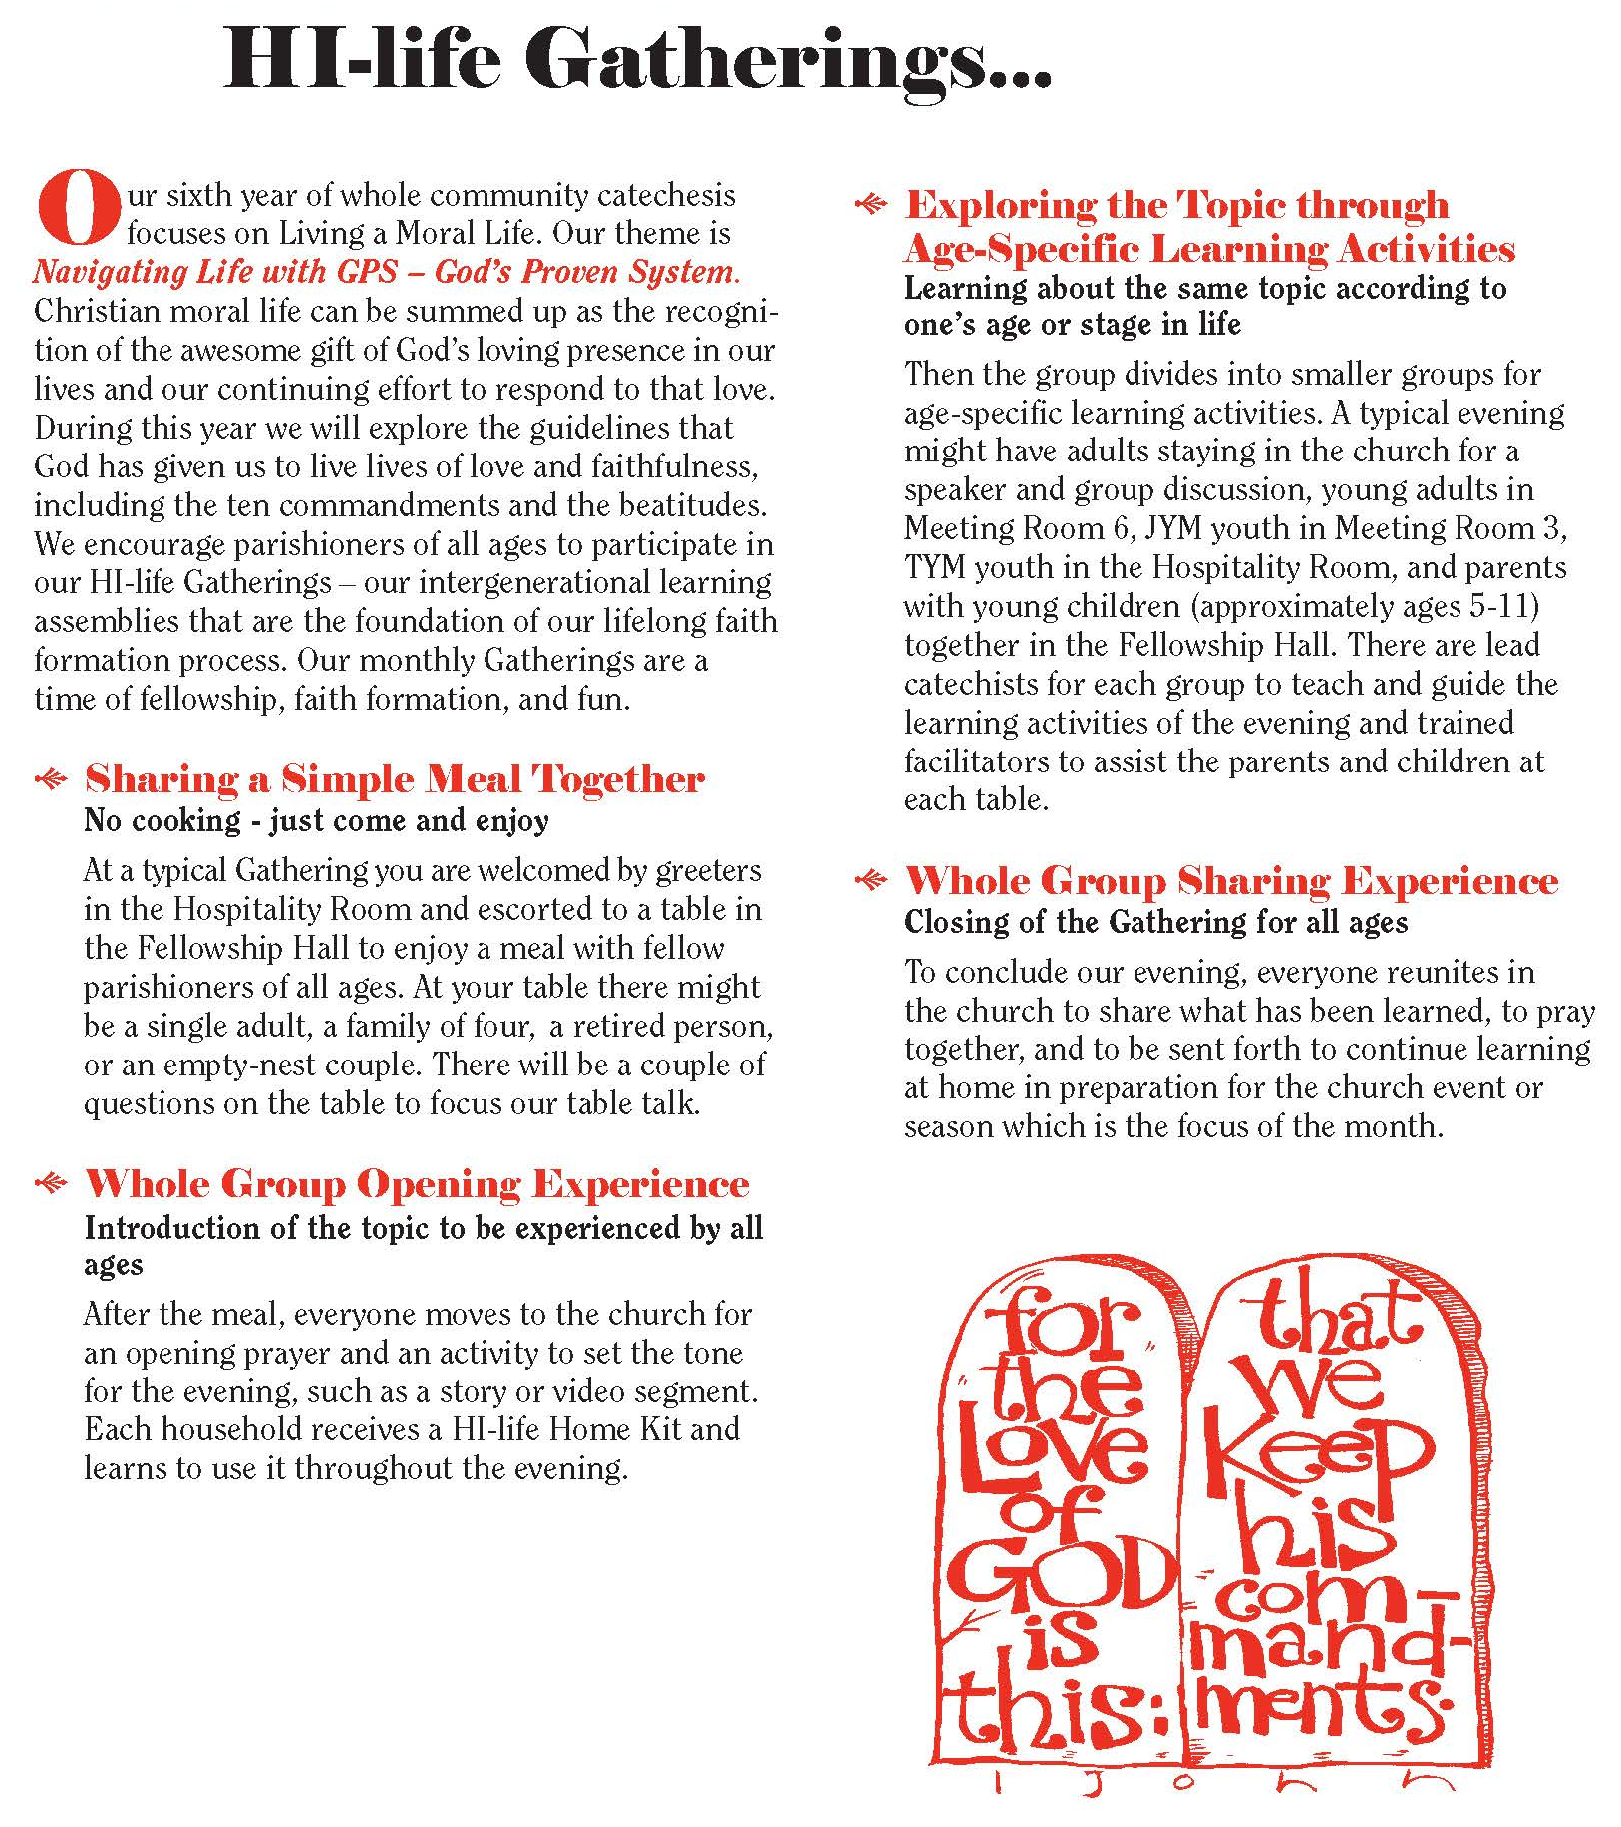
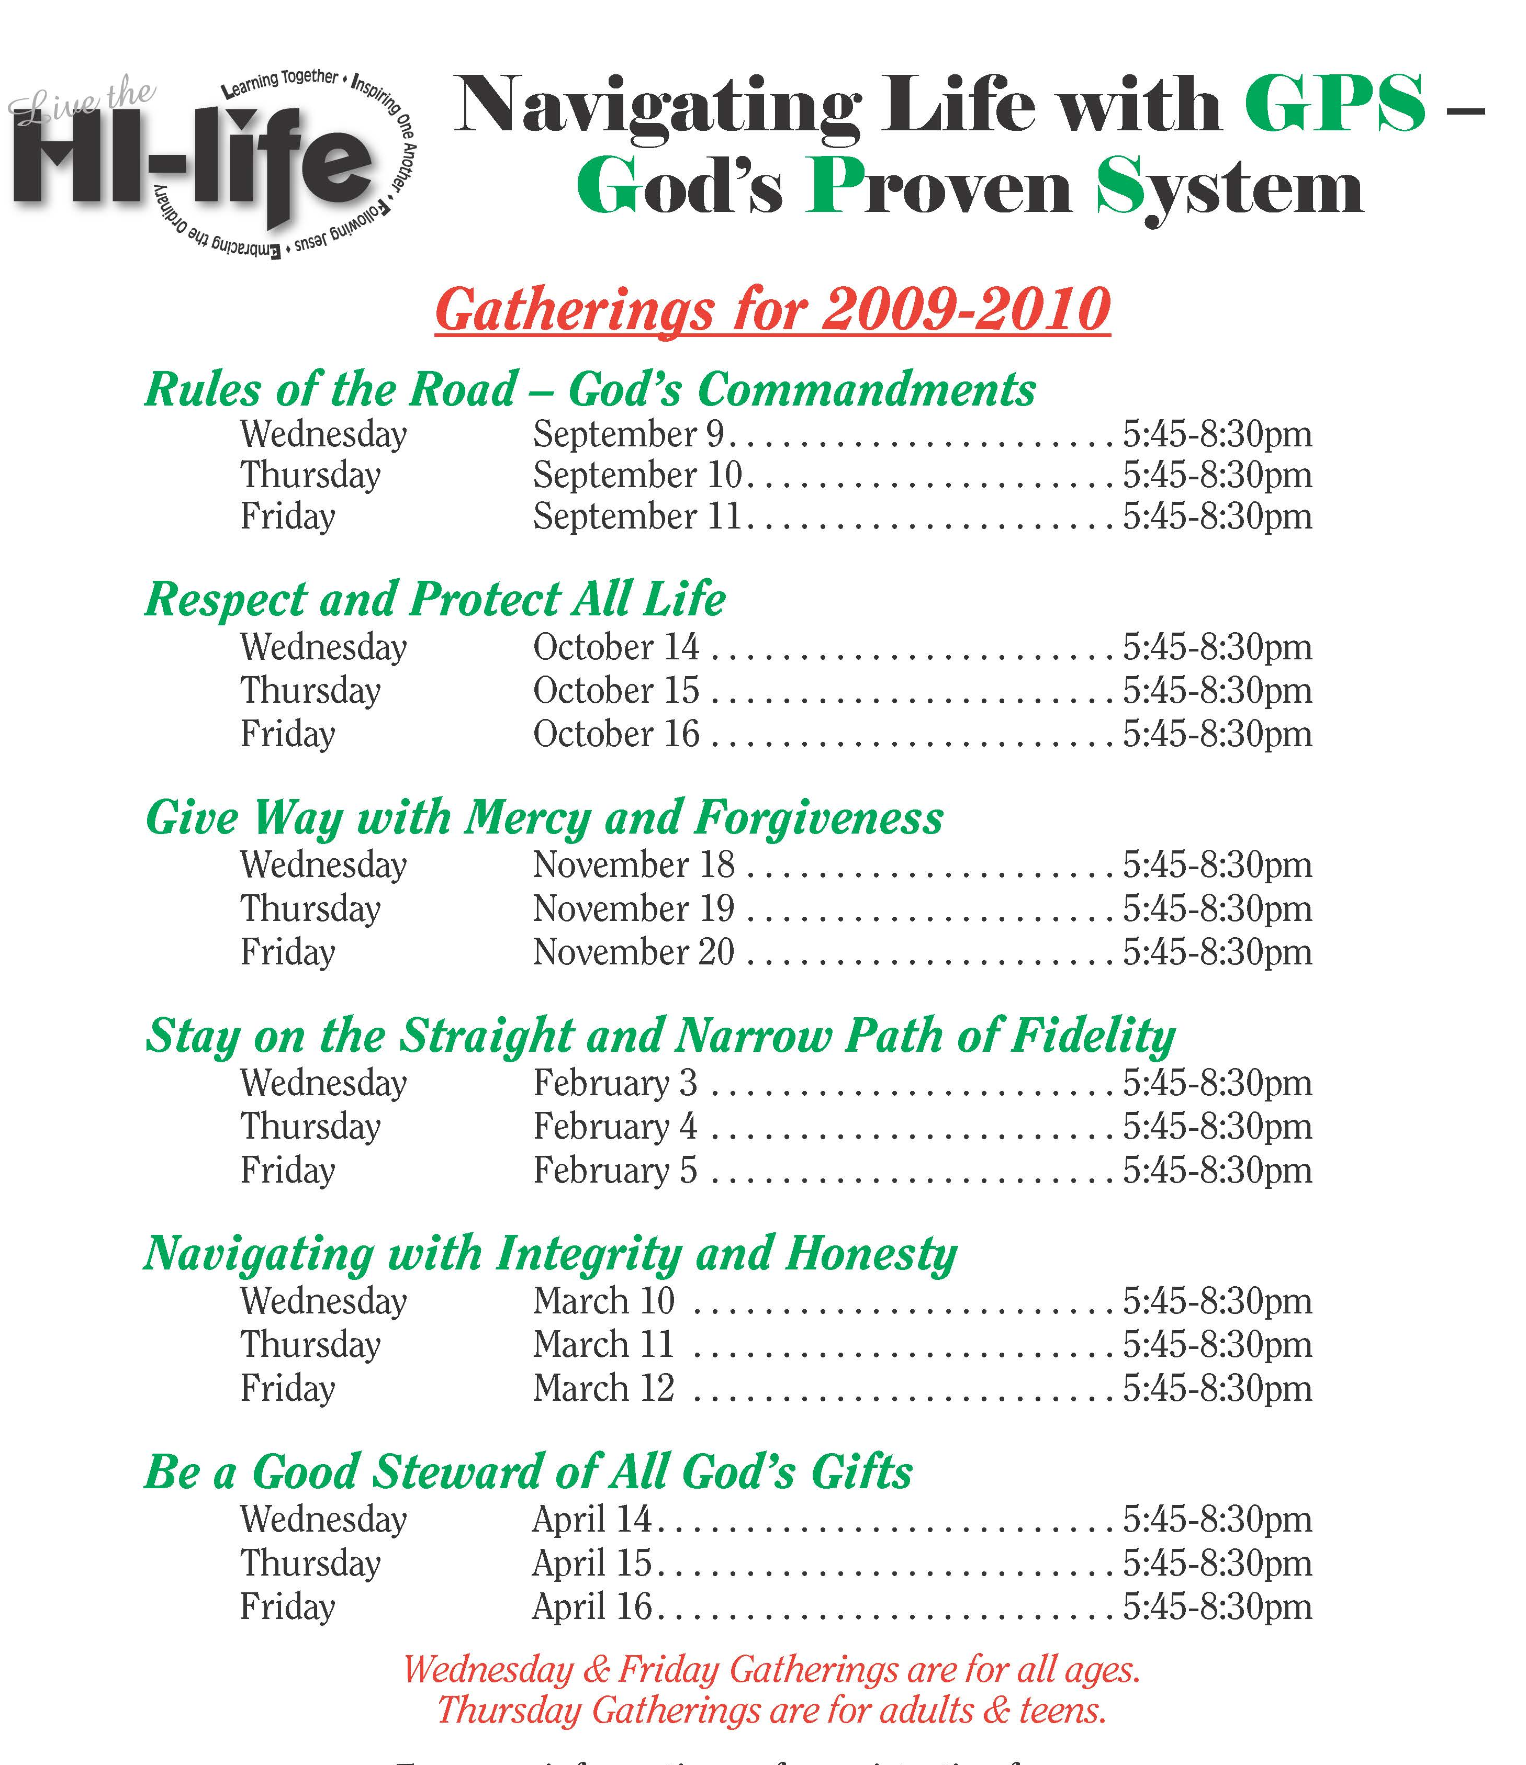
#6. Connecting Families intergenerationally: Learning

Slide 57
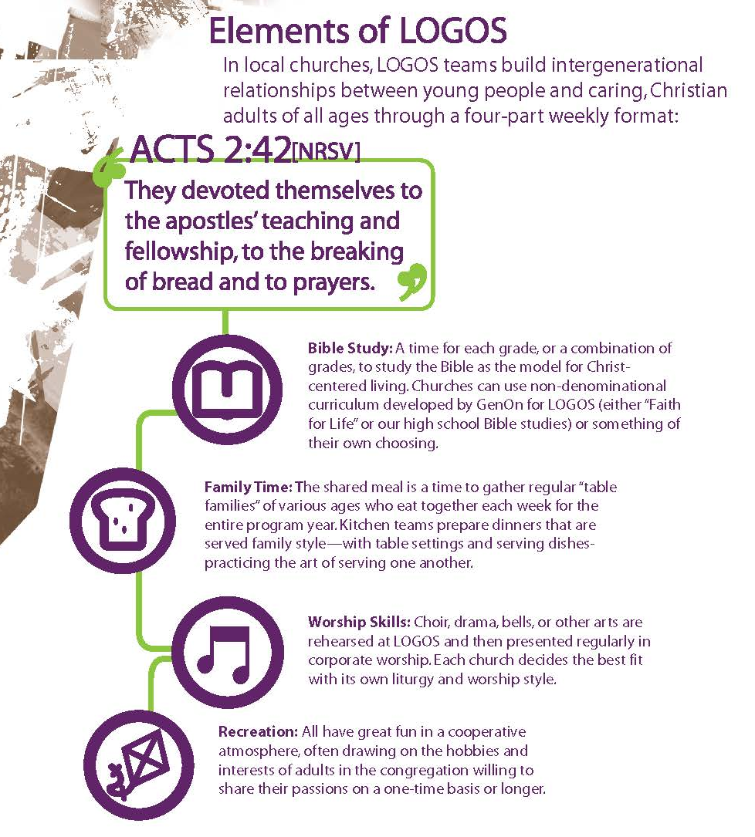
#6. Connecting Families intergenerationally: Learning
Bible Study
Family Time
Worship Skills
Recreation
GenOn Ministries
www.genonministries.org

Slide 58

#6. Connecting Families intergenerationally: Learning
A flexible, relaxed arrival time with drinks and snacks
Creative exploration of a Bible story/theme through creative experiences for people of different learning styles and of all ages. Children and adults are not separated and are encouraged to explore the story/theme together
A short but explicit time of worship with story, music and prayers that builds on the creative exploration.
A generous welcome and hospitality is expressed through a delicious home-cooked, sit-down meal with others

Slide 59
#6. Connecting Families intergenerationally: @ Home
THEME
Family Convers-ation
Reading the Bible
Serving/Action Ideas
Rituals
Prayer/Devotion
Learning - Going Deeper

Slide 60
#7. Developing a strong family life
Family faith formation strengthens family life by developing the assets/strengths and skills for healthy family life and providing a supportive context for forming faith, living the Christian faith, and promoting positive development in children and youth.
Developing family assets or strengths
Promoting character strengths in young people through developmental relationships.

Slide 61
#7. Developing a strong family life
Family Assets – Search Institute

Slide 62
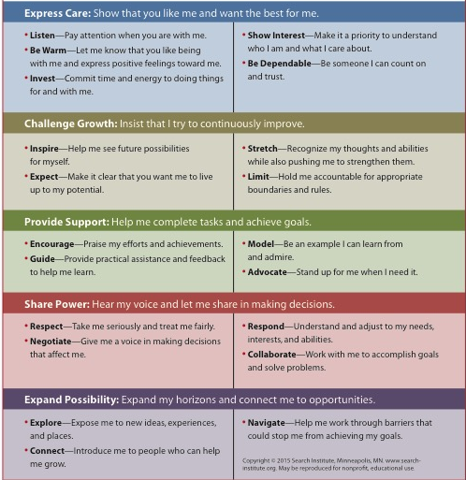
#7. Developing a strong family life

Slide 63
#7. Developing a strong family life
Create a Family Life Plan for Each Life Cycle Stage
Using the Family Assets and Developmental Relationships, curate and create developmentally-appropriate programs, activities, and resources for families at each stage.
Family website
Parent programs
Family programs
Family mentors
Life cycle support groups for parents

Slide 64
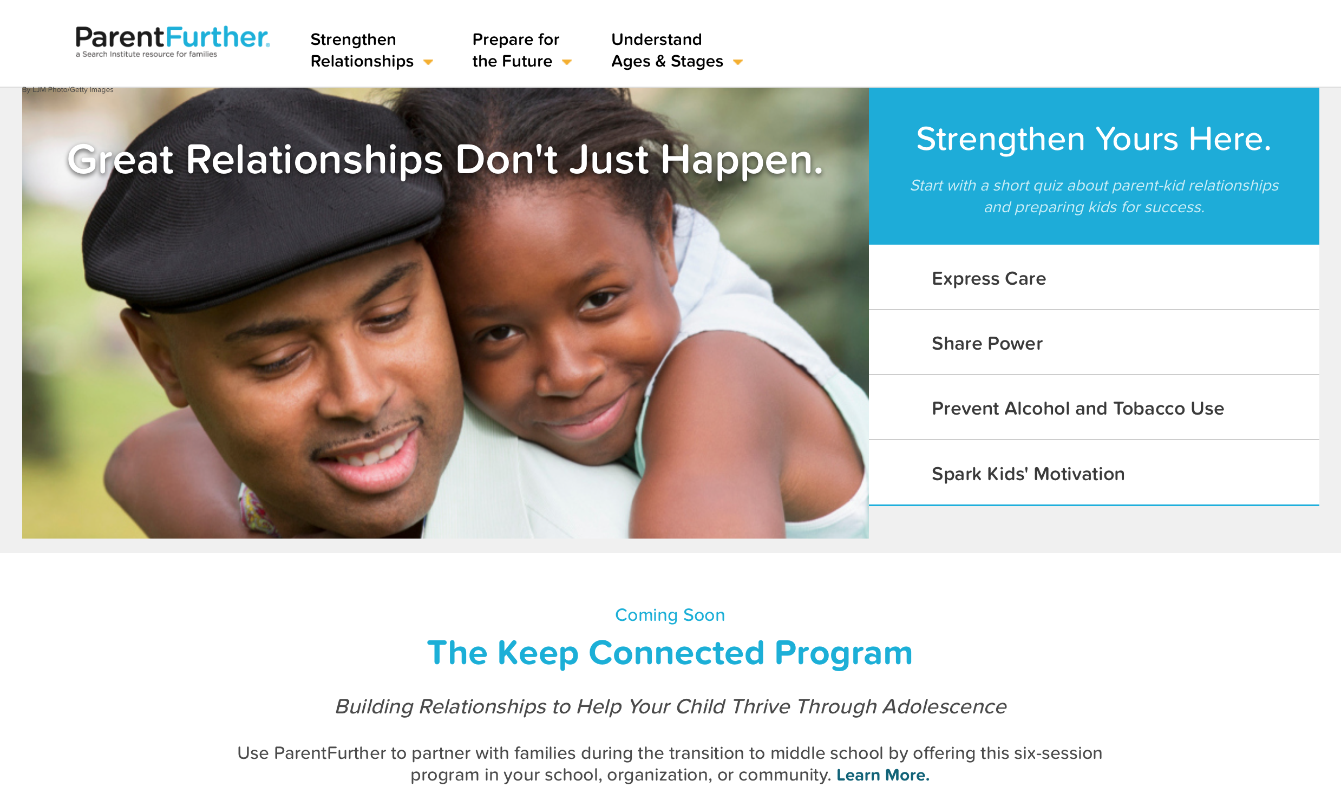
#7. Developing a strong family life

Slide 65
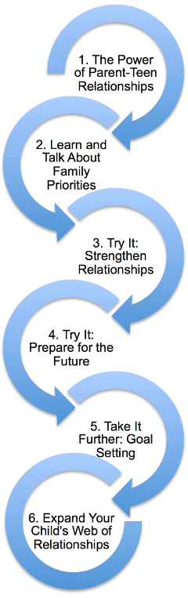
#7. Developing a strong family life
Parent Program (Keep Connected)
Family Programming
  Communicating effectively
  Establishing family routines: family meals, shared activities, daily commitments
  Celebrating meaningful traditions and rituals
  Discussing tough topics
  Making decisions and solving problems as a family
  Learning how to build strong relationships and express care for each other
  Developing the strengths & potential of children & youth
  Supporting each other: encouraging and praising, giving feedback, standing up for each other
  Treating each with respect and dignity

Slide 66
#8. Empowering Parents & Grandparents
Twin Tasks
Promoting the faith growth of parents
Developing the faith forming skills of parents
Content
Theological and spiritual formation of parents
Skills for parenting for faith growth
Knowledge and skills for parenting

Slide 67
#8. Empowering Parents & Grandparents
Guides for Developing Parent Programming
Address diverse spiritual-religious identities of parents.
Have parents practice new skills with their own children during program sessions.
Give parents a plan for parenting.
    Give them a plan for parenting proactively.
    Show them how it works.
    Tell them what to do today.

Slide 68
#8. Empowering Parents & Grandparents
Guides for Developing Parent Programming
Address the levels of partnership with parents.
    Aware
    Involved
    Engaged
    Invested
Design programs that engage parents in the learning experience.
Use a variety of environments & methods to engage all parents.
Use online platforms and digitally enabled strategies.

Slide 69
#8. Empowering Parents & Grandparents
Ideas for Parent Programming
Parent website
Parent programs—a progression of workshops, webinars, and/or courses for each stage of the lifecycle
Laboratory experiences—immersion/hands-on experiences through church events or family/intergenerational programs
Parent mentors
Lifecycle support groups for parents
A parent catechumenate—around key milestone experiences and “moments of return”

