Slide 1
A 21st Century View of Children & Youth Faith Formation
John Roberto, LifelongFaith Associates

Slide 2
An Ecological Approach

Slide 3
Exemplary YM Research

Slide 4
Congregational Culture
Congregational Life
& Ministries
Youth Ministry
Congregational Leadership
Family & Household Faith
It is the culture of the whole church that is most influential in nurturing youth of vital Christian faith.

Slide 5
Congregational Leadership
Spiritual Influence
Congregational Faith & Qualities
Age-Group Ministry
Environment
Family & Household Faith
Parental Faith
Discipleship
Scripture
Mission
Prayer & Worship
Intergenerational
Relationships
Multiple Approaches
Focus on Jesus
Well Organized
Family Faith Practices
Family Harmony
Family Relationships
Models Faith
Interpersonal & Leadership Competence
Support Teams & Leaders
Community Life

Slide 6
Congregational Culture:44 Assets
Congregational Faith & Qualities
Youth Ministry Qualities
Family & Household Faith Qualities
Congregational Leadership Qualities

Slide 7
Faith Forming Processes
GROWTH IN FAITH
Caring Relationships
Rituals & Milestones
Church Year Seasons
Worshipping
Learning the Tradition
Praying
Spiritual Formation
Reading the Bible
Serving Working for Justice Caring for Creation

Slide 8
Intergenerational Connections
The congregation’s basic ministries are thoroughly intergenerational.
Young people are welcomed and expected to participate.
Young people lead in church-wide ministries:
Worship
Education
Fellowship
Service and Outreach
Decision-making

Slide 9
Family Faith
Parental Faith Life & Practice
Family Harmony
Parental Affection toward Children
Parental Help with Problems

Slide 10
Family Faith
Parents possess and practice a vital and informed faith – understanding the Christian faith, participating in worship, praying, and engaging in service and mission.
Family members’ expressions of respect and love create an atmosphere promoting faith.
Parents engage youth and the whole family in conversations, prayer, Bible reading, and service that nurture faith and life.

Slide 11
Youth Ministry Qualities
Congregations have developed age-level ministries.
Marked by trusted relationships
Custom-designed ministry practices and activities
Caring atmosphere of high expectation
Multiple nurturing relationships and activities intentionally planned to create:
atmosphere of respect
growth
belonging
Generates an “alternative youth subculture

Slide 12
Common YM Practices
Retreats
Service & Mission Trips
Bible Study & Religious Education
Prayer
Spiritual Support Groups
Youth-Oriented Worship
Special Events
Family & Intergenera-tional Activities
Peer Ministry & Youth Leadership

Slide 13
Congregational Leadership
Positive Characteristics & Competence (devout faith and exemplary life, interpersonal competence, effective role model for others, helps youth on their spiritual journey)
Leadership Effectiveness (trusted and respected, leadership skills, recruits and trains leaders, supports leaders, good organizer, works with parents)

Slide 14
Research to Practice
Take an ecological view.
Pay attention to the culture of the whole congregation
Recognize the power of the congregation’s theological commitments.
Make discipleship the heart of congregational life & ministries.

Slide 15
Research to Practice
Nurture the power of faith-filled, multi-generational Christian relationships; create intentional intergenerational connections, relationships, and faith experiences between all ages and generations.
Equip parents for family socialization & faith practice at home.
Deepen the faith and spiritual life of parents.

Slide 16
A Network Approach

Slide 17
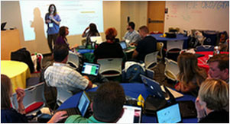
A shift from education to learning anywhere, anytime.
A shift from consumption of information to participatory learning.
A shift from institutions to networks.

Slide 18
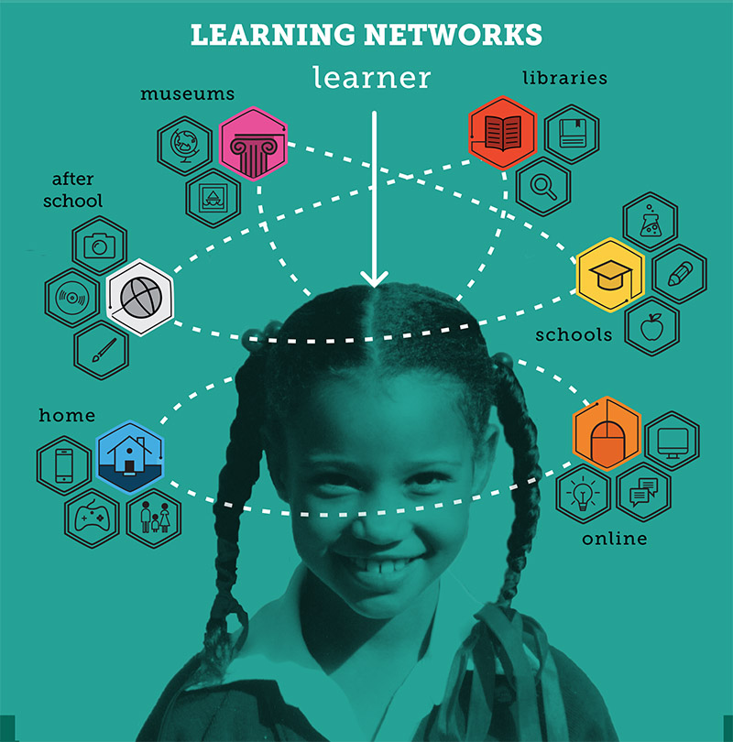

Slide 19
Faith Formation Networks
A network of relationships, content, experiences, & resources. . . .
Offering a variety of content, methods, formats, and delivery systems (online & physical settings) to address the diverse life tasks and situations, needs and interests, and spiritual and faith journeys of people.
Offering content and experiences that is responsive to the diverse religious and spiritual needs of people today—from the spiritually committed and engaged to the spiritual but not religious and the unaffiliated.
Offering multiple environments to address people’s busy lives and providing more ways to participate: self-directed, mentored, at home, in small groups, in large groups, church-wide, in the community, and in the world.

Slide 20
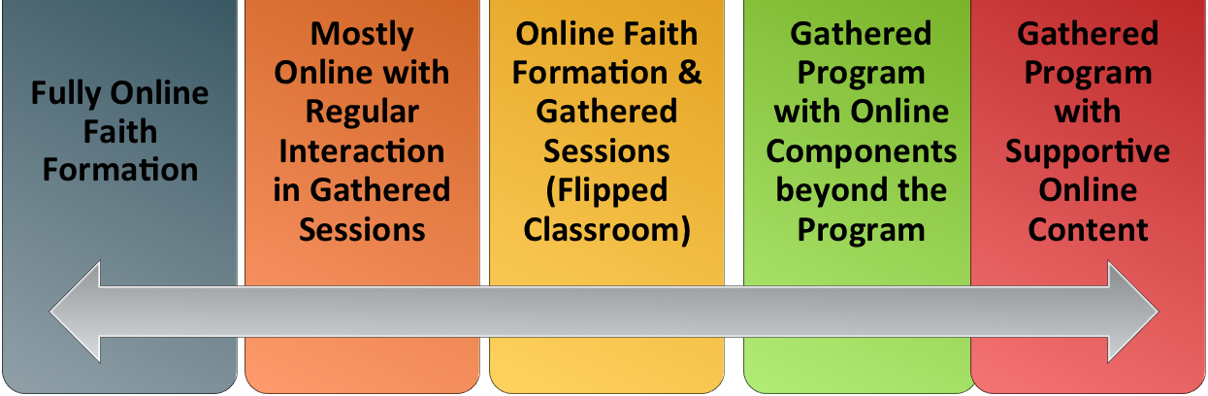
Faith Formation Networks
Digitally-Enabled
Blending gathered community settings with online learning environments and utilizing the abundance of digital media and tools for learning and faith formation

Slide 21
Faith Forming Processes
GROWTH IN FAITH
Caring Relationships
Rituals & Milestones
Church Year Seasons
Worshipping
Learning the Tradition
Praying
Spiritual Formation
Reading the Bible
Serving Working for Justice Caring for Creation

Slide 22
Faith Formation Networks
Caring Relationships
Celebrating the Seasons
Celebrating Rituals & Milestones
Learning the Christian Tradition
Praying & Spiritual Formation
Reading the Bible
Serving, Working for Justice, & Caring for Creation
Worshipping God
Life Stage Issues
Missional
Faith Community
Content Area
Content Area
Content Area
Content Area
Content Area
Content Area

Slide 23
Service & Mission Trips
Adolescent Faith Formation Network
Prayer & Spiritual Formation
Youth Leadership
Youth Programs
Bible Study & Religious Learning
For Parents
Confirmation
Adolescent Life Issues
Family Life
Missional Outreach

